Slide 1

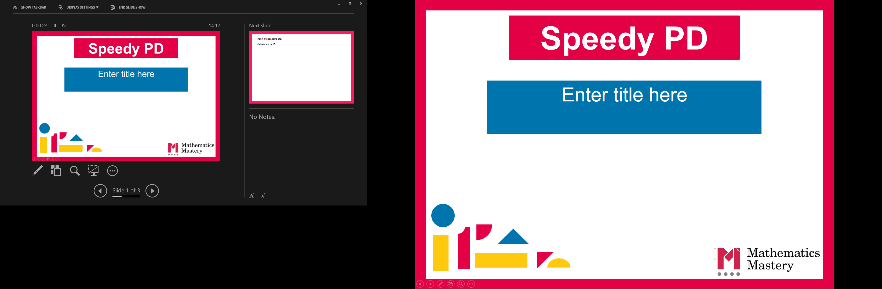

Year 3
Spring Term
Parent workshop
Notes:
General Guidance about parent workshops
This workshop (if delivering in full) is designed to be completed in 50 minutes – 1 hour.
This workshop can be adapted and shortened to suit the priorities of your school. Select the parts that are purposeful for you.
See our parent workshop guidance for an overview of the structure to support you in adapting.
Additionally you may wish to add in information specific to your school e.g. photos, videos, calculation policy.
Have on the tables the termly parent packs - these are to be taken home after the workshop and contain the Big Picture, vocabulary, key representations and games discussed in the workshop. This can also be sent out to parents who were not able to attend the workshop.
Resources: Cuisenaire, bead strings, tens and ones Dienes, dice

Slide 2
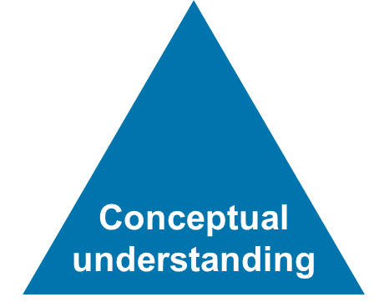
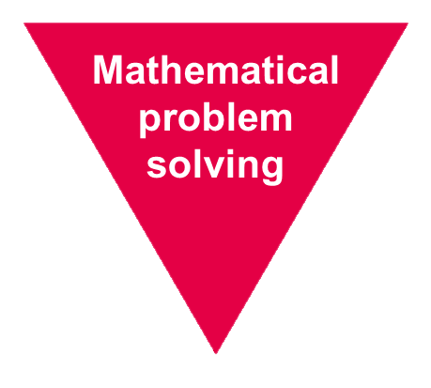
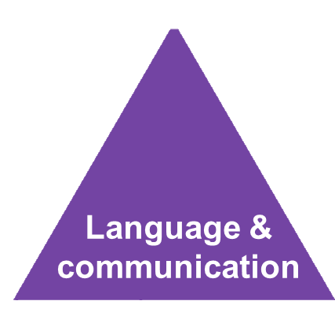
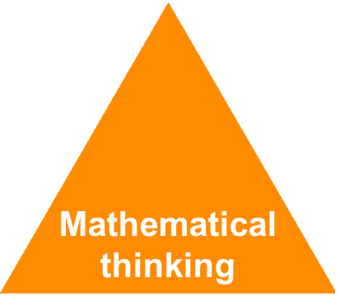
Mathematics Mastery
Year 3
Spring Term
Success for all
Notes:
Time: 2-3 minutes
Purpose: Remind parents of the principles of mathematics mastery.
Facilitation: A full introduction to mathematics mastery was included in the Autumn Parent workshop. If this is the first parent workshop being delivered please refer to slides 1-6 of the Autumn workshop. Remind parents that we use the Mathematics Mastery curriculum materials and that mastery in maths refers to gaining a deeper understanding of concepts so that pupils can apply their learning and solve problems. Explain that in order to achieve this we promote the Dimensions of Depth: a focus on conceptual understanding, language and communication and mathematical thinking. A definition of each of these can be found in your packs. The programme is based on research and evidence from both national and the curriculum is designed so that all pupils can succeed regardless of background and ability. Give parents a moment to refer to the parent pack.

Slide 3
Creating a positive attitude to maths
Year 3
Spring Term
Talk to your children about everyday maths
Play maths games with them
Value mistakes as learning opportunities
Recognise that there is more than one way to work things out
Praise children for effort over outcome
Avoid saying things like “I’m useless at maths”
Notes:
Time: 2 minutes
Purpose: Remind parents about the opportunities to support with mathematics at home
Facilitation:
This was also included in the Autumn workshop but the messaging may be worth reiterating. Make the following points:
Everyday Talk: try to talk about maths when doing activities like shopping, cooking, time etc. 5 minutes a day can make a big difference!
Play with your child: puzzles, board games, verbal games help them to apply vocabulary, problem solve and reason. Interaction and dialogue that you cannot get from playing on a computer or iPad!
Mistakes are opportunities for learning.
You may have learned one method at school but at school we actively encourage children to seek out multiple strategies and choose one that works for them and build connections between strategies.
Praise children for trying hard and overcoming challenges. If pupils are only praised for getting everything correct they may not try and challenge themselves as they may be afraid to get things wrong.
6) Try to avoid saying things like “I’m useless at maths”. You may remember maths as being hard, but if your child hears you saying that, or that it's not important to be good at maths, they will believe that too!

Slide 4
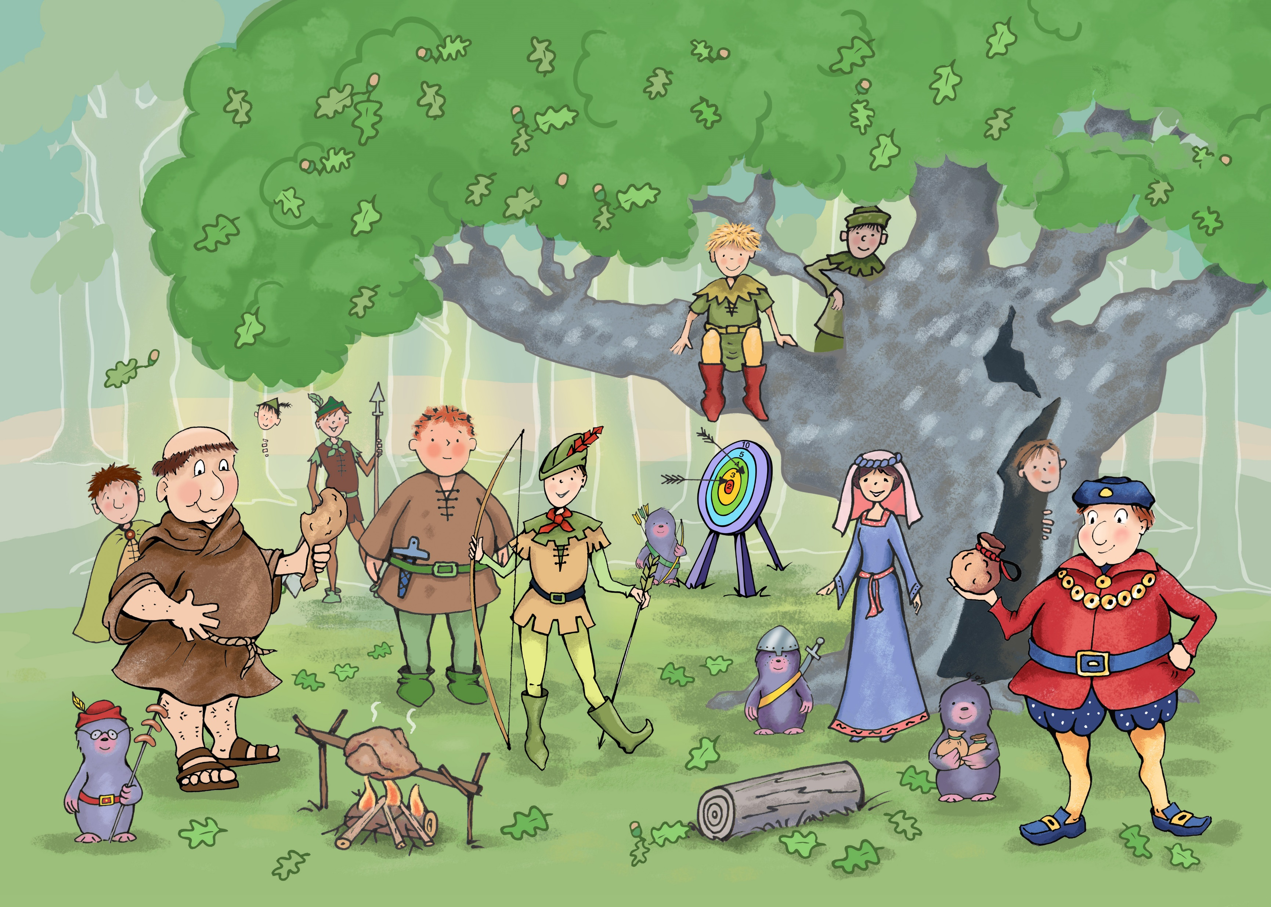

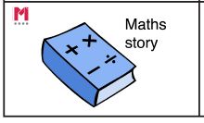
Big Pictures
Year 3
Spring Term
What maths can you see?
?
multiplication division equal parts commutative lots of equal groups sharing product
Notes:
Time: 5 minutes
Purpose: To show parents how we use the big picture to connect maths to a context/the real world.
Facilitation: Explain that the big pictures are used to provide children with opportunities to connect maths with the real world, make connections and supports mathematical talk and reasoning. The Big Pictures in Year 3 relate to areas of the UK. Give parents a copy of the restaurant big picture (in parent pack or display on the board) and explain this is used in the fractions unit, which is our focus today. Allow them to discuss what maths they can see with their children.
Mathematics Mastery encourages pupils to make connections between the maths they are doing and real life contexts. Often pupils are asked to relate the maths they are doing to a real life problem which we call a “maths story”. (click to animate sticker)

Slide 5
Year 3 Spring Curriculum Map
Year 3
Spring Term
Multiplication and division | Deriving multiplication and division facts
Multiplication and division facts for 2, 3, 4, 5, 6, 8 and 10 Multiplicative structures: equal groups/parts, change and comparison, correspondence problems Relationships: commutativity and inverse | Multiply and divide by 10 and 100 Multiply a 2-digit number by 2, 3, 4, 5 and corresponding division situations Divide 2-digit by a 1-digit
Time | Fractions
• Tell, record, write and order the time analogue and digital; 12-hour, a.m., p.m. Measure, calculate and compare durations | Part-whole relationships Fractions as part of a whole or a whole set and as a number Add, subtract, compare and order fractions
Notes:
Time: 2 minutes
Purpose: To share the Spring curriculum map with parents.
Facilitation: Allow parents to view the Year 3 curriculum map for Spring and briefly talk through the focus of each unit (no need to go through the individual objectives)
Explain that the Spring map is in the parent pack. Explain that in this workshop we have chosen to focus on multiplication and division as this is the main focus of the term. Work in later units such as fractions will draw upon learning from these units.
You may want to handout entire Year 3 curriculum map for parents to take home. Entire curriculum map can be found here:
http://toolkit.mathematicsmastery.org/download/5ce3b99b3c6e1

Slide 6
In focus: multiplication and division
Year 3
Spring Term
Understand that multiplication is commutative
Understand the relationship between multiplication and division (exploring the inverse)
Recall multiplication facts for 2, 3, 4, 5, 8, 10 multiplication tables
Derive multiplication facts from known facts
Multiply a number by 10 and 100
Multiply a two-digit number by a one-digit number(without regrouping and with regrouping)
Divide a two-digit number by a one-digit number
Notes:
Time: 2 minutes
Purpose: To share the progressive learning steps pupils will follow for multiplication and division
Facilitation: Explain that Mathematics Mastery is a cumulative curriculum meaning that learning is built over time, with new learning that makes connections to prior learning. The multiplication and division units are broken down into small progressive steps that are covered over several weeks. Before pupils begin to learn strategies to multiply two digit numbers they need a firm understanding of multiplicative relationships, familiarity with the shown multiplication tables, mental strategies to derive multiplication/division facts and an understanding of the link between multiplication and division.

Slide 7
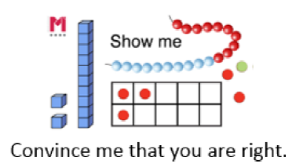
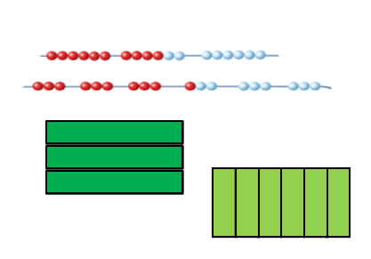
Year 3
Commutativity
Spring Term
Jamie says
3 x 5 = 5 x 3
How do you know she’s correct?
Use the equipment on
the table to convince me.
factor parts whole product commutative equal groups lots of multiply is equal to
Notes:
Time: 5 minutes
Purpose: To explore commutativity
Facilitation: Explain that one of the key concepts that pupils first explore in Year 3 is the rule of commutativity. Multiplication (like addition) is commutative which means that 2 numbers can be multiplied in any order and the product will remain the same, 5 multiplied by 3 is the same as 3 multiplied by 5, both equations will have a product of 15. Pupils are introduced to this concept in Key Stage One and so should already be familiar with it. In Year 3 pupils should be able to use manipulatives or drawings together with explanation to demonstrate why this is correct. The ‘show me’ sticker is used to promote pupils to prove their answers or “convince me”. Ask parents to use the equipment on their tables or their own drawings (bead strings and Cuisenaire) to show why the shown statement is true. Reveal the blue box as a hint. Encourage them to back up their representations with explanations that use the star words.
Resources: Bead strings and Cuisenaire

Slide 8
Year 3
Arrays
Spring Term
Fact families
3 x 4 = 12
4 x 3 = 12
12 x 3 = 4
12 x 4 = 3
Multiply divide inverse array equation equal groups of part whole commutative product
Notes:
Time: 3 minutes
Purpose: To share a key representation for multiplication and division
Facilitation: Explain that arrays can be used to represent both multiplication and division and consistently using this model supports pupils in making links between the two operations which are the inverse of each other.
This array represents all four of the shown equations. Demonstrate the following statements by referring to the diagram: (you may wish to use your own drawn array on a flip chart)
We can see 4 groups of three or three groups of four.
We can see if we divide 12 into three groups each group will have a value of 4.
If we divide 12 into four groups each group will have a value of 3.
Together we can call the 4 related equations a fact family.
Explain the array can be presented in a different orientation (animate) and it still represents the same fact family.

Slide 9
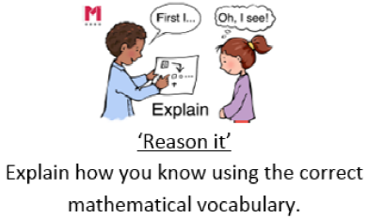
Year 3
Arrays
Spring Term
What equation is the array representing?
Multiply divide inverse array equation equal groups of part whole commutative product
Notes:
Time: 3 minutes
Purpose: To share a key representation for multiplication and division
Facilitation: Ask parents to write all 4 equations for this fact family and explain how they know using the star words.

Slide 10
Year 3
Recalling multiplication tables
Spring Term
Pupils are expected to already be familiar with the 2,5 and 10 multiplication tables from Key Stage One
In Year 3 the National Curriculum requires pupils to: “recall and use multiplication and division facts for the 3, 4 and 8 multiplication tables”
Pupils need to be able to recall all multiplication tables by the end of Year 4 and will have to take the Multiplication Table Check
How can you help your child to practise their multiplication tables at home?
Notes:
Time: 3 minutes
Purpose: To explain the expectations for multiplication tables
Facilitation: Explain to parents the expectation for times tables. Emphasise that pupils should practise counting forwards and backwards in the given times tables as well as out of order. Emphasise the importance of learning the division facts as well as the multiplication facts.
Ask them how they might support their child with multiplication tables. Explain that learning times tables should be made enjoyable; using songs and rhymes can be helpful as well as online multiplication games. Share any strategies your school may use to promote times tables e.g. an online platform, home learning initiatives.

Slide 11
Year 3
Making connections
Spring Term
If I know 4 multiplied by 6 is 24
then I know 8 multiplied by 6 is 48
Notes:
Time: 1 minutes
Purpose: To point out the connections between multiplication tables
Facilitation: Explain that when learning new multiplication tables pupils be encouraged to derive facts from facts they know. Once pupils have learnt their 4 times table, use that to help derive their 8 times table. The sentence stem “If I know…then I know” is useful in prompting children to connect previous learning to new learning.

Slide 12
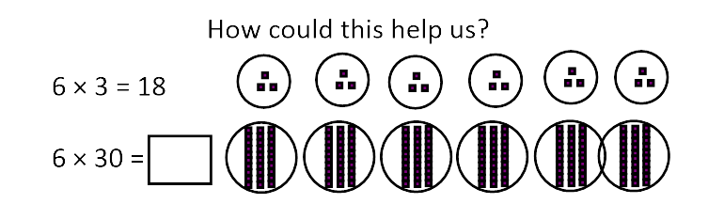
Year 3
Deriving facts
Spring Term
If I know…..
then I know….
ten times greater/less ten times as much value place value related facts
Notes:
Time: 2 minutes
Purpose: To explain the importance of mental strategies in multiplication and division
Facilitation: Pupils should also be encouraged to use their knowledge of place value to derive new facts. Pupils can use their knowledge of ten times greater to work out problems like the one shown. Rather than using a formal strategy for 6 x 30, it may be more efficient to use the fact 6 x 3 then multiply by 10. The supporting image supports pupils understanding of why this is true.
Similarly pupils may draw upon doubles fact to derive a new fact. For example, if I know 6 x 3 = 18 I know that 6 x 6 will be double (36) and that 12 x 3 will also be equal to 36.

Slide 13
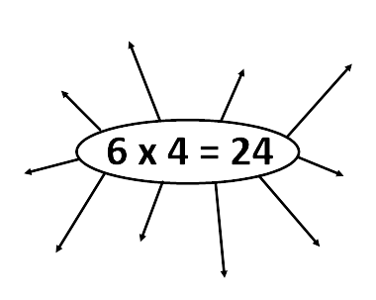
Year 3
Deriving facts
Spring Term
If I know...then I know...
ten times greater/less ten times as much value place value related facts inverse commutative
Notes:
Time: 5 minutes
Purpose: To explain the importance of mental strategies in multiplication and division
Facilitation: Ask parents and their children to derive facts from his multiplication equation using what they know about commutativity, inverse relationships, doubling facts related multiplication tables and place value. Encourage them to use division facts as well as multiplication.

Slide 14
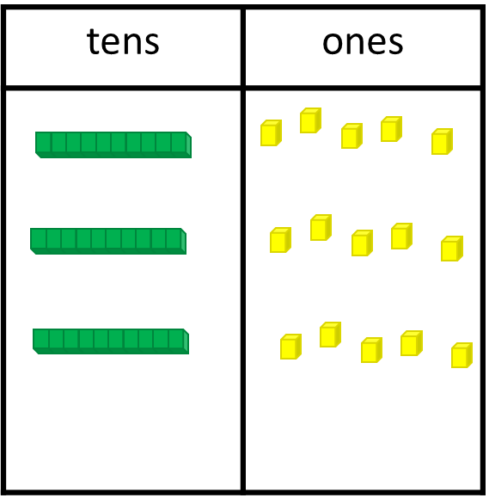
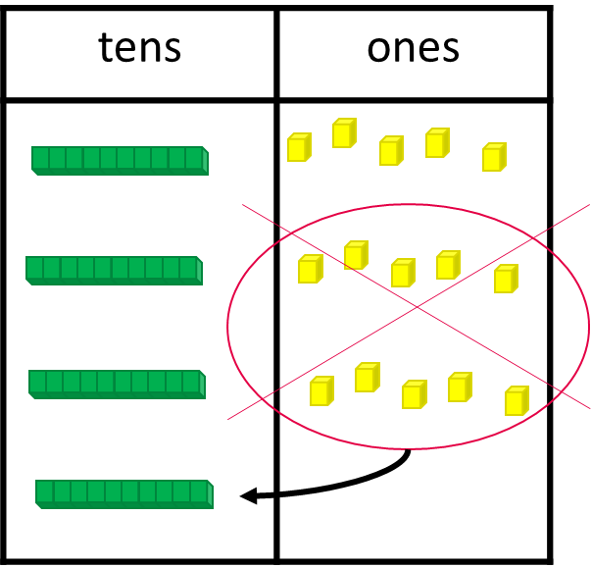
Year 3
Multiplying a two-digit number
Spring Term
15 x 3
27 x 4
multiply regroup ones tens part whole partition product
Notes:
Time: 3-5 minutes
Purpose: To share a strategy for multiplying two digit numbers using Dienes
Facilitation: In Year 3, once pupils have a deep understanding of multiplicative relationships, pupils begin to multiply two digit numbers by a one digit number. This shown to pupils using dienes blocks. Demonstrate how to use dienes blocks to solve the problem shown, making sure to use the star words. Animate to reveal image. Use concrete dienes rather than the PowerPoint image when modelling.
E.g. I need to partition 15 into tens and ones, I need three groups of 15. Now there are 3 tens and fifteen ones. There are 15 ones, I need to regroup ten ones to one ten.
Ask parents to have a go at the second equation: 27 x 4
Resources: Dienes

Slide 15
Year 3
Dividing a 2-digit number
Spring Term
48 ÷ 4 =
hundreds | tens | ones
whole parts divide share group equal ones tens
Notes:
Time: 3 minutes
Purpose: To share a strategy for dividing two digit numbers using Dienes
Facilitation: Demonstrate using Dienes cubes (again use concrete resources rather than the PowerPoint) how to divide a two digit number by a two digit number.
Explain that the strategies used in Year 3 will be built upon next year in Year 4 as pupils move towards using more formal methods.
Resources: Dienes

Slide 16
Year 3
Let’s explore
Spring Term
Fill up the square!
You will need: A pair of dice or online dice, two 10 by 10 grids.
Each player has a ten by ten grid.
Take it in turns to roll the pair of dice. If I roll a 3 and a 6 I need to make an array that represents 3 x 6, see example right.
The aim of the game is to fill up the square.
x
x
x
x
x
x
x
x
x
x
x
x
x
x
x
x
x
x
multiply divide array product parts whole equation equal groups
Notes:
Time: 10 -15 minutes
Purpose: To share a multiplication game parents can play at home
Facilitation: Explain and model how to play the game referring to the Star Words as you play.
Note: This is an adapted version of “fill up the square” task in the Y3U6 Task Bank:
https://toolkit.mathematicsmastery.org/downloads/view/5ce411482abe4
Resources: Give parents black 100 squares (if possible laminated to reuse and take home) or use the ones in the parent pack.

Slide 17
Helping at home
Year 3
Spring Term
Games played today
Exploring the big picture, vocabulary and activities in this term’s Maths Pack
Talking about maths during “everyday” routines e.g. shopping, cooking, sequencing daily routine.
Board games
Singing
Practising times tables (2,3,4, 5, 8 and 10)
Telling the time (to the nearest minute)
Notes:
Time: 1 minute
Purpose: To suggest activities to build upon learning in school.
Facilitation: Go through each bullet point.
Explain that today’s games and some further activities to support addition and subtraction can be found in the maths pack.
Make sure everyone takes their maths pack home.

Slide 18
Year 3
Spring Term
Thank you
Notes:
Thank parents for attending the workshop and take any questions afterwards.

