Slide 1

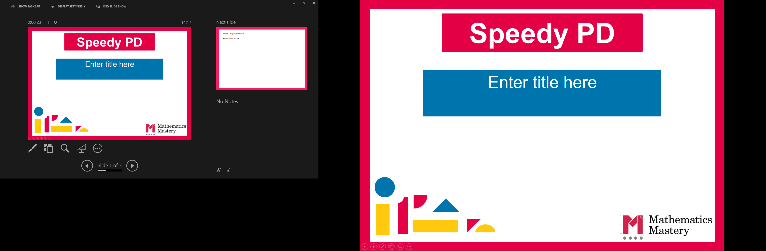

Year 2
Spring Term
Parent workshop
Notes:
General Guidance about parent workshops
This workshop (if delivering in full) is designed to be completed in 50 minutes – 1 hour.
This workshop can be adapted and shortened to suit the priorities of your school. Select the parts that are purposeful for you.
See our parent workshop guidance for an overview of the structure to support you in adapting.
Additionally you may wish to add in information specific to your school e.g. photos, videos, calculation policy.
Have on the tables the termly parent packs - these are to be taken home after the workshop and contain the Big Picture, vocabulary, key representations and games discussed in the workshop. This can also be sent out to parents who were not able to attend the workshop.

Slide 2
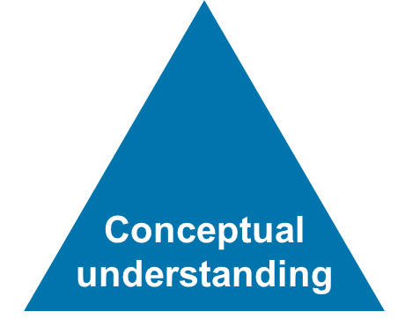
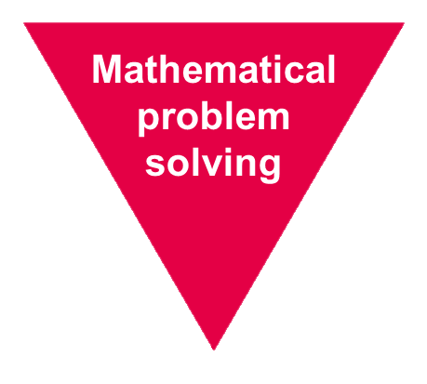
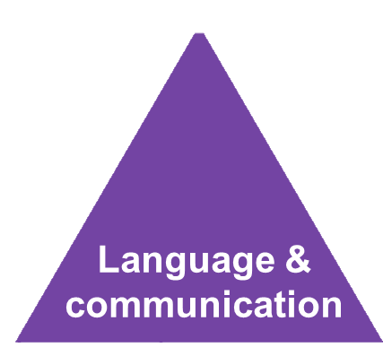
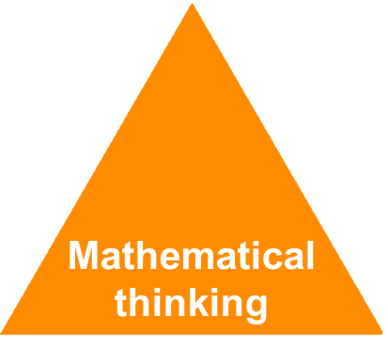
Mathematics Mastery
Year 2
Spring Term
Success for all
Notes:
Time: 2-3 minutes
Purpose: Remind parents of the principles of mathematics mastery.
Facilitation: A full introduction to mathematics mastery was included in the Autumn Parent workshop. If this is the first parent workshop being delivered please refer to slides 1-6 of the Autumn workshop. Remind parents that we use the Mathematics Mastery curriculum materials and that mastery in maths refers to gaining a deeper understanding of concepts so that pupils can apply their learning and solve problems. Explain that in order to achieve this we promote the Dimensions of Depth: a focus on conceptual understanding, language and communication and mathematical thinking. A definition of each of these can be found in your packs. The programme is based on research and evidence from both national and the curriculum is designed so that all pupils can succeed regardless of background and ability. Give parents a moment to refer to the parent pack.

Slide 3
Creating a positive attitude to maths
Year 2
Spring Term
Talk to your children about everyday maths
Play maths games with them
Value mistakes as learning opportunities
Recognise that there is more than one way to work things out
Praise children for effort over outcome
Avoid saying things like “I’m useless at maths”
Notes:
Time: 2 minutes
Purpose: Remind parents about the opportunities to support with mathematics at home
Facilitation:
This was also included in the Autumn workshop but the messaging may be worth reiterating. Make the following points:
Everyday Talk: try to talk about maths when doing activities like shopping, cooking, time etc. 5 minutes a day can make a big difference!
Play with your child: puzzles, board games, verbal games help them to apply vocabulary, problem solve and reason. Interaction and dialogue that you cannot get from playing on a computer or iPad!
Mistakes are opportunities for learning.
You may have learned one method at school but at school we actively encourage children to seek out multiple strategies and choose one that works for them and build connections between strategies.
Praise children for trying hard and overcoming challenges. If pupils are only praised for getting everything correct they may not try and challenge themselves as they may be afraid to get things wrong.
6) Try to avoid saying things like “I’m useless at maths”. You may remember maths as being hard, but if your child hears you saying that, or that it's not important to be good at maths, they will believe that too!

Slide 4

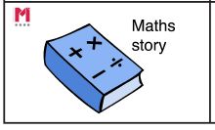
Big Pictures
Year 2
Spring Term
What maths can you see?
?
Equal parts whole one half one quarter divide numerator denominator vinculum
Notes:
Time: 5 minutes
Purpose: To show parents how we use the big picture to connect maths to a context/the real world.
Facilitation: Explain that the big pictures are used to provide children with opportunities to connect maths with the real world, make connections and supports mathematical talk and reasoning. The Big Pictures in Year 2 relate to occupations. Give parents a copy of the restaurant big picture (in parent pack or display on the board) and explain this is used in the fractions unit, which is our focus today. Allow them to discuss what maths they can see with their children.
Mathematics Mastery encourages pupils to make connections between the maths they are doing and real life contexts. Often pupils are asked to relate the maths they are doing to a real life problem which we call a “maths story”. (click to animate sticker)

Slide 5
Year 2 Spring Curriculum Map
Year 2
Spring Term
Time | Fractions | Addition and subtraction of 2-digit numbers
Tell the time on an analogue clock: quarter past, quarter to and five-minute intervals Calculate durations of time in minutes and seconds Sequence daily events Minutes in an hour and hours in a day | Part-whole relationships Fractions as part of a whole or a whole set Relate to division Equivalent fractions | Illustrate, represent and explain addition and subtraction involving regrouping including ‘Make Ten’, ‘Round and adjust’ and near doubles strategies
Money | Faces, shapes and patterns; lines and turns
• Recognise coins and notes • Use £ and p accurately • Add and subtract amounts • Calculate change | Explore, sort and describe 2-D shapes Lines of symmetry in 2-D shapes Identify 2-D shapes on 3-D shapes Compare and sort 2-D and 3-D shapes Use language to describe position, direction and rotation to follow a route
Notes:
Time: 2 minutes
Purpose: To share the Spring curriculum map with parents.
Facilitation: Allow parents to view the Year 2 curriculum map for Spring and briefly talk through the focus of each unit (no need to go through the individual objectives)
Explain that the Spring map is in the parent pack. Explain that in this workshop we have selected two topics to focus on: fractions and shape.
You may want to handout entire Year 2 curriculum map for parents to take home. Entire curriculum map can be found here: https://toolkit.mathematicsmastery.org/download/5ce3b99ad5406

Slide 6
In focus: fractions
Year 2
Spring Term
Identify parts of a fraction
Find halves, thirds and quarters of a shape
Identify fractions of a shape with different numerators
Identify unit fractions of quantities
Identify non-unit fractions of quantities
Identify equivalent fractions
Notes:
Time: 2 minutes
Purpose: To share the progressive learning steps pupils will follow for addition and subtraction.
Facilitation: In this workshop we have chosen to focus firstly on fractions as this a big focus for us this term and learning from this unit can be consolidated throughout the year and reinforced at home. Mathematics Mastery is a cumulative curriculum meaning that learning is built over time, with new learning that makes connections to prior learning. In Year 1 pupils will have learned about finding halves and quarters of shapes and quantities. This year they are introduced to the formal notation of fractions and will explore halves, quarters and thirds, learning will centre around finding parts of a while and therefore draw upon previous learning of sharing and division. They will explore both unit fractions (where the numerator is one) for example one third or one quarter and non-unit fractions where the numerator is more than one for example two thirds.

Slide 7

Star words
Year 2
Spring Term
$$\frac{1}{2}$$
numerator
part whole
Unit fraction
Non-unit fraction
vinculum
denominator
Notes:
Time: 2 minutes
Purpose: To share the progressive learning steps pupils will follow for addition and subtraction.
Facilitation: Explain to parents in each mastery lesson children are introduced to star words that are displayed and referred to throughout the lesson. Go through the star words displayed and explain their meaning. Explain that these are all words that your children will be using in their maths lessons. Teaching precise mathematical vocabulary and encouraging pupils to use these words in full sentences allows them to be able to explain and reason and feel more confident to participate in maths lessons.

Slide 8
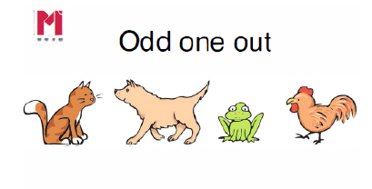
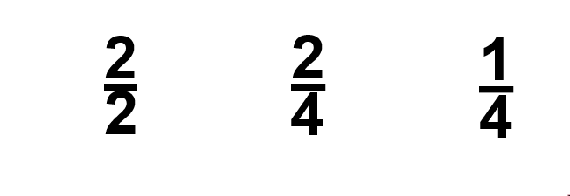
Opportunities for Reasoning
Year 2
Spring Term
Convince me!
Half quarter third whole part numerator denominator vinculum
Notes:
Time: 2 minutes
Purpose: To share an example of a task involving reasoning
Facilitation: Explain that that reasoning is embedded in every maths lesson. Pupils have opportunity to explore and discuss questions to support them in developing a deeper understanding. In this question the emphasis isn’t on getting the correct answer but providing a sound explanation using the precise vocabulary. Allow parents to discuss the question and justify their answers.
Pupils are encouraged to prove their answers or “convince me” (animate) and often this will include using other representations with concrete objects or diagrams to accompany their explanation.

Slide 9
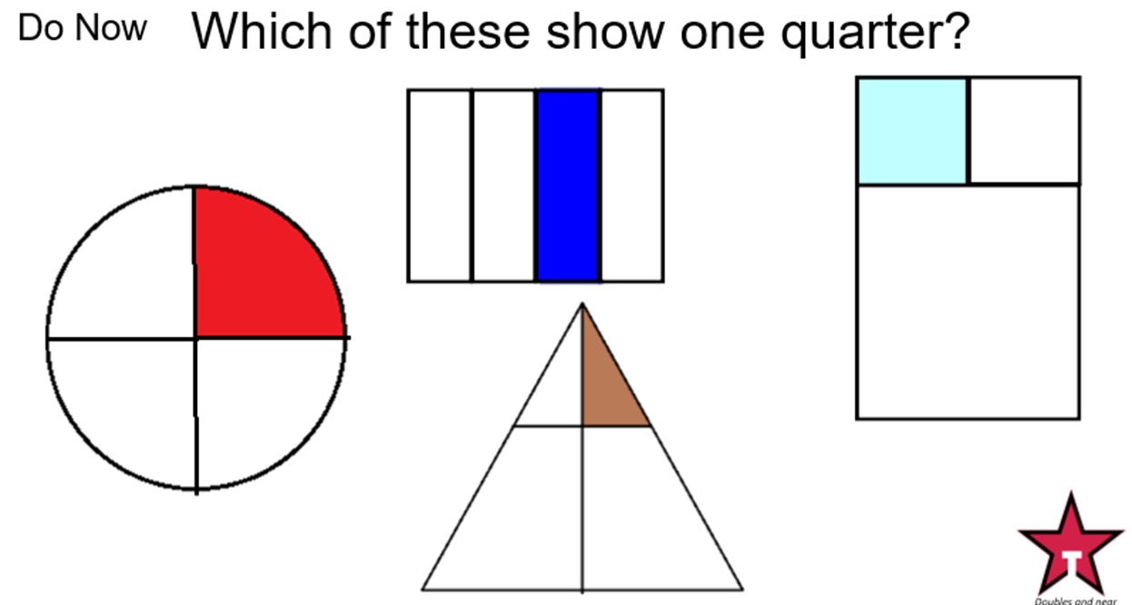
Opportunities for Reasoning
Year 2
Spring Term
Equal parts one half one quarter divide numerator denominator vinculum
Notes:
Time: 2 minutes
Purpose: To share an example of a task involving reasoning
Facilitation: Explain that pupils will need to understand how to find a half, a third and a quarter of a shape and a quantity. In the example shown pupils were asked which of these show a quarter. The purpose of the question is to ensure pupils understand the importance of equal parts to avoid misconceptions in the future. Again there is a large focus on deepening understanding by getting children to reason and justify their answer. Why is this shape showing one quarter? Why is this not a quarter of the shape? Ask parents to discuss and explain their answer. Ask one of them to explain why one of the shapes does not show a quarter. Ask parents to then create their own example and non examples. Explain that showing non-examples are important step in many areas of mathematics in helping pupils to understand without misconceptions.

Slide 10
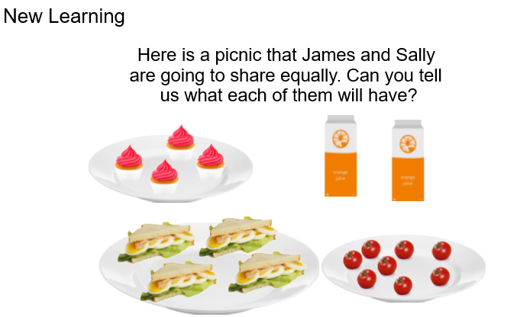
Making connections
Year 2
Spring Term
Half quarter third whole part numerator denominator vinculum
Notes:
Time: 3 minutes
Purpose: To show how to find a fraction of a quantity using a part whole model
Facilitation: Each lesson should also be rich in problem solving. In order to solve problems pupils will need to draw upon previous knowledge. Pupils will be familiar with the part whole model and would have used it to represent calculations. Using it for problems involving finding fractions of quantities helps pupils to make connections between fractions and division. Finding half of four is the same as four divided by two. Demonstrate how to use the part whole model to solve a half of eight. “the whole is eight, I need to share eight into two parts. Model using full sentences and star words e.g. “Eight divided by two is four, half of eight is four. Each person will have four tomatoes”.

Slide 11
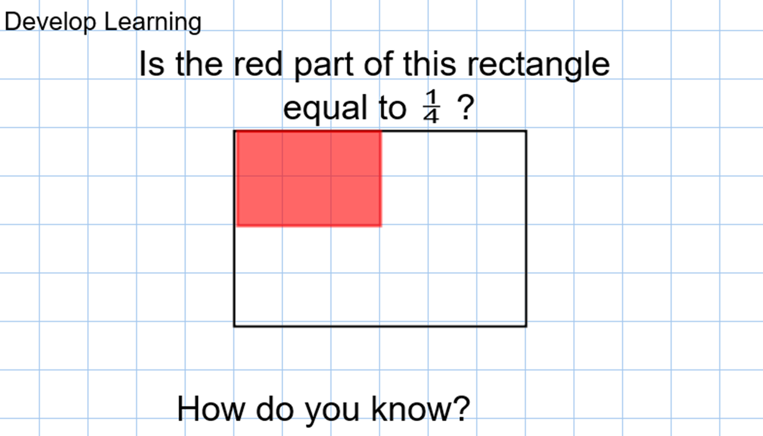
Making connections
Year 2
Spring Term
Half quarter third whole part numerator denominator vinculum
Notes:
Time: 2 minutes
Purpose: To emphasise the importance of making connections in maths.
Facilitation: Explain that maths is an interconnected subject and pupils gain a deeper understanding when they can make connections between concepts such as fractions and division and also within a concept, drawing upon previous learning. For example here when looking at fraction of shape, squares are provided to support pupils in making connections to fractions of a quantity.

Slide 12
Let’s explore
Year 2
Spring Term
Half a square
These images show a square that’s been split in half. How do you know they are correct?
Investigate: How many other ways can you split a square in half?
Variations to try at home: Why not try and see how many ways you can split a square in thirds or quarters? What happens if we change the shape?
Half numerator denominator I know because equal parts divide
Notes:
Time: 10 minutes
Purpose: To explain how to play game 2
Facilitation: Give parents 5-10 minutes to have a go at the activity with their children. You may want to provide them with blank squares, provided in folder. Remind parents to use the Star Words.

Slide 13
In focus: shape
Year 2
Spring Term
Identify shapes by the number of vertices and sides
Identify right angles in shapes
Recognise lines of symmetry within 2D shapes
Describe and sort 2D shapes according to their properties
Identify 2D shapes on the surfaces of 3D shapes
Describe and create shape patterns
Compare and sort 2D and 3D shapes
Notes:
Time: 2 minutes
Purpose: To share the progressive learning steps pupils will follow for addition and subtraction.
Facilitation: Explain that we are now going to look at another part of the Year 2 curriculum - shape - which is also a focus this term. In Year 1 pupils would have explored 2D and 3D shapes and were expected to be able to name and recognise shapes. In Year 2 pupils are expected to be able describe shape properties including vertices, sides, right angles and lines of symmetry in 2D shapes. Pupils will then need to describe properties of 3D shapes including number of vertices, edges and faces of shapes as well as recognise 2D shapes on the surface of 3D shapes. Pupils will use their knowledge of properties of shape to compare and sort shapes.

Slide 14
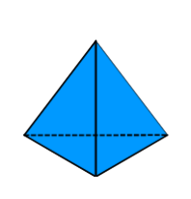

Star words
Year 2
Spring Term
face
right angle
vertex
(plural: vertices)
side
edge
quadrilateral
line of symmetry
Notes:
Time: 2 minutes
Purpose: To share the precise vocabulary used when describing the properties or 2D and 3D shapes.
Facilitation: Share the vocabulary, using an example 3D and 2D shape to demonstrate each one. Vertex should be used to describe where two edges meet on a 3d shape and where two sides meet on a 2d shape. The word corner is more of a colloquial word and it is important that we are using the mathematical terminology. An edge is where two faces meet on a 3d shape (2D shapes do not have edges). The face is the 2D shape on the surface of a 3D shape. As well as the number of faces, pupils will need to name the shape of the face e.g. a triangular prism has 5 faces - 2 triangular faces and 3 rectangular faces. As well as describing the quantity of sides and vertices on a 2D shape, pupils will need to identify the number of right angles and lines of symmetry. A quadrilateral is a 4 sided shape. A full list of the names of shapes and other vocabulary can be found in your maths pack.

Slide 15
Rectangles and squares
Year 2
Spring Term
A rectangle is a quadrilateral with all four angles right angles.
A square is a quadrilateral with all four angles right angles and all four sides of the same length.
So a square is a special kind of rectangle, it is one where all the sides have the same length
quadrilateral rectangle equal square oblong 3D sides vertices
Notes:
Time: 2 minutes
Purpose: To share the precise vocabulary used when identifying the names and properties of rectangles.
Facilitation: Explain that it is important for pupils to understand the individual properties of a shape in order to identify the type of shape and compare and classify shapes. Explain that a common challenge for children (and adults) is the fact that a square is also a rectangle. Rectangle is an ‘umbrella term’ to describe both squares - with four equal sides and other rectangles that have two pairs of equal sides. You may want to introduce the word oblong to parents which can be used to describe rectangles that are not squares.
Pupils may also have the misconception that a rectangle but always be in the shown orientation so it is important that we show them different orientations (animate) so tat pupils understand that it is still a rectangle even if rotated. We often hear pupils use the word ‘diamond’ to describe such shapes but diamond is not a mathematical shape and no used in our maths lessons.

Slide 16
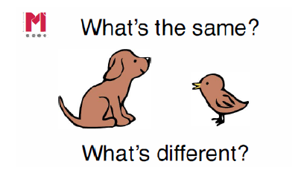
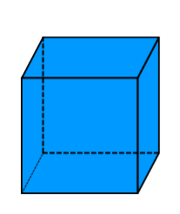
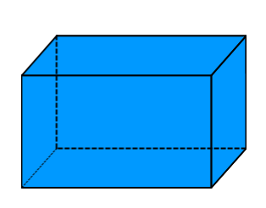
Compare, sort and classify
Year 2
Spring Term
faces quadrilateral rectangle equal square oblong 3D edges vertices
Notes:
Time: 2 minutes
Purpose: To demonstrate how to promote mathematical thinking through comparison.
Facilitation: Explain that pupils are encouraged to discuss similarities and differences between shapes with each other using their star words in order to make sense of the properties of each shape. The question “what’s the same? What’s different?” is useful to prompt discussion.
Here parents may point out that both have 6 faces, 12 edges and 8 vertices. But the difference is that the cube’s six faces are all square and that all edges are equal length.

Slide 17
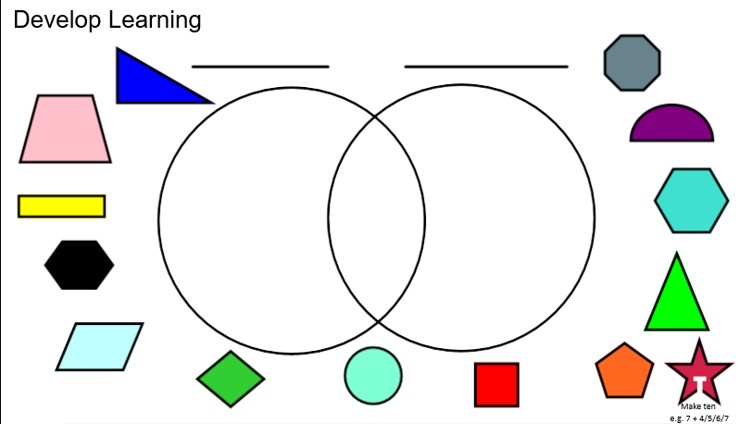
Compare, sort and classify
Year 2
Spring Term
sides lines of symmetry quadrilateral 2D vertices vertex right angle
Notes:
Time: 2-3 minutes
Purpose: To demonstrate how to promote mathematical thinking through comparing, sorting and classifying.
Facilitation: Sorting diagrams such as Venn diagrams are used to promote dialogue and opportunities for reasoning. Pupils will be encourage to explain how they know a shape goes into a certain place. If you have time, run through an example with parents selecting appropriate headings such as “quadrilateral”, “has a right angle”, “more than 2 lines of symmetry”, “all sides are equal”.

Slide 18
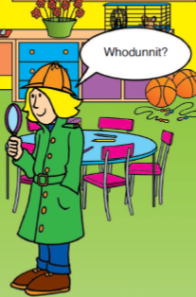
Let’s explore
Year 2
Spring Term
Shape Detectives (2+ players)
3 or more players
One person becomes the shape master. The shape master secretly chooses a shape (it could be either 2D or 3D). The rest of the players take it in turns to ask the shape master a question. The shape master can only answer yes or no. The first person to correctly identify the shape on their turn wins!
2 player version
If playing with 2 people try setting a limit on the amount of questions e.g. you can only have six questions. If you identify the shape then the detective wins, if you don’t identify the shape, the shape master wins!
sides faces lines of symmetry quadrilateral 2D 3D edges vertices right angle
Notes:
Time: 10 minutes
Purpose: To share a game to play at home to consolidate pupils knowledge of properties of shape.
Facilitation: Demonstrate the game by becoming the shape master, invite a pupil or parent to ask an initial question. Explain that when playing as a group it is just as important for pupils to listen to others’ questions/answers as it is to think of their own question. Give parents 5-10 minutes to play the game with their children or another parent.

Slide 19
Year 2
Spring Term
Thank you
Notes:
Thank parents for attending the workshop and take any questions afterwards.

