Slide 1

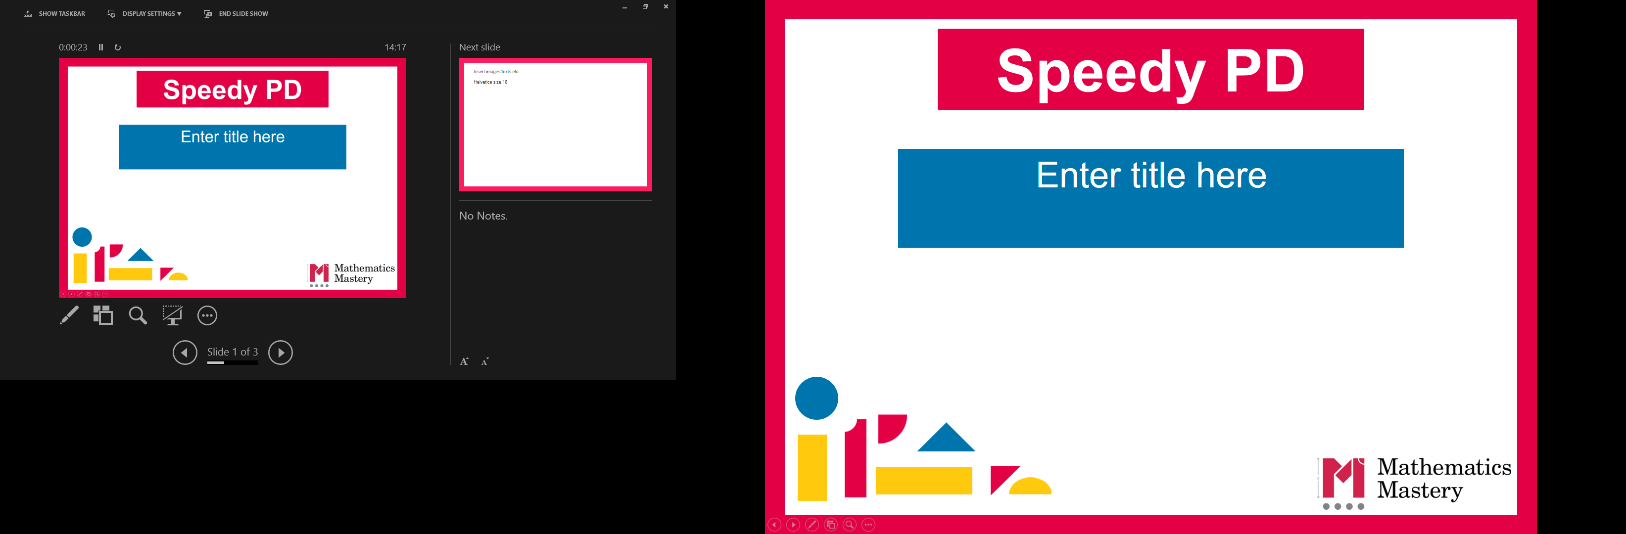

Year 1
Spring Term
Parent workshop
Notes:
General Guidance about parent workshops
This workshop (if delivering in full) is designed to be completed in 50 minutes to 1 hour.
This workshop can be adapted and shortened to suit the priorities of your school. Select the parts that are purposeful for you.
See our parent workshop guidance for an overview of the structure to support you in adapting.
Additionally you may wish to add in information specific to your school e.g. photos, videos, calculation policy.
Have on the tables the termly parent packs - these are to be taken home after the workshop and contain the Big Picture, vocabulary, key representations and games discussed in the workshop. This can also be sent out to parents who were not able to attend the workshop.

Slide 2
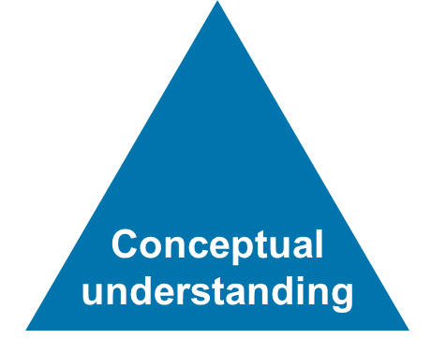
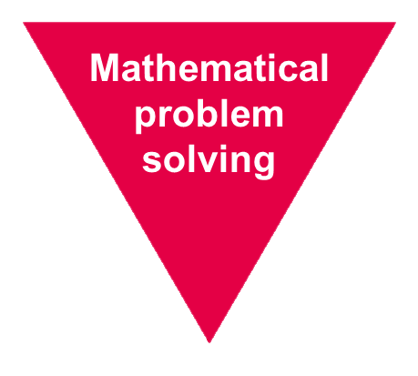
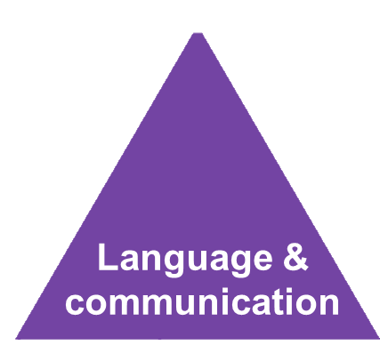
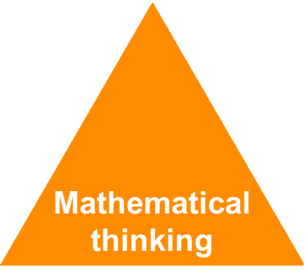
Mathematics Mastery
Year 1
Spring Term
Success for all
Notes:
Time: 2-3 minutes
Purpose: Remind parents of the principles of mathematics mastery.
Facilitation: A full introduction to mathematics mastery was included in the Autumn Parent workshop, if this is the first parent workshop being delivered please refer to slides 1-6 of the Autumn workshop. Remind parents that we use the Mathematics Mastery curriculum materials, mastery in maths refers to gaining a deeper understanding of concepts so that pupils can apply their learning and solve problems. Explain that in order to achieve this we promote the dimensions of depth: a focus on conceptual understanding, language and communication and mathematical thinking. A definition of each of these can be found in your packs. The programme is based on research and evidence from across the world and the curriculum is designed so that all pupils can succeed regardless of background and ability. Give parents a moment to refer to the parent pack.

Slide 3
Creating a positive attitude to maths
Year 1
Spring Term
Talk to your children about everyday maths
Play maths games with them
Value mistakes as learning opportunities
Recognise that there is more than one way to work things out
Praise children for effort over outcome
Avoid saying things like “I’m useless at maths”
Notes:
Time: 2 minutes
Purpose: Remind parents about the opportunities to support with mathematics at home
Facilitation: This was also included in the Autumn workshop but the messaging may be worth reiterating. Make the following points:
Everyday Talk: try to talk about maths when doing activities like shopping, cooking, time etc. 5 minutes a day can make a big difference!
Play with your child: puzzles, board games, verbal games help them to apply vocabulary, problem solve and reason. Interaction and dialogue that you cannot get from playing on a computer or iPad!
Mistakes are opportunities for learning.
You may have learned one method at school but at school we actively encourage children to seek out multiple strategies and choose one that works for them and build connections between strategies.
Praise children for trying hard and overcoming challenges. If pupils are only praised for getting everything correct they may not try and challenge themselves as they may be afraid to get things wrong.
6) Try to avoid saying things like “I’m useless at maths”. You may remember maths as being hard, but if your child hears you saying that, or that it's not important to be good at maths, they will believe that too!

Slide 4

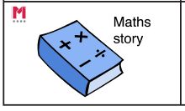
Big Pictures
Year 1
Spring Term
What maths can you see?
before after next then first o'clock half past minute hand hour hand morning afternoon
Notes:
Time: 5 minutes
Purpose: To show parents how we use the big picture to connect maths to a context/the real world.
Facilitation: Explain that the Big Pictures are used to provide children with opportunities to make connections with their mathematics learning and where it fits in the real world. They also support mathematical talk and reasoning. The Big Pictures in Year 1 relate to fairy tales. Give parents a copy of the Red Riding Hood Big Picture (in parent pack or display on the board) and explain this is used in the time unit, which is our focus today. Allow them to discuss what maths they can see with their children.
Mathematics Mastery encourages pupils to make connections between the maths they are doing and real life contexts. Often pupils are asked to relate the maths they are doing to a real life problem which we call a “maths story”. (click to animate sticker)

Slide 5
Year 1 Spring Curriculum Map
Year 1
Spring Term
Time | Exploring calculation strategies within 20 | Numbers to 50
Read, write and tell the time to o’clock and half past on analogue clock Sequencing daily activities Whole and half turns linked to time | Model, explain and choose addition and subtraction strategies | 2-digit numbers – represent, sequence, explore, compare. Count in 2s, 5s and 10s Describe and complete number patterns
Addition and subtraction within 20 | Fractions | Measures: Length and mass
Illustrate, explain and link addition and subtraction with equations Apply ‘Make Ten’ strategy Use language to quantify and compare difference | Represent and explain addition and subtraction strategies including ‘Make Ten’ Use known facts to add and subtract | Compare and measure lengths and mass using cm and kg Doubling and halving
Notes:
Time: 2 minutes
Purpose: To share the Spring curriculum map with parents.
Facilitation: Allow parents to view the Year 1 curriculum map for Spring and briefly talk through the focus of each unit (no need to go through the individual objectives)
Explain that the Spring map is in the parent pack.
You may want to handout the entire Year 1 curriculum map for parents to take home. Entire curriculum map: http://toolkit.mathematicsmastery.org/download/5ce3b987ecdd7

Slide 6
In focus: time
Year 1
Spring Term
To know and order the months of the year
To put events in order
To understand time is measured in minutes and seconds
To read the time on an analogue clock to the nearest o’clock
To read the time on an analogue clock to half past
To read the time to o’clock and half past on an analogue clock
To read and write the time in words to o’clock and half past
To explore adding on hours and half hours
To use the language of position, movement and direction
Notes:
Time: 2 minutes
Purpose: To share the progressive learning steps pupils will follow for time.
Facilitation: In this workshop we have chosen to focus on time as this is a big focus across the spring term and learning from these units can be consolidated throughout the year and reinforced at home. The learning focuses on using the analogue clock, with digital clocks being introduced later in Year 3.
Explain that in Year 1, pupils are required to tell the time to o’clock and half past. Mathematics Mastery is a cumulative curriculum meaning that learning is built up over time, with new learning connecting to your child’s prior learning. Before telling the time they need to understand what a second and minute is and relate this to their own experience and daily routine. (Possibly include anecdote of saying to a child give me a minute…..how often is it one minute?)

Slide 7
Getting a personal sense of time
Year 1
Spring Term
Before children understand cultural time, they need to understand their own personal and social time sequences and the language of before and after, earlier and later.
Montague-Smith & Price (2012
How can you support your children in gaining a sense of time in everyday life?
Notes:
Time: 2 minutes
Purpose: To explain the importance of gaining a personal sense of time
Facilitation: Before pupils learn how to tell the time they need to make sense of their own personal experiences of time. We begin the unit by ordering the months of the year and then move onto ordering events using language such as before/after/earlier/later. Throughout the unit we link back to personal experiences. Ask parents what kinds of things they can do at home to help develop their children’s awareness of time? Examples could include: talking about the daily routine, keeping a diary, using the precise language e.g. earlier/later/before/after, discussing what they did in school, discussing what happened in a story they have read or television programme that they watched.

Slide 8

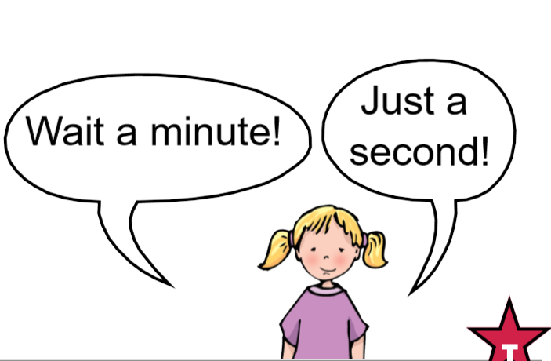
How long is a minute?
Year 1
Spring Term
What could you do in one minute?
Notes:
Time: 3 minutes
Purpose: To demonstrate the importance of understanding what a minute is before telling the time.
Facilitation: Explain to parents that before children learn how to tell the time they need to have an understanding of what a minute in relation to their own experience. In Year 1 they learn that a minute is made up of 60 seconds and an hour is made up of 60 minutes. This is a really abstract concept for pupils so it’s important for them to relate time to real life experiences. One of the activities we do with pupils is to ask them what they could do in one minute. Ask parents to discuss with their children what they could do within a minute and take feedback. Explain that once pupils have a concept of one minute we then build upon this and think about how long it might take to do certain activities e.g. how long does it take to eat lunch, walk to school, do a maths lesson etc. These are great kinds of conversations to be having at home too to support your children in having a deeper understanding of time.
Another alternative task could be to ask parents to close their eyes and stand up/put their hand up when they think one minute has passed.

Slide 9


True or False
Year 1
Spring Term
I can throw a ball in the air and catch it 20 times in ten seconds.
I can eat my dinner in 10 minutes.
I can run around the playground in 2 minutes.
I can draw a picture of a house in 30 seconds.
How do you know?
Notes:
Time: 3 minutes
Purpose: To demonstrate a game to play at home.
Facilitation: Play true or false with parents and children. Explain that at school we have a big focus on language and we encourage children from Early Years and Year 1 to discuss and explain their answers, justifying their responses.
Again this could be a quick game you could play at home, it could also be linked to making a prediction – “how long do you think it will take dad to get ready?”, “how long do you think the adverts will last” – this will develop pupils ability to think mathematically.

Slide 10
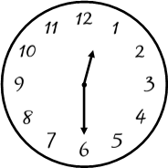
Time – Talk task
Year 1
Spring Term
“The time is ____________________ in the ____________ and I would be _____________________.”
o'clock half past minute hand hour hand time
Notes:
Time: 5 minutes
Purpose: To model a Talk task and explain the expectations of telling the time in Year 1.
Facilitation: Explain that in Year 1 pupils learn how to tell the time to o’clock and half past over a series of lessons. Again, it is important that pupils relate telling the time to personal experience. Explain that one of the parts of our maths lesson is a Talk Task, where the pupils work in pairs to discuss the day’s mathematical concept before they later work independently. In this Talk Task we are going to tell the time, make the time on our own clock and discuss what we would be doing at that time. Model the first example that is displayed on the board. You may wish to discuss the importance of being able to identify the hour hand and the minute hand and know the purpose of each. Here we say the hour hand is pointing straight down rather than saying it’s pointing ‘at the 6’, as this focusses children on the position of the hand rather than the number, which does not relate to the amount of minutes.

Slide 11
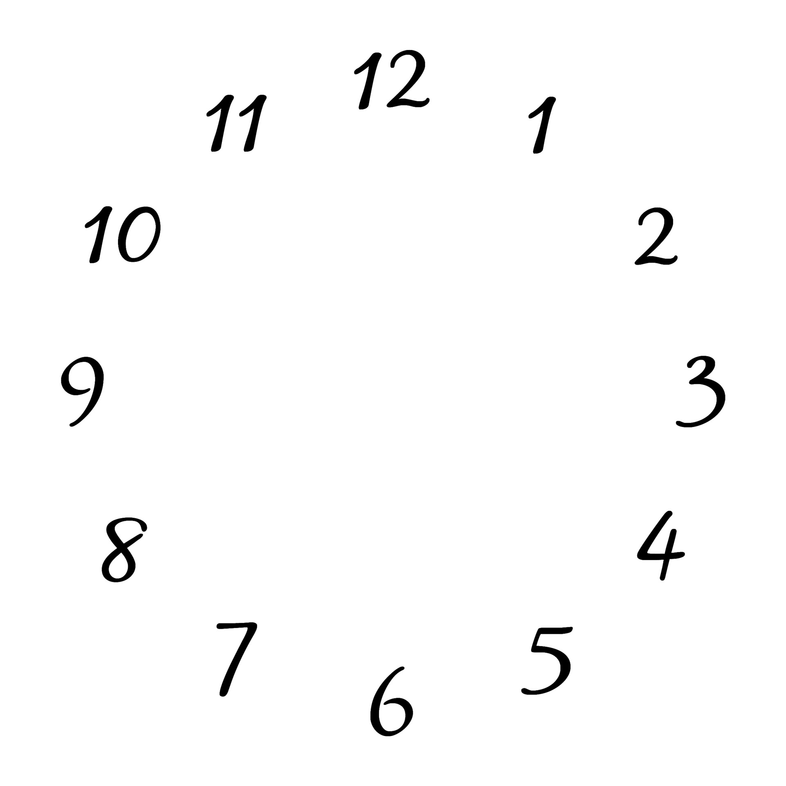
Time – Talk task
Year 1
Spring Term
Ten o’clock
Half past eight
“The time is ____________________ in the _______________________
and I would be _____________________.”
o'clock half past minute hand hour hand time
Notes:
Time: 5 minutes
Purpose: To try a Talk Task with their children
Facilitation: Ask parents to work with their children, taking it in turns choosing a time from the board either written or a picture and make the time on an analogue clock, following the sentence stems to make a sentence.

Slide 12
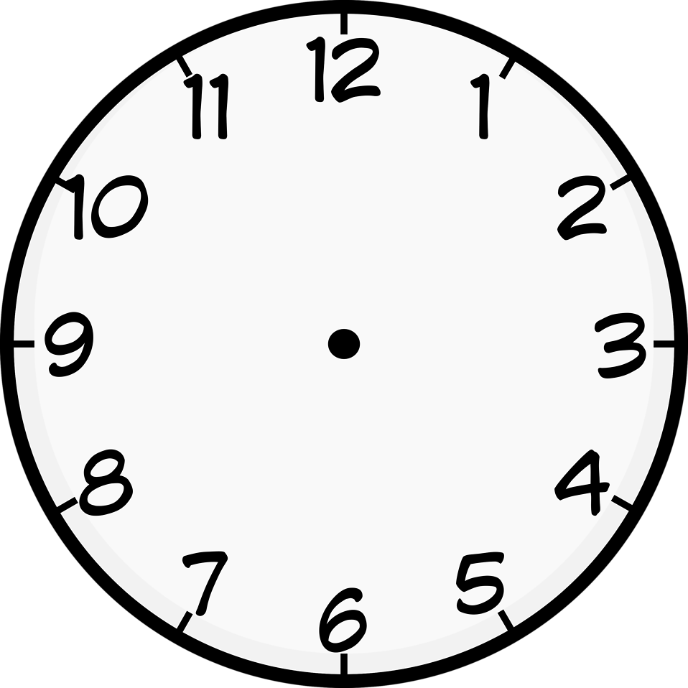
Let’s explore
Year 1
Spring Term
First to 12 O’clock
Players: This game is for two players
What you need: Geared clock or paper clock faces
To start set the clock to 6 o’clock.
Player 1 chooses to put the clock forward by either one hour or half an hour and moves the clock hands to that time.
Pass the clock over for player 2’s turn.
The winner is the player who moves the hands onto 12 o’clock.
Can you work out a winning strategy so that you can always beat your opponent?
Minute hand hour hand minutes hour half hour analogue clock
Notes:
Time: 10 minutes
Purpose: To explain how to play game 2
Facilitation: Give each pair a geared clock. Explain that if they don’t have a toy clock/geared clock at home they can make their own clock with instructions in their pack or draw hands onto paper clock faces.
Explain the rules of the game and demonstrate with a volunteer.
Remind parents to use the Star Words.
Give parents 5-10 minutes to have a go at the games with their children.

Slide 13
In focus: fractions
Year 1
Spring Term
To Identify half of a shape or object
To find half of a quantity
To identify one quarter of a shape or object
To find one quarter of a quantity
To describe position and direction using half, whole and quarter turns, including three quarter turns.
Notes:
Time: 2 minutes
Purpose: To share the progressive learning steps pupils will follow for fractions
Facilitation: In Year 1 pupils will have experienced the word half in the context of number – halves and doubles to 20 and in the context of time –half past. When beginning the fractions unit they connect the idea of a half to find half of shape. They then will apply this idea to find half of a quantity. Explain that quarters are only introduced when children have a deep understanding of a half and again lessons will first focus on a quarter of a shape or object before moving on to a quarter of a quantity. Pupils apply their understanding of halves and quarters to position and direction, building on what was learnt in the time unit.

Slide 14
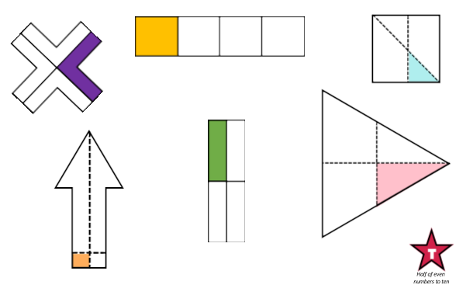
Examples and Non Examples
Year 1
Spring Term
quarter equal unequal part whole divide
Notes:
Time: 2 minutes
Purpose: To share examples and non examples of a quarter.
Facilitation: Explain that pupils will need to understand how to find a half and a quarter of a shape and a quantity. In the example shown pupils were asked which of these show a quarter. Again there is a large focus on deepening understanding by getting children to reason and justify their answer. Why is this shape showing halves? Why does this not represent half of the shape? Ask parents to discuss with their children which one of the diagrams shows a quarter and explain how they know? Ask Which one of the shapes does not show a quarter and why? Ask parents to then create their own example and non examples. Explain that showing non-examples are and important step in many areas of mathematics to help pupils understand without misconceptions. You may wish to use napkins/bread to show examples and non-examples as used in the Year 1 lesson materials.

Slide 15
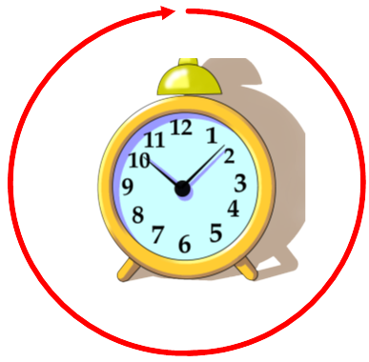
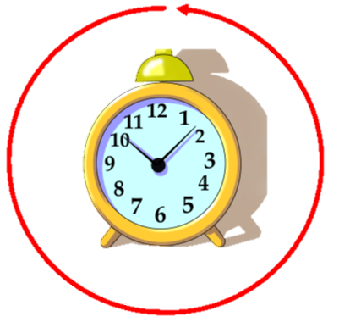
Position and direction
Year 1
Spring Term
Clockwise
Anti-Clockwise
Half turn Quarter turn Clockwise Anti-clockwise
Notes:
Time: 2 minutes
Purpose: To share the expectations for position and direction in Year 1
Facilitation: Explain that pupils in Year 1 will use their knowledge of both the clock movement and fractions to describe position and direction. They will need to understand the direction of clock-wise and anticlockwise and how to make full, half, quarter and three quarter turns.

Slide 16
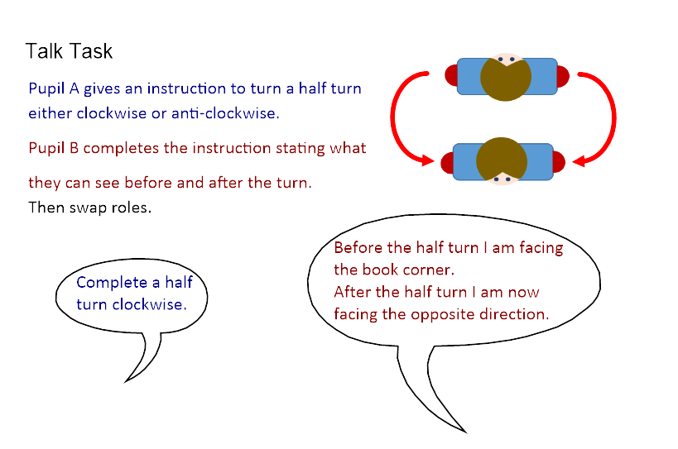
Let’s explore: directions
Year 1
Spring Term
Half turn Quarter turn Clockwise Anti-clockwise
Notes:
Time: 10 minutes
Purpose: To show parent the expectations in Year 1 for position and direction
Facilitation: Explain the Talk Task to parents (taken from unit 10 lesson 5) and model with a partner.
Ask parents to have a go with their children as their partner.
Once parents have tried doing half turns, you may want to introduce quarter turns and three-quarter turns.
Ask parents how they might use some of the language in the task at home.

Slide 17
Helping at home
Year 1
Spring Term
Games played today
Exploring the Big Picture, vocabulary and activities in this term’s Maths Pack
Talking about maths during “everyday” routines e.g. shopping, cooking, daily routine, calendar.
Board games
Singing
Practising number bonds
Notes:
Time: 1 minute
Purpose: To suggest activities to build upon learning in school.
Facilitation: Go through each bullet point.
Explain that today’s games and some further activities to support parents can be found in the maths pack.
Make sure everyone takes their maths pack home.

Slide 18
Year 1
Spring Term
Thank you
Notes:
Thank parents for attending the workshop and take any questions afterwards.

