Slide 1

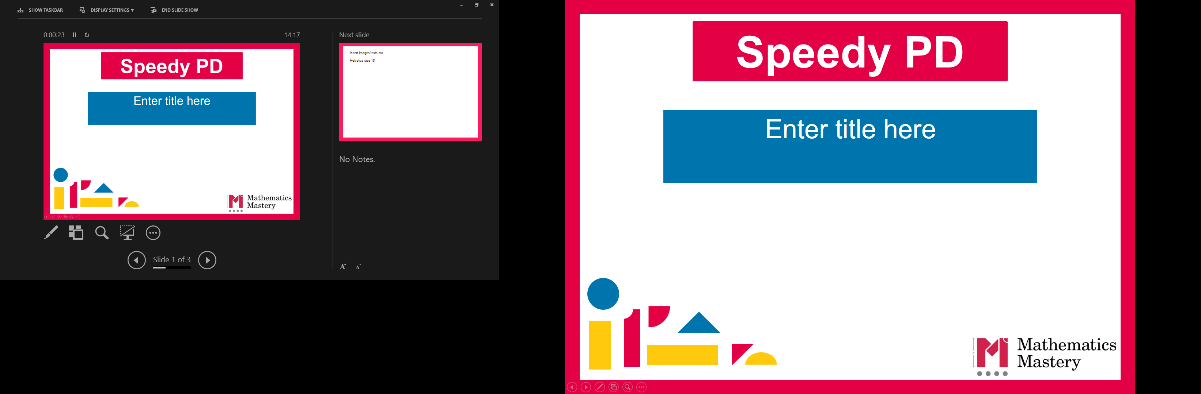

Reception
Spring Term
Parent workshop
Notes:
General Guidance about parent workshops
This workshop (if delivering in full) is designed to be completed in 50 minutes to 1 hour.
This workshop can be adapted and shortened to suit the priorities of your school. Select the parts that are purposeful for you.
See our parent workshop guidance for an overview of the structure to support you in adapting.
Additionally you may wish to add in information specific to your school e.g. photos, videos, calculation policy.
Have on the tables the termly parent packs - these are to be taken home after the workshop and contain the Big Picture, vocabulary, key representations and games discussed in the workshop. This can also be sent out to parents who were not able to attend the workshop.
Resources: Bead strings, 0-9 dice, 0-20 number lines

Slide 2
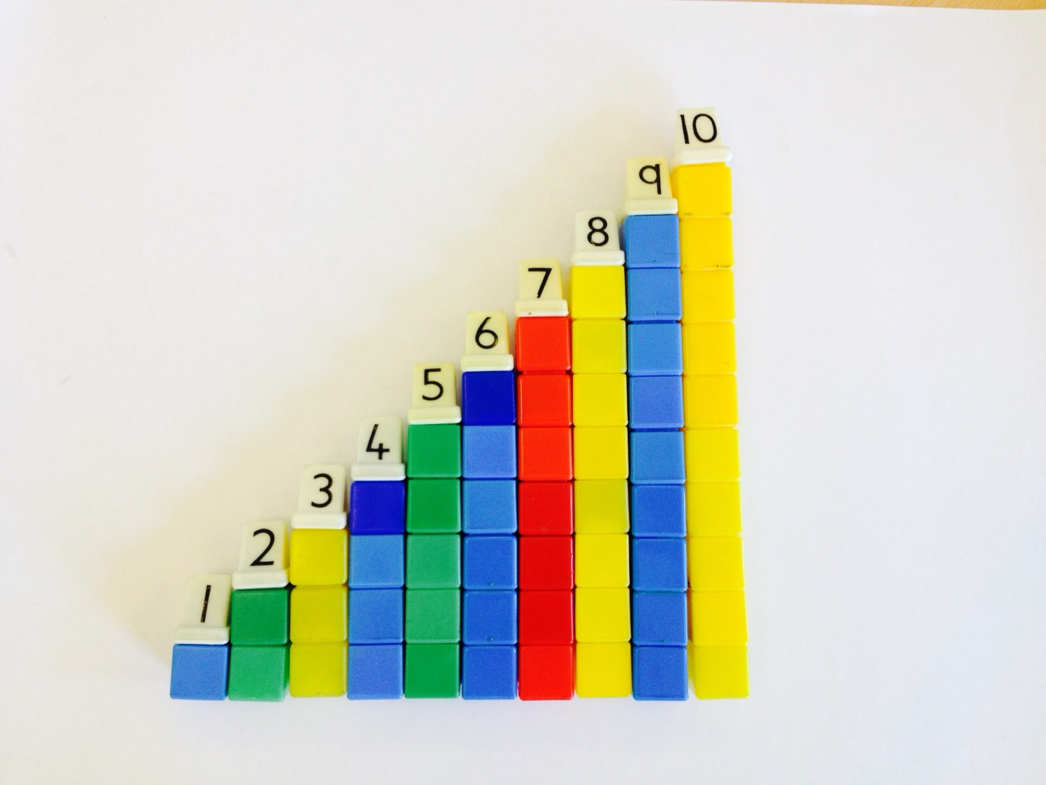
Do Now
Reception
Spring Term
What do you notice?
Why does this happen?
Notes:
Time: You may want to do this as parents come in
Purpose: To introduce numbers to ten, show an example of a question that prompts pupil talk.

Slide 3
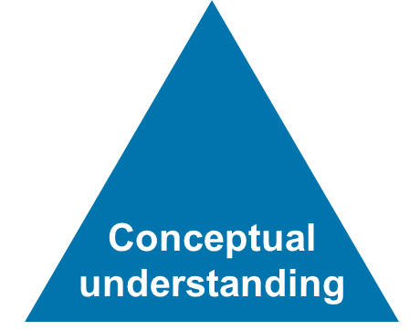
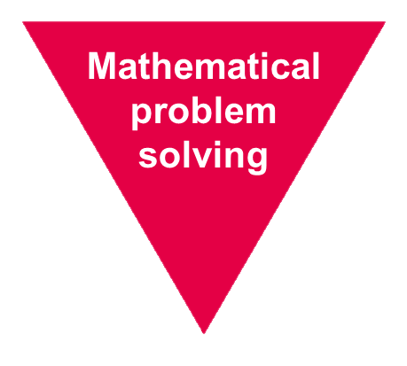
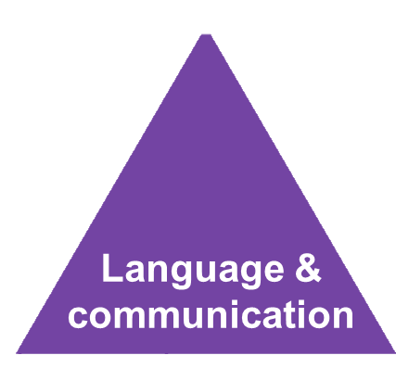
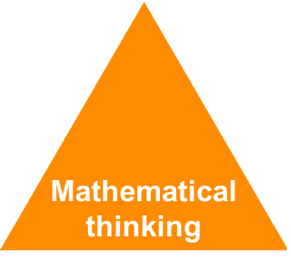
Mathematics Mastery
Reception
Spring Term
Success for all
Notes:
Time: 2-3 minutes
Purpose: Remind parents of the principles of Mathematics Mastery.
Facilitation: A full introduction to Mathematics Mastery was included in the Autumn Parent workshop, if this is the first parent workshop being delivered please refer to slides 1-6 of the Autumn workshop. Remind parents that we use the Mathematics Mastery curriculum materials; mastery in maths refers to gaining a deeper understanding of concepts so that pupils can apply their learning and solve problems. Explain that in order to achieve this we promote the Dimensions of Depth: a focus on conceptual understanding, language and communication and mathematical thinking. A definition of each of these can be found in their packs. The programme is based on research and evidence from across the world and the curriculum is designed so that all pupils can succeed regardless of background and ability. Give parents a moment to refer to the parent pack.

Slide 4
Creating a positive attitude to maths
Reception
Spring Term
Talk to your children about everyday maths
Play maths games with them
Value mistakes as learning opportunities
Recognise that there is more than one way to work things out
Praise children for effort over outcome
Avoid saying things like “I’m useless at maths”
Notes:
Time: 2 minutes
Purpose: Remind parents about the opportunities to support with mathematics at home
Facilitation:
This was also included in the Autumn workshop but the messaging may be worth reiterating. Make the following points:
Everyday Talk: try to talk about maths when doing activities like shopping, cooking, time etc. 5 minutes a day can make a big difference!
Play with your child: puzzles, board games, verbal games help them to apply vocabulary, problem solve and reason. Interaction and dialogue that you cannot get from playing on a computer or iPad!
Mistakes are opportunities for learning.
You may have learned one method at school but at school we actively encourage children to seek out multiple strategies and choose one that works for them and build connections between strategies.
Praise children for trying hard and overcoming challenges. If pupils are only praised for getting everything correct they may not try and challenge themselves as they may be afraid to get things wrong.
6) Try to avoid saying things like “I’m useless at maths”. You may remember maths as being hard, but if your child hears you saying that, or that it's not important to be good at maths, they will believe that too!

Slide 5

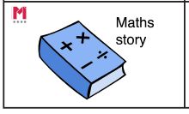
Big Pictures
Reception
Spring Term
What maths can you see?
?
number order greater less more fewer same equal before after between
Notes:
Time: 5 minutes
Purpose: To show parents how we use the big picture to connect maths to a context/the real world.
Facilitation: Explain that Big Pictures are used to provide children with opportunities to connect maths with the real world, make connections and support mathematical talk and reasoning. Give parents a copy of the Mother Hubbard Big Picture (in parent pack, or display on the board) and explain that the Big Pictures in Reception are all related to nursery rhymes that the pupils spend time singing along to. This one is used in the numbers to fifteen unit, which is our focus today. Allow them to discuss what maths they can see with their children and take some feedback.
Mathematics Mastery encourages pupils to make connections between the maths they are doing and real contexts. Often pupils are asked to relate the maths they are doing to a real life problem which we call a “maths story”.

Slide 6
Reception Spring Curriculum Map
Reception
Spring Term
Numbers within 10 | Addition and subtraction within 10 | Numbers within 15
Count up to ten objects Represent, order and explore numbers to ten One more or fewer, one greater or less | Explore addition as counting on and subtraction as taking away | Count up to 15 objects and recognise different representations Order and explore numbers to 15 One more or fewer
Grouping and sharing | Numbers within 20 | Doubling and Halving
Counting and sharing in equal groups Grouping into fives and tens Relationship between grouping and sharing | Count up to 10 objects Represent, order and explore numbers to 15 One more or fewer | Doubling and halving Relationship between
Notes:
Time: 3 minutes
Purpose: To share the Spring curriculum map with parents.
Facilitation: Allow parents to view the Reception curriculum map for Spring and briefly talk through the focus of each unit (no need to go through the individual objectives)
Explain that the Spring map is in the parent pack.
You may want to handout entire Reception curriculum map for parents to take home. Entire curriculum map:
http://toolkit.mathematicsmastery.org/download/5ce3b97817654

Slide 7
In focus: numbers to 20
Reception
Spring Term
Numbers within 15
Count up to 15 objects and recognise different representations Order and explore numbers to 15 One more or fewer
To be able to count up to 15 objects and place them in order
To know what is one more than a number within 15
To know what is one fewer than a number within 15
To apply knowledge of one more and one fewer
To use the 'guess and check' strategy for problem solving
To be able to order numbers within 15
To explore numbers within 15
Notes:
Time: 2 minutes
Purpose: To share the progressive learning steps for number.
Facilitation: Explain that each unit is broken down into small progressive steps. This term pupils will spend/have spent three weeks exploring numbers within ten, before moving on to numbers to fifteen in depth and finally numbers to 20. Pupils need to do more than just be able to count, they will need to be able to know what one greater or less than a given number is, be able to order numbers, problem solve and reason with numbers and are expected to show their answers in different representations and explain their thinking. This helps them to gain a greater understanding of the structure of numbers which will help them later when calculating. The slide shows how one of the mentioned units - ‘numbers to 15’ - is broken down into steps.

Slide 8
Key early number skills
Reception
Spring Term
Counting Principles
Associating one object with one number - One to one principle.
The order of number names remains consistent e.g. 1,2,3 not 2,3,1 -Stable order principle
The final word tells us the number of objects - Cardinal principle .
You can count any collection of things whether real, imaginary or sounds - Abstraction principle.
It doesn’t matter what order we count objects in - Order irrelevance principle
Notes:
Time: 3-5 minutes
Purpose: To remind parents of key early number skills.
Facilitation: Remind parents that in the Autumn workshop we explored the key early number skills and these will be developed throughout all number units this term. (If this is the first workshop being run this year, please refer to the slides and video in the Autumn workshop files). Remind parents again about the importance of having a deep understanding of number, which is a lot more than simply being able to count aloud. Briefly explain each skill using objects or cubes to demonstrate.
One to one correspondence – matching a number with an object.
Stable order – numbers should be named in order, 1,2 3. Some children may begin counting in order but may count another set of numbers in a different order, or miss numbers out e.g 1,2,4,5,3,
Cardinal principle - refers to the number of objects as a whole; developing an understanding of the ‘three-ness of three’ rather than a number in a sequence of numbers: 1, 2, 3. The final number in the count represents the cardinal value of the number.
Abstraction principle - counting objects that are not visible such as hand claps, dropping coins into a tin.
Order irrelevance - to understand that objects can be counted in any order. For example, counting does not have to take place from left to right – they can be counted in any order and the total number will be the same.

Slide 9
Key early number skills
Reception
Spring Term
Other early number key skills
Understanding that the amount of objects remains the same, even if we rearrange them
- Conservation of number.
The ability to instantly recognise how many objects are in a group - Subitising
Notes:
Time: 2-3 minutes
Purpose: To share and explain key early number skills.
Facilitation:
Conservation of number – the ability to know that a set of counted objects, such as cubes, when rearranged differently, is the same number – we don’t need to recount each time. Young children will often need to keep checking the number of fingers on each hand for example as they have not yet established conservation of number. This is a developmental stage and through frequent exposure to number will be grasped by pupils.
Subitising – the ability to know how many objects in a set without counting. Generally five is seen as the maximum number that can be subitised, for numbers larger than this you see smaller numbers, for example, for six, someone may see three dots and three dots and know that is six without counting them all. Using dotted dice is a good way of knowing if a pupil can subitise or not.
Explain that we will refer to these skills throughout the rest of the workshop and not to worry too much about the technical terms but the skills being demonstrated.

Slide 10

Key representations – The ten frame
Reception
Spring Term
How can we use the ten frame to support key early number skills?
Notes:
Time: 5 minutes
Purpose: To introduce the ten frame as the next step after the five frame.
Facilitation: Highlight that the ten frame will be introduced to pupils after they have had the opportunity to explore the five frame (they may remember the five frame from the Autumn workshop). Similar to the five frame, it can support pupils’ understanding about the early number skills and allows them to begin thinking about number facts within and up to ten. Demonstrate how to represent the number eight with the ten frame (with a printed ten frame and cubes/counters would be best), referring to early number skills as you model. (e.g. one to one correspondence, conservation of number).

Slide 11
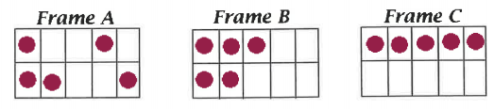
Key representations – The ten frame
Reception
Spring Term
What numbers are represented?
What does the arrangement tell you about the numbers?
What can you say about each number’s relationship to ten?
Notes:
Time: 3 minutes
Purpose: To demonstrate how different representations show different aspects of a number
Facilitation: Explain that arranging the same number in different ways helps pupils to make mathematical connections and gain a greater understanding of that number. Let’s look at different ways of representing the number 5 using the ten frame.
What does each arrangement tell you about the number 5?
What can we say about each arrangement and the relationship 5 has to ten?
You may also wish to mention subitising here e.g. by referring to Frame A and seeing a group of 3 and a group of 2 without the need to count.

Slide 12
Key representations – The ten frame
Reception
Spring Term
Notes:
Time:1 minute
Purpose: To demonstrate how to use the ten frame for numbers that are greater than ten
Facilitation: Ask parents what number is being represented this time and how the ten frame helps to support their understanding of the structure of 14.
Responses might include that it supports understanding of 14 being 4 greater than ten or 6 less than 20. You may see 4 groups of three with two remainder or 2 groups of five with four remainder. If we rearranged the counters you may see two groups of seven. (animate) or seven groups of two (animate)

Slide 13
Key representations – The ten frame
Reception
Spring Term
Notes:
Time:2 minute
Purpose: To demonstrate how to use the ten frame for numbers that are greater than ten
Facilitation: Ask parents what number is being represented this time and how the ten frame helps to support their understanding of the structure of 14.
Responses might include that it supports understanding of 14 being 4 greater than ten or 6 less than 20. You may see 4 groups of three with two remainder or 2 groups of five with four remainder. If we rearranged the cubes you may see two groups of seven.

Slide 14
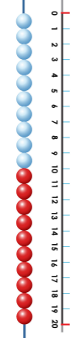
Bead string and number line
Reception
Spring Term
Notes:
Time: 2 minutes
Purpose: To explain how the bead string and number line develop number sense
Facilitation: Explain that the bead string is an important resource we use in school to develop number sense. Demonstrate how to show the number 17 on a bead string referring again to early number skills (e.g. one to one correspondence, stable order principle, cardinal principle). The bead string is often used alongside a number line. The number line supports pupils with the stable order principle, and understanding what comes before and after a given number. The number line is a rich resource which pupils will continue to use (perhaps with different scales) throughout school.
Remind parents that pupils will need to represent numbers in a variety of ways and the number line is another representation When exploring the number 11 for example ask pupils to show you it in another way? And another? And another? etc. to get them to think mathematically.

Slide 15



Fewer or less? Greater or more?
Reception
Spring Term
What sentences can you make to describe the picture using the star words?
Maya
Zane
fewer less greater more
When do we use fewer and when do we use less?
When do we use greater and when do we use more?
Notes:
Time: 3 minutes
Purpose: To demonstrate the importance of using precise vocabulary
Facilitation: Explain that we teach pupils to use the word fewer as well as less, greater and more. It’s important that we are using these words precisely. Let parents create some of their own sentences with their pupils then ask the question of when is it correct to use greater/more and less/fewer? Example sentences on next slide
General Rule: If you are using countable objects, then we use fewer or more
If you are describing the value of a number, then we use less or greater

Slide 16
Fewer or less? Greater or more?
Reception
Spring Term
Maya
Zane
fewer less greater more
Maya has more sweets thane Zane. 8 is greater than 6.
Zane has fewer sweets than Maya. 6 is less than 8.
Notes:
Time: 1 minute
Purpose: To give exemplification of possible sentences

Slide 17
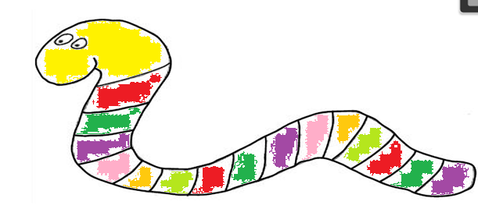
Ordinal numbers
Reception
Spring Term
Which colour comes first?
Which colour comes fourth?
Which colour comes last?
first second third fourth fifth sixth seventh eighth ninth tenth last
How might you practise ordinal numbers at home?
Notes:
Time: 3 minutes
Purpose: To explain what ordinal numbers are and the expectation for pupils to use them during their talk
Facilitation: Explain that pupils are expected to know ordinal numbers such as first, second, third etc.
Ask parents to talk about when they might practise this at home. Examples may include: who was first/second etc to tidy up/eat their dinner/wash their hands/go to bed? Ordering events: how was your day at school what happened first/second/next? Challenge pupils by asking them to recognise what comes third/fourth/fifth in a larger sequence.
This is one of the activities the pupils may do as part of unit 12. You may wish to include this in the workshop.
https://toolkit.mathematicsmastery.org/download/5a211b1f09f0c

Slide 18
Let’s explore
Reception
Spring Term
Number line fun
Draw a line each and mark 0 and 10 at either end or use the template number line with given intervals.
Roll the dice and decide where that number would go and write it in.
Then it’s your partner’s turn.
The first to get all numbers from 1-9 wins.
Watch out! If you get a repeat number it will mean you have to wait until next time!
0
10
greater fewer before after between order 1st 2nd 3rd 4th 5th 6th 7th 8th 9th 10th
Notes:
Time: 10 - 12 minutes
Purpose: To model a game that parents can play with their children
Facilitation: Explain the game and model the first couple of a turns with a partner, explain what happens if you roll the same number twice. Give parents and their children a chance to play the game for ten minutes.
Afterwards explain ways to vary the game e.g. you could draw the number line for your children with boxes for each number and over time move on to them drawing their own line and deciding where to place the number.
After some practice you may want to change the start and end numbers! This is really flexible and could be played with older children too with larger numbers, or even negative numbers or fractions!
Resources: 0-9 dice or spinner
Explain to parents that if playing at home an online 0-9 die could be used, link is here and in their packs.
https://rollthedice.online/en/cdice/0-9-dice

Slide 19
Let’s explore
Reception
Spring Term
5 questions!
Secretly write down a number between 0 and 20 and don’t show your partner.
Your partner needs to ask you questions using the star words greater than, less than and between. For example “is it less than 18?“
The aim of the game is to try and guess the number after asking 5 questions.
Example
Is it less than 18? Yes
Is it greater than 5? Yes
Is it between 10 and 15? Yes
Is it greater than 12? Yes
Is it less than 14? No
Guess: 14
Variations: The game can be simplified by using numbers 0 – 5, 0 – 10 or 0 – 15 instead of 0 – 20
Tip: have a number line out whilst playing. Ask children to refer to the number line before they ask their next question
greater than less than between
Notes:
Time: 10-12 minutes
Purpose: To model a game that parents can play with their children
Facilitation: Explain the second game, emphasise that this game can be adapted - when you first play this game you may not use all numbers to 20. You may start by picking a number between 0 and 10 for example. Give parents 10 minutes to play the game.

Slide 20
Helping at home
Reception
Spring Term
Games played today
Exploring the Big Picture, vocabulary and activities in this term’s Maths Pack
Talking about maths during “everyday” routines e.g. shopping, cooking, daily routine, calendar.
Board games
Singing
Notes:
Time: 1 minute
Purpose: To suggest activities to build upon learning in school.
Facilitation: Go through each bullet point.
Explain that today’s games and some further activities to support developing number sense can be found in the maths pack.
Make sure everyone takes their maths pack home.

Slide 21
Reception
Spring Term
Thank you
Notes:
Thank parents for attending the workshop and take any questions afterwards.

