Slide 1


Year 3
Spring Term
Parent Maths Pack
Focus: Multiplication and Division
This pack includes:
An overview of Mathematics Mastery
Key vocabulary
Key representations for multiplication and division
Big pictures
A multiplication game to play at home

Slide 2
Mathematics Mastery
What is ‘Mastery’?
The ‘mastery approach’ to teaching mathematics is the underlying principle of Mathematics Mastery. Instead of learning mathematical procedures by rote, we want your child to build a deep understanding of concepts which will enable them to apply their learning in different situations. To achieve this we aim to develop pupils’ Conceptual Understanding, Mathematical Thinking and Language and Communication.
(See diagram below).
Representing concepts using objects, pictures, words and symbols; making connections
Making conjectures, trying out specific examples, organising, comparing, looking for patterns and generalizing
Conceptual understanding
Explaining, justifying and discussing using accurate mathematical language
Mathematical problem solving
Mathematical thinking
Language & communication
Central to learning mathematics
Success for all
At school we believe all pupils can achieve success in maths. We encourage pupils to have a ‘growth mindset’ – a belief that effort leads to success and that challenges are opportunities to learn.
Here are a few tips to encourage your children at home with maths:
Talk to your children about everyday maths
Play games with them
Value mistakes as learning opportunities
Recognise that there is more than one way to work things out.
Praise children for effort over outcome.
Avoid saying things like “I’m useless at maths”.

Slide 3



Spring focus: Multiplication and Division
Year 3 - Spring Curriculum Map
Multiplication and division | Deriving multiplication and division facts
Multiplication and division facts for 2, 3, 4, 5, 6, 8 and 10 Multiplicative structures: equal groups/parts, change and comparison, correspondence problems Relationships: commutativity and inverse | Multiply and divide by 10 and 100 Multiply a 2-digit number by 2, 3, 4, 5 and corresponding division situations Divide 2-digit number by a 1-digit number
Time | Fractions
Tell, record, write and order the time analogue and digital; Use am and pm accurately Measure, calculate and compare durations | Explore unit and non-unit fractions Understand equivalent fractions Add, subtract, compare and order fractions
This term one of our key focuses in Year 3 this term is multiplication and division. Below are some of the key small steps pupils will be learning about:
Understand that multiplication is commutative
Understand the relationship between multiplication and division (exploring the inverse)
Recall multiplication facts for 2, 3, 4, 5, 8, 10 multiplication tables
Derive multiplication facts from known facts
Multiply a number by 10 and 100
Multiply a 2-digit number by a 1-digit number(without regrouping and with regrouping)
Divide a two-digit number by a 1-digit number
Key vocabulary for Year 3 – Multiplication and Division
multiplication division equal groups lots of sharing array
Commutative - A property of addition and multiplication. It does not matter in which order the addends or factors are added or multiplied; the result will be the same.
Inverse - Opposite operations that ‘undo’ each other. Division is the inverse of Multiplication.
Product - The result you get when you multiply two numbers.
Ones: Tens: Hundreds:
Partition - To split a number into two or more parts. E.g. we can partition 16 into 10 and 6.
Regroup – To exchange 1 ten for 10 ones or unitise 10 ones for 1 ten. “ I have regrouped my 10 ones for 1 ten”.
Arrays
An arrangement of items (counters, objects, numbers etc) in columns and rows, used to represent multiplication and division. The array on the right represents the following equations: 3 x 6 = 18, 6 x 3 = 18, 18 ÷ 3 = 6 and 18 ÷ 6 = 3

Slide 4
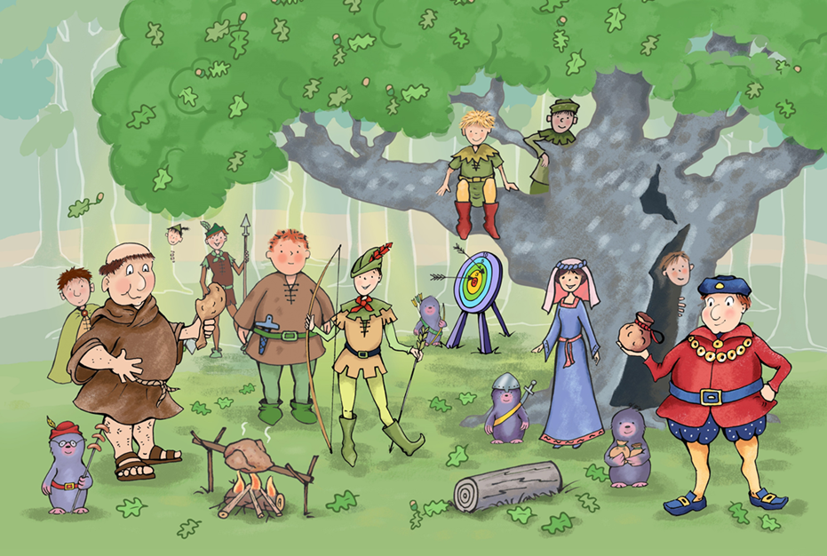
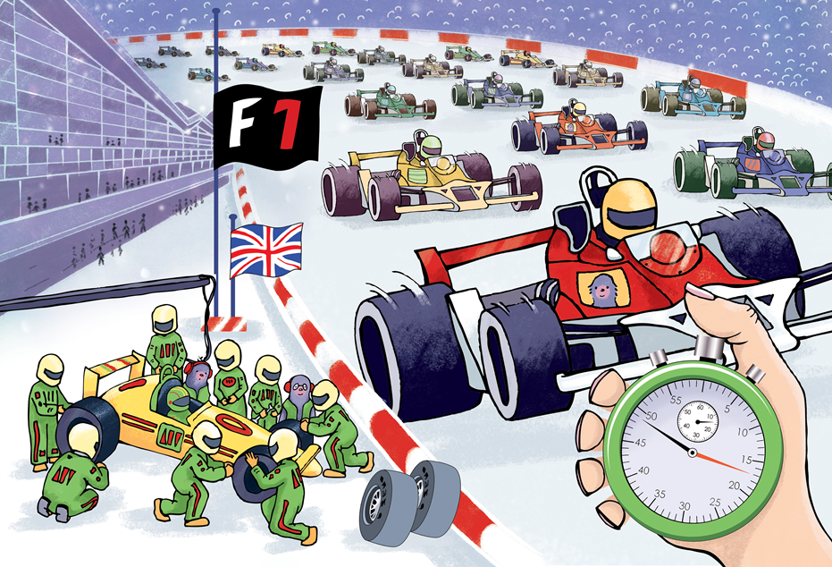
Big Pictures
What maths can you see? Discuss with your children at home using the key vocabulary from the previous page.

Slide 5

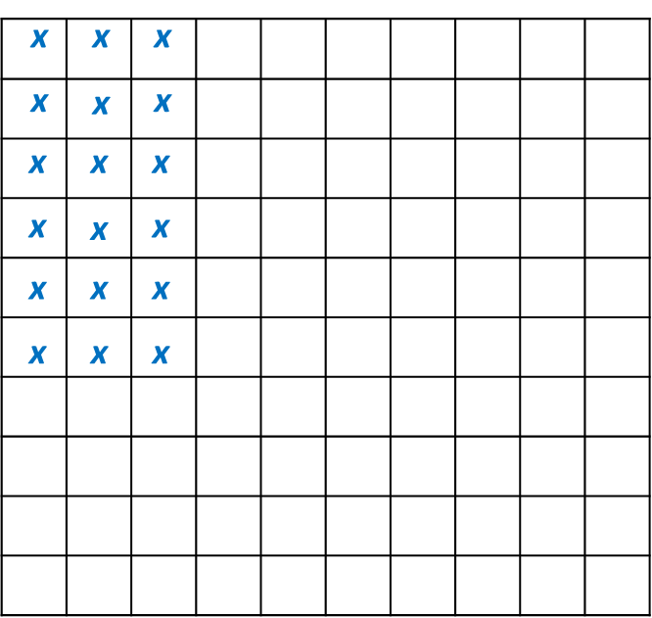
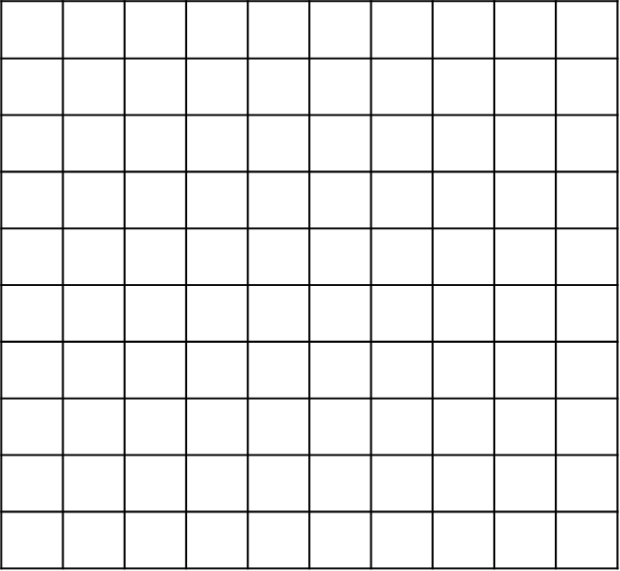
Try this at home – workshop game
Fill up the square!
You will need: A pair of dice or online dice, two 10 by 10 grids.
Each player has a ten by ten grid.
Take it in turns to roll the pair of dice. If I roll a 3 and a 6 I need to make an array that represents 3 x 6, see example to the right.
The aim of the game is to fill up the square.
multiply divide array product parts whole equation equal groups

Slide 6
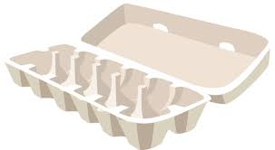
Try this at home – more ideas
Daily practice – multiplication and division facts
Pupils in Year 3 are expected to be able to recall multiplication and division facts for 2, 3, 4, 5, 8 and 10 multiplication tables and required to know all multiplication tables up to 12 by the end of Year 4. Practising these little and often can often be the best way to remember them. Why not try putting some tables practice into your daily routine such as on the walk to school or during a car journey?
Cooking
Cooking is a great way to practise a range of mathematical skills whilst having fun. To practice multiplication. Why not try multiplying or dividing the ingredients of a recipe by 2, 3 or 4 to change the portion size?
Array hunt
An array is a set of objects arranged into rows and columns. An egg box is an example of an array. What other arrays can you find around the house? What multiplication and division problems would they represent?
Helping children to find arrays in their daily lives will support their understanding of multiplicative relationships such as commutativity and the inverse.
Telling the Time
Although we haven’t focused on it in this workshop, another unit we cover in Spring is time. In Year 3 pupils are expected to tell the time to the nearest minute on an analogue clock. Daily practice of this at home will help to support your child. Questions to think about: Have you got an analogue clock or watch at home? If not where could they see one? Are there any outdoor clocks in your local area you could refer to?
Questions to support thinking
What do you think would happen if….
What’s the same? What’s different?
How do you know that?
Can you see a pattern? What would come next?
What else could go in this set? What couldn’t?
Websites
The Oxford Owl website has some helpful tips and activities for helping your child at home with times tables:
https://www.oxfordowl.co.uk/for-home/maths/times-tables-tips/
Online dice:
To play the dice game included in the pack you might want to use online dice.
https://www.random.org/dice/?num=2

