Slide 1


Year 2
Spring Term
Parent Maths Pack
Focus: Fractions and shape
This pack includes:
An overview of Mathematics Mastery
Learning overview for this term
Key vocabulary
Big Pictures
Games to play at home

Slide 2
Mathematics Mastery
What is ‘Mastery’?
The ‘mastery approach’ to teaching mathematics is the underlying principle of Mathematics Mastery. Instead of learning mathematical procedures by rote, we want your child to build a deep understanding of concepts which will enable them to apply their learning in different situations. To achieve this we aim to develop pupils’ Conceptual Understanding, Mathematical Thinking and Language and Communication. (See diagram below).
Representing concepts using objects, pictures, words and symbols; making connections
Making conjectures, trying out specific examples, organising, comparing, looking for patterns and generalising
Conceptual understanding
Explaining, justifying and discussing using accurate mathematical language
Mathematical problem solving
Mathematical thinking
Language & communication
Central to learning mathematics
Success for all
At school we believe all pupils can achieve success in maths. We encourage pupils to have a ‘growth mindset’ – a belief that effort leads to success and that challenges are opportunities to learn.
Here are a few tips to encourage your children at home with maths:
Talk to your children about everyday maths
Play games with them
Value mistakes as learning opportunities
Recognise that there is more than one way to work things out
Praise children for effort over outcome
Avoid saying things like “I’m useless at maths”

Slide 3
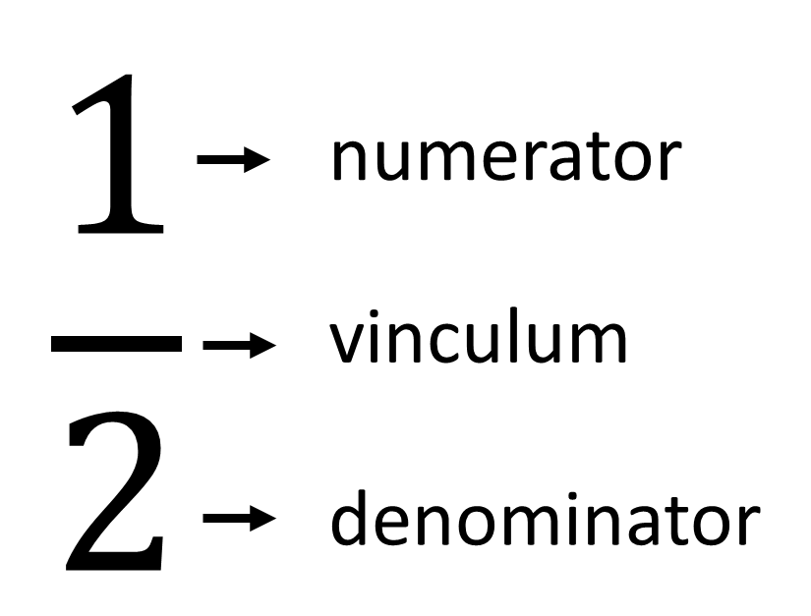
Autumn focus: Time and Fractions
Year 2 - Spring Curriculum Map
Time | Fractions | Addition and subtraction of 2-digit numbers
Tell the time on an analogue clock: quarter past, quarter to and five-minute intervals Calculate durations of time in minutes and seconds Sequence daily events Minutes in an hour and hours in a day | Part-whole relationships Fractions as part of a whole or a whole set Relate to division Equivalent fractions | Illustrate, represent and explain addition and subtraction involving regrouping including ‘Make Ten’, ‘Round and adjust’ and near doubles strategies
Money | Faces, shapes and patterns; lines and turns
• Recognise coins and notes • Use £ and p accurately • Add and subtract amounts • Calculate change | Explore, sort and describe 2-D shapes Lines of symmetry in 2-D shapes Identify 2-D shapes on 3-D shapes Compare and sort 2-D and 3-D shapes Use language to describe position, direction and rotation to follow a route
This term, two of our key focuses in Year 2 are fractions and shape:
Fraction Small Steps
Identify parts of a fraction
Find halves, thirds and quarters of a shape
Identify fractions of a shape with different numerators
Identify unit fractions of quantities
Identify non-unit fractions of quantities
Identify equivalent fractions
Shape Small Steps
Identify shapes by the number of vertices and sides
Identify right angles in shapes
Recognise lines of symmetry within 2D shapes
Describe and sort 2D shapes according to their properties
Identify 2D shapes on the surfaces of 3D shapes
Describe and create shape patterns
Compare and sort 2D and 3D shapes
Key vocabulary – Fractions:
The denominator tells us the number of equal parts
The numerator tells us the number of equal parts highlighted.
Unit fractions – fractions where the numerator is one
Non-unit fractions – fractions where the numerator is greater than one
part whole half quarter third
Key vocabulary – Shape:
Faces – One of the plane surfaces of a solid shape.
Edges – where two faces meet
Vertex or vertices – where two edges meet on a 3D shape or where two sides meet on a 2D shape (colloquially known as a corner.)
Sides - A straight line that forms part of the boundary of a shape. Shapes can have curved and straight sides
Right angle – an angle made by a quarter turn (90⁰)
Line of symmetry – an imaginary line that passes through the center of the shape or object and divides it into identical halves.
2D Shapes
circle triangle quadrilateral rectangle square oblong pentagon hexagon heptagon octagon
3D Shapes
sphere cone pyramid cylinder cube cuboid

Slide 4
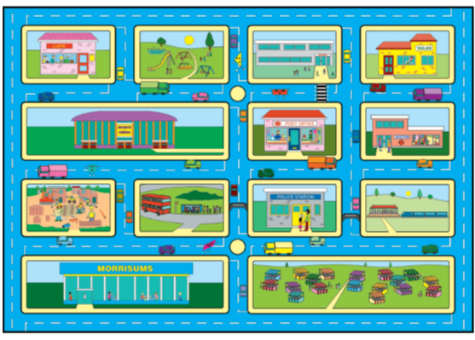
Big Pictures
What maths can you see? Discuss with your children at home using the key vocabulary from the previous page.

Slide 5
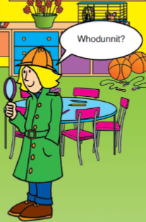
Try this at home – workshop games
Half a square
These images show a square that’s been split in half. How do you know they are correct?
Investigate: How many other ways can you split a square in half?
Variations to try at home: Why not try and see how many ways you can split a square in thirds or quarters? What happens if we change the shape?
Half numerator denominator I know because equal parts divide
Shape Detectives (2+ players)
3 or more players
One person becomes the shape master. The shape master secretly chooses a shape (it could be either 2D or 3D). The rest of the players take it in turns to ask the shape master a question. The shape master can only answer yes or no. The first person to correctly identify the shape on their turn wins!
2 player version
If playing with 2 people try setting a limit on the amount of questions e.g. you can only have six questions. If you identify the shape then the detective wins, if you don’t identify the shape, the shape master wins!
sides faces lines of symmetry quadrilateral 2D 3D edges vertices right angle

Slide 6
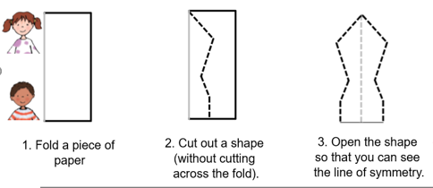
Try this at home – more ideas
Finding Halves, thirds and quarters
Try finding fractions in your daily routine at home. For example when sharing toys or food, “let’s have half each”, “how can I share this between the four of us?”.
When preparing meals or baking show your children how to measure half a cup or half of a jug of something.
Link this to time, "It has been half an hour since…" "We have half an hour until we get to go to grandma’s house."
Songs
Try singing this song with the actions about fractions:
https://www.bbc.co.uk/teach/supermovers/ks1-maths-fractions-with-joe-tracini/zmjy2sg
Exploring symmetrical shapes
With a partner take a piece of paper, each fold it in half and cut out a shape without crossing the fold.
Compare your shapes.
What’s the same? What’s different?
Go on a shape hunt
Try seeing what 2D and 3D shapes you can spot around the house, in the garden or on your way to school!
Shape of the week
Select a shape to be the shape of the week. How many of these shapes can your child spot during the week, at home and when you are out?
Questions to support thinking
What do you think would happen if….
What’s the same? What’s different?
How do you know that?
Can you see a pattern? What would come next?
What else could go in this set? What couldn’t?

