Slide 1
Year 1
Spring Term
Parent Maths Pack
Focus: Time and Fractions
This pack includes:
An overview of Mathematics Mastery
Key vocabulary
Key representations
Big Pictures
Games to play at home
Copyright © 2019 Mathematics Mastery.

Slide 2
Mathematics Mastery
What is ‘Mastery’?
The ‘mastery approach’ to teaching mathematics is the underlying principle of Mathematics Mastery. Instead of learning mathematical procedures by rote, we want your child to build a deep understanding of concepts which will enable them to apply their learning in different situations. To achieve this we aim to develop pupils’ Conceptual Understanding, Mathematical Thinking and Language and Communication. (See diagram below).
Representing concepts using objects, pictures, words and symbols; making connections
Making conjectures, trying out specific examples, organising, comparing, looking for patterns and generalising
Conceptual understanding
Explaining, justifying and discussing using accurate mathematical language
Mathematical problem solving
Mathematical thinking
Language & communication
Central to learning mathematics
Success for all
At school we believe all pupils can achieve success in maths. We encourage pupils to have a ‘growth mindset’ – a belief that effort leads to success and that challenges are opportunities to learn.
Here are a few tips to encourage your children at home with maths:
Talk to your children about everyday maths
Play games with them
Value mistakes as learning opportunities
Recognise that there is more than one way to work things out.
Praise children for effort over outcome.
Avoid saying things like “I’m useless at maths”.

Slide 3
Spring focus: Time and Fractions
Year 1 - Spring Curriculum Map
Time | Calculation strategies within 20 | Numbers to 50
Read, write and tell the time to o’clock and half past on analogue clock Sequencing daily activities Whole and half turns linked to time | Model, explain and choose addition and subtraction strategies | 2-digit numbers – represent, sequence, explore, compare. Count in 2s, 5s and 10s Describe and complete number patterns
Addition and subtraction within 20 | Fractions | Measures: Length and mass
Illustrate, explain and link addition and subtraction with equations Apply ‘Make Ten’ strategy Use language to quantify and compare difference | Represent and explain addition and subtraction strategies including ‘Make Ten’ Use known facts to add and subtract | Compare and measure lengths and mass using cm and kg Doubling and halving
This term, Year 1 focus on both time and fractions:
Time Small Steps
To know and order the months of the year
To put events in order
To understand time is measured in minutes and seconds
To read the time on an analogue clock to the nearest o’clock
To read the time on an analogue clock to half past
To read the time to o’clock and half past on an analogue clock
To read and write the time in words to o’clock and half past
To explore adding on hours and half hours
To use the language of position, movement and direction
Fractions Small Steps
To Identify half of a shape or object
To find half of a quantity
To identify one quarter of a shape or object
To find one quarter of a quantity
To describe position and direction using half, whole and quarter turns, including three quarter turns.
Key vocabulary – Time:
before after next then first o'clock half past minute hand hour hand morning afternoon time
analogue clock
Key vocabulary – Fractions:
quarter equal unequal part whole divide quarter turn half turn clockwise anti-clockwise

Slide 4
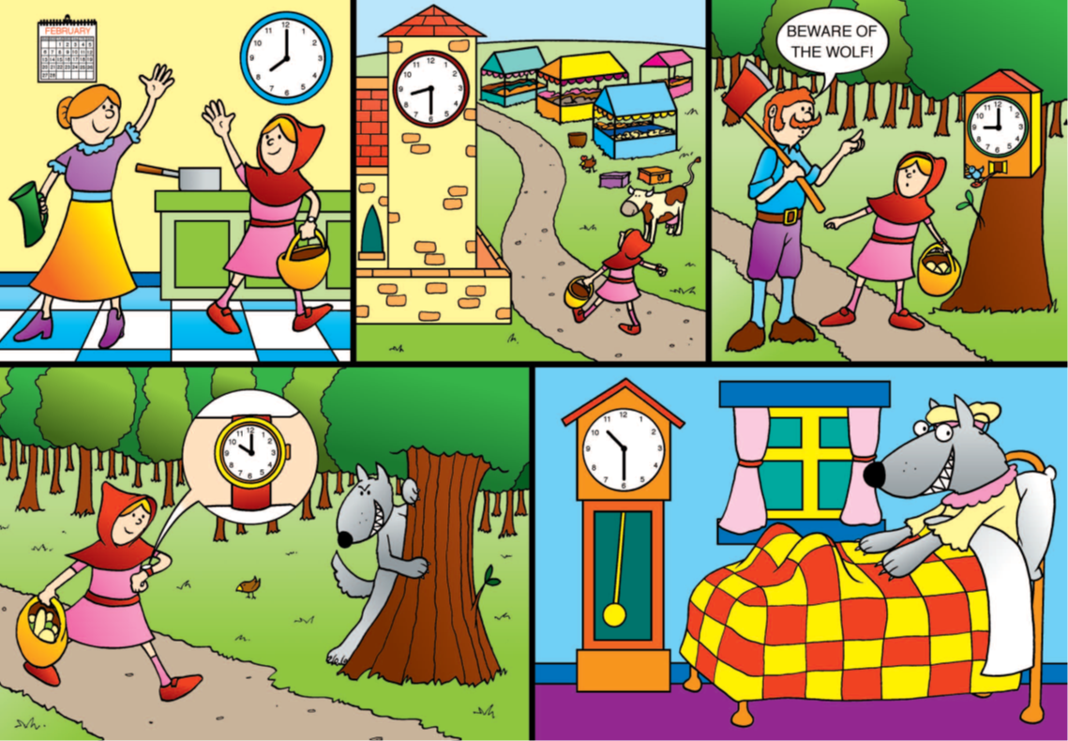
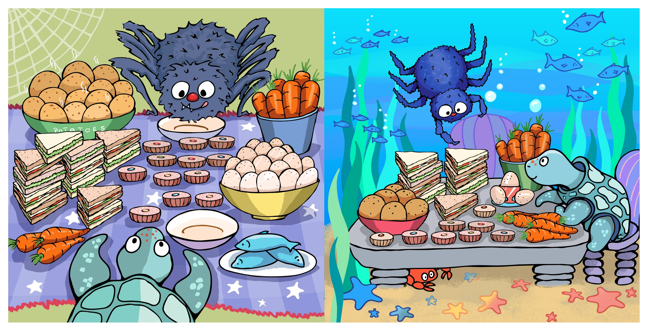
Big Pictures
What maths can you see? Discuss with your children at home using the key vocabulary from the previous page.

Slide 5
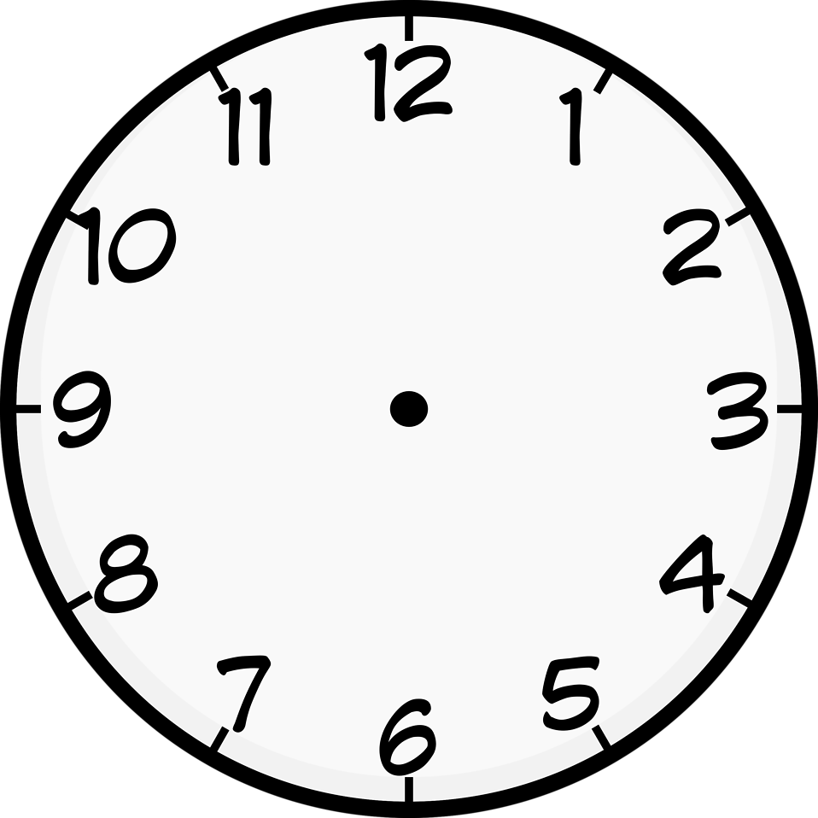
Try this at home – workshop games
First to 12 O’clock
Players: This game is for two players
What you need: Geared clock or paper clock faces
To start set the clock to 6 o’clock.
Player 1 chooses to put the clock forward wither one hour or half an hour and moves the clock hands to that time.
Pass the clock for player 2’s turn.
The winner is the player who moves the hands onto 12 o’clock.
Can you work out a winning strategy so that you can always beat your opponent?

Slide 6
Try this at home – more ideas
Months of the year
Talk about what happens in each month,
Create a calendar at home, marking on special occasions e.g. birthdays, festivals etc.
Play 'Game 21’
Game 21 – in pairs
Partner A: chooses to say either 1 or 2 months, e.g. January, February.
Partner B: continues to sequence the month choosing either 1 or 2 months, e.g. March
Take it in turns until you get to December. Whoever says December is the winner.
Make a paper plate clock at home
Why not make your own clock that can be used to practise telling the time or play the “Stop the clock” game on the previous page.
You will need: a paper plate, split pins, coloured card, felt tips.
Write numbers 1-12 around your clock, discuss how might be the best way to do this accurately with your children. E.g. start with 12, 6, 3 and 9 first.
Create arrow hands from coloured card, one longer to be the minute hand and a shorter one to be the hour hand
Use your split pins to attach these to the centre of the plate.
Songs
Try singing this song with the actions to learn how to tell the time https://www.bbc.co.uk/teach/supermovers/ks1-maths-telling-the-time/zk4t8xs
Finding Halves and quarters
Try finding halves and quarters in your daily routine at home. For example when sharing toys or food, “let’s have half each”, “how can I share this between the four of us?”.
When preparing meals or baking, show your children how to measure half a cup or half of a jug of something.
Link this to time, it has been half an hour since… We have half an hour until we get to go to grandma’s.
Questions to support thinking
What do you think would happen if….
What’s the same? What’s different?
How do you know that?
Can you see a pattern? What would come next?
What else could go in this set? What couldn’t?

