Slide 1


Reception
Spring Term
Parent Pack
Focus: Numbers to 20
This pack includes:
An overview of Mathematics Mastery
Big Pictures
Key vocabulary
Key representations for numbers to 20
Number games to play at home
Copyright © 2020 Mathematics Mastery.

Slide 2
Mathematics Mastery
What is ‘Mastery’?
The ‘mastery approach’ to teaching mathematics is the underlying principle of Mathematics Mastery. Instead of learning mathematical procedures by rote, we want your child to build a deep understanding of concepts which will enable them to apply their learning in different situations. To achieve this we aim to develop pupils’ Conceptual Understanding, Mathematical Thinking and Language and Communication. (See diagram below)
Representing concepts using objects, pictures, words and symbol; making connections between these
Making conjectures, trying out specific examples, organising, comparing, looking for patterns and generalising
Conceptual understanding
Explaining, justifying and discussing using accurate mathematical language
Mathematical problem solving
Mathematical thinking
Language & communication
Central to learning mathematics
Success for all
At school we believe all pupils can achieve success in maths. We encourage pupils to have a ‘growth mindset’ – a belief that effort leads to success and that challenges are opportunities to learn.
Here are a few tips to encourage your children at home with maths:
Talk to your child about everyday maths
Play games with them
Value mistakes as learning opportunities
Recognise that there is more than one way to work things out.
Praise your child for effort over outcome.
Avoid saying things like “I’m useless at maths”.
Copyright © 2020 Mathematics Mastery.

Slide 3
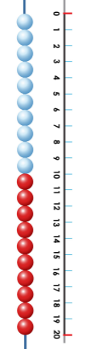
Spring focus: Numbers to 20
This term one of our key focusses in Reception is developing understanding of numbers to 20.
Reception - Spring Curriculum Map
Numbers within 10 | Addition and subtraction within 10 | Numbers within 15
Count up to ten objects Represent, order and explore numbers to ten One more or fewer, one greater or less | Explore addition as counting on and subtraction as taking away | Count up to 15 objects and recognise different representations Order and explore numbers to 15 One more or fewer
Grouping and sharing | Numbers within 20 | Doubling and Halving
Counting and sharing in equal groups Grouping into fives and tens Relationship between grouping and sharing | Count up to 10 objects Represent, order and explore numbers to 15 One more or fewer | Doubling and halving Relationship between
Key vocabulary for Reception – Numbers 1 – 20
zero (0) one (1) two (2) three (3) four (4) five (5) six (6) seven (7)
eight (8) nine (9) ten (10) eleven (11) twelve (12) thirteen (13) fourteen (14) fifteen (15) sixteen (16) seventeen (17) eighteen (18) nineteen (19) twenty (20) first (1st) second (2nd) third (3rd) fourth (4th) fifth (5th) sixth (6th) seventh ( 7th) eighth (8th) ninth (9th) tenth (10th) last how many count more fewer greater less same different next before after between
The ten frame is used to support early number skills
The bead string and number line further supports number sense
Copyright © 2020 Mathematics Mastery.

Slide 4
Big Pictures
What maths can you see? Discuss with your child at home using the key vocabulary on the previous page.
Copyright © 2020 Mathematics Mastery.

Slide 5
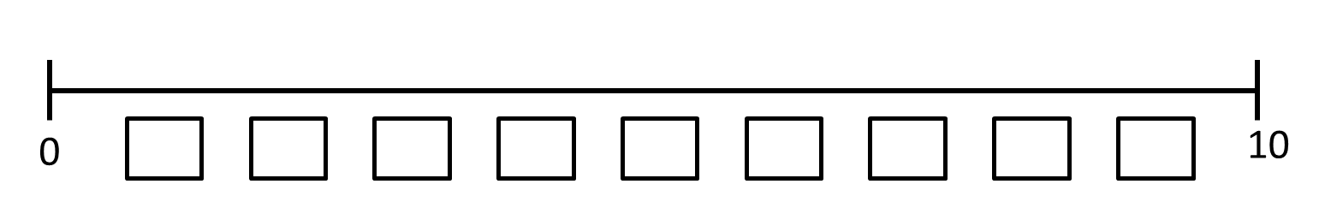
Try this at home – workshop games
Number line fun
Draw a line each and mark 0 and 10 at either end or use the template number line with given intervals.
Roll the dice and decide where that number would go and write it in.
Then it’s your partners turn.
The first to get all numbers from 1-9 wins.
Watch out! If you get a repeat number it will mean you have to wait until next time!
more less before after between order
1st 2nd 3rd 4th 5th 6th 7th 8th 9th 10th
5 questions!
Secretly write down a number between 0 and 20 and don’t show your partner.
Your partner needs to ask you questions using the star words greater than and less than. For example, “Is it less than 18?“
The aim of the game is to try and guess the number after asking 5 questions.
Example
Is it less than 18? Yes
Is it more than 5? Yes
Is it between 10 and 15? Yes
Is it more than 12? Yes
Is it less than 14? No
Guess: 14
Variations: The game can be simplified by using numbers 0 – 5, 0 – 10 or 0 – 15 instead of 0 – 20
Tip: have a number line out whilst playing. Ask children to refer to the number line before they ask their next question
more than less than between
Copyright © 2020 Mathematics Mastery.

Slide 6
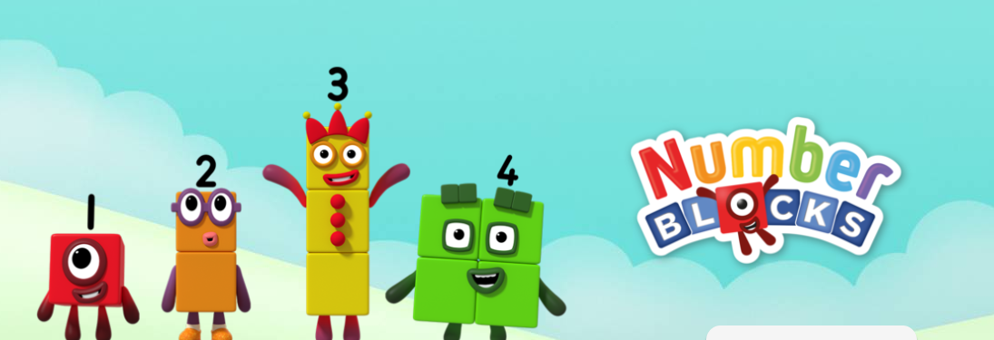
Try this at home – more ideas
Number of the week
Pick a number of the week. Where can you see examples of that number in your house, when you’re outside or on your way to school? What songs do you know that use that number? What stories do you know that use that number? What is one more or one less than that number?
How many ways
Select a number. Can you draw that number? Can you find that amount of objects? Can you show the number on a number line? Can you show me on your fingers? Can you show me on your fingers in a different way? How else can you show that number?
Exploring ordinal numbers
Discuss the order of events that happened e.g. What happened first? What happened second?
Gather a range of objects and ask, which is first? Which is fourth? etc.
Discuss who came first in an activity or game e.g. Who came third in the game? Who was the last one to arrive?
Useful Website – Number blocks
https://www.bbc.co.uk/cbeebies
/shows/numberblocks
Dice games
Playing with dice can be a great way to support your children with number bonds. If you don’t have a pair of dice, try these online dice:
http://dice.virtuworld.net/ https://rollthedice.online/en/cdice/0-9-dice
Sharing
Share up to twenty items into equal groups. For example sharing sweets between two people or creating groups of ten out of twenty objects.
Questions to support thinking
What do you think would happen if….
What’s the same? What’s different?
How do you know that?
What do you notice?
Can you see a pattern? What would come next?
What else could go in this set? What couldn’t?

