Slide 1
Year 3
Autumn Term
Parent workshop
Notes:
General Guidance about parent workshops
This workshop (if delivering in full) is designed to be completed in 50 minutes – 1 hour.
This workshop can be adapted and shortened to suit the priorities of your school, select the parts that are purposeful for you.
See our parent workshop guidance for an overview of the structure to support you in adapting.
Additionally you may wish to add in information specific to your school e.g. photos, videos, calculation policy.
Have on the tables the termly parent packs - these are to be taken home after the workshop and contain the big picture, vocabulary, key representations and games discussed in the workshop. This can also be sent out to parents who were not able to attend the workshop.
Resources
Mini whitebaords/pencil and paper
Hundreds, tens and ones dienes
0-9 spinners
Dice (2 per pair if possible)

Slide 2
What is Mathematics Mastery?
Year 3
Autumn Term
Success for all pupils
Based on research and evidence
Problem solving is at the heart
Focus is on depth, not acceleration
Aligned to National Curriculum
Focus on talk and reasoning about mathematics
Notes:
Time: 10 – 15 minutes for introduction slides 1 – 6. Depending on how familiar parents are from previous workshops in Year 2, you may just want to quickly recap on the DofD or go into more detail
Purpose: To give an overview of Mathematics Mastery.
Facilitation: Explain that the school follows a mastery curriculum. Mastery reflects the needs of the 2014 curriculum (click) with a greater focus on talk and reasoning (click) with problem solving at its heart. (click) The programme is based on research and evidence from across the world (click) and the curriculum is designed so that all pupils can succeed (click) regardless of background and ability, with greater focus on exploring a problem in depth rather than moving onto something new, for example pupils will fully explore numbers within 20 before moving onto larger numbers.

Slide 3
Depth not acceleration
Year 3
Autumn Term
What do we mean by depth?
How do we deepen understanding?
Notes:
Time: 10 – 15 minutes for introduction slides 1 – 6. Depending on how familiar parents are from previous workshops, you may just want to quickly recap on the DofD or go into more detail.
Purpose: To explain what we mean by depth.
Facilitation: Link to the previous slide, where it was noted that mastery is about having a deep understanding rather than moving on to something new, for example fully understanding numbers 1 – 20 before moving on to larger numbers. But what do we mean by depth? (click)
Explain that the Mathematics Mastery programme is based on three key principles (the dimensions of depth): conceptual understanding, language and communication and mathematical thinking.

Slide 4
Conceptual understanding
Year 3
Autumn Term
Representing a concept in different ways
Making connections between each way to deepen their understanding.
32
Notes:
Time: 10 – 15 minutes for introduction slides 1 – 6. Depending on how familiar parents are from previous workshops in Reception, you may just want to quickly recap on the DofD or go into more detail
Purpose: To explain how to develop conceptual understanding.
Facilitation: Have manipulatives out to show concrete examples of the number 32.
Explain in the following way: When a child first hears or see the number 32, they have little understanding of what it means: it’s only by seeing other representations that they build connections and develop understanding. (Animate slide)
Each representation build pupils' understanding of a different aspect of that number. For example: some of these representations place emphasis on place value (point out base ten/Dienes). Some of these help pupils to understand the order of numbers (number line). Some of these help pupils to see combinations to make 32 (part whole, Cuisenaire).
It’s important pupils see maths in different ways, make connections between these ways and deepen their understanding. Remember, just because a child knows how to say and count to 32 doesn’t mean that they know where it might lie on a number line, how far away it is from 40 or how to separate it into three tens and two ones etc.
Explain that at home parents can use everyday items such as buttons, coins, money. For place value, straws bundled into tens with an elastic band make a good representation.

Slide 5
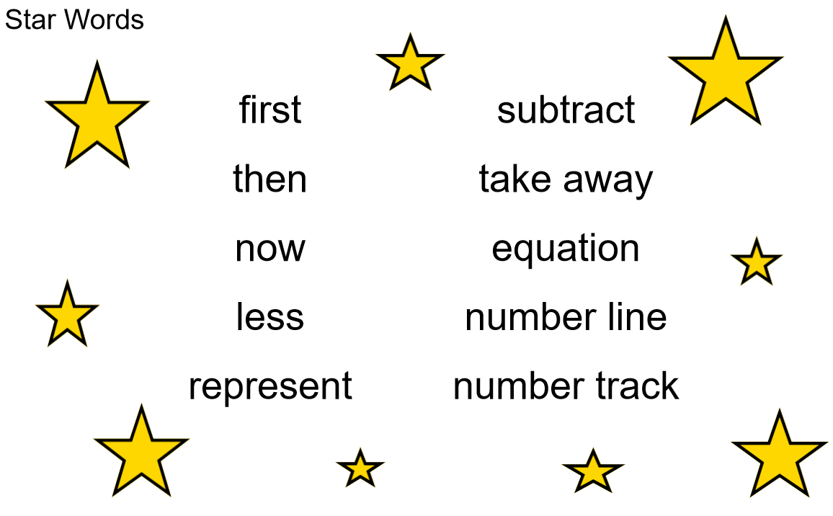
Language and communication
Year 3
Autumn Term
Can you say that in a full sentence, please?
Notes:
Time: 10 – 15 minutes for introduction slides 1 – 6. Depending on how familiar parents are from previous workshops in Reception, you may just want to quickly recap on the DofD or go into more detail
Purpose: To explain how to develop language and communication in maths.
Facilitation: Emphasise that the programme and your school place an emphasis on pupils using precise mathematical vocabulary. Each lesson has key words, called star words, and there will be some of this term’s star words included in the parent pack to take home.
Share that we encourage pupils to speak in full sentences. This supports them in applying that vocabulary and with more practise builds their ability to have a mathematical discussion and reason about the maths. Mathematical talk is central to all maths lessons and happens throughout the lesson. It helps to build pupils’ understanding and gives them opportunity to work together and share strategies.
Explain that when working with children at home parents should aim to talk about maths rather than give them a sheet of maths to do alone. They could try asking your child about this week’s star words, “What new maths words did you use today? How do you use them in a sentence?”. Emphasise that the more they discuss maths with their child the more they will get an idea of their understanding.

Slide 6
Mathematical thinking
Year 3
Autumn Term
Do you think … would always happen?
What’s the same? What’s different?
What do you think would happen if…?
How do you know that?
What else could go in this set? What couldn’t?
Can you see a pattern? What would come next?
Notes:
Time: 10 – 15 minutes for introduction slides 1 – 6. Depending on how familiar parents are from previous workshops, you may just want to quickly recap on the DofD or go into more detail.
Purpose: To explain how to develop mathematical thinking.
Facilitation: Share in the following way: Pupils are encouraged to think mathematically which includes imagining, sorting and comparing, making connections to things that you already know, spotting patterns and drawing conclusions.
These are things children do without being taught and you may have noticed your child doing them in their play, e.g. pointing out patterns, or sorting their toys into groups according to certain properties.
The slide shows some question prompts to support your child with mathematical thinking.

Slide 7
Creating a positive attitude to maths
Year 3
Autumn Term
Talk to your children about everyday maths
Play maths games with them
Value mistakes as learning opportunities
Recognise that there is more than one way to work things out
Praise children for effort over outcome
Avoid saying things like “I’m useless at maths”
Notes:
Time: 2 minutes
Purpose: To give advice about opportunities to support with mathematics at home
Facilitation:
Share, making the following points:
Everyday Talk: try to talk about maths when doing activities like shopping, cooking, time etc. 5 minutes a day can make a big difference!
Play with your child: puzzles, board games, verbal games help them to apply vocabulary, problem solve and reason. Interaction and dialogue that you cannot get from playing on a computer or iPad!
Mistakes are opportunities for learning.
You may have learned one method at school but at school we actively encourage children to seek out multiple strategies and choose one that works for them and build connections between strategies.
Praise children for trying hard and overcoming challenges. If pupils are only praised for getting everything correct they may not try and challenge themselves as they may be afraid to get things wrong.
6) Try to avoid saying things like “I’m useless at maths”. You may remember maths as being hard, but if your child hears you saying that, or that it's not important to be good at maths, they will believe that too!

Slide 8
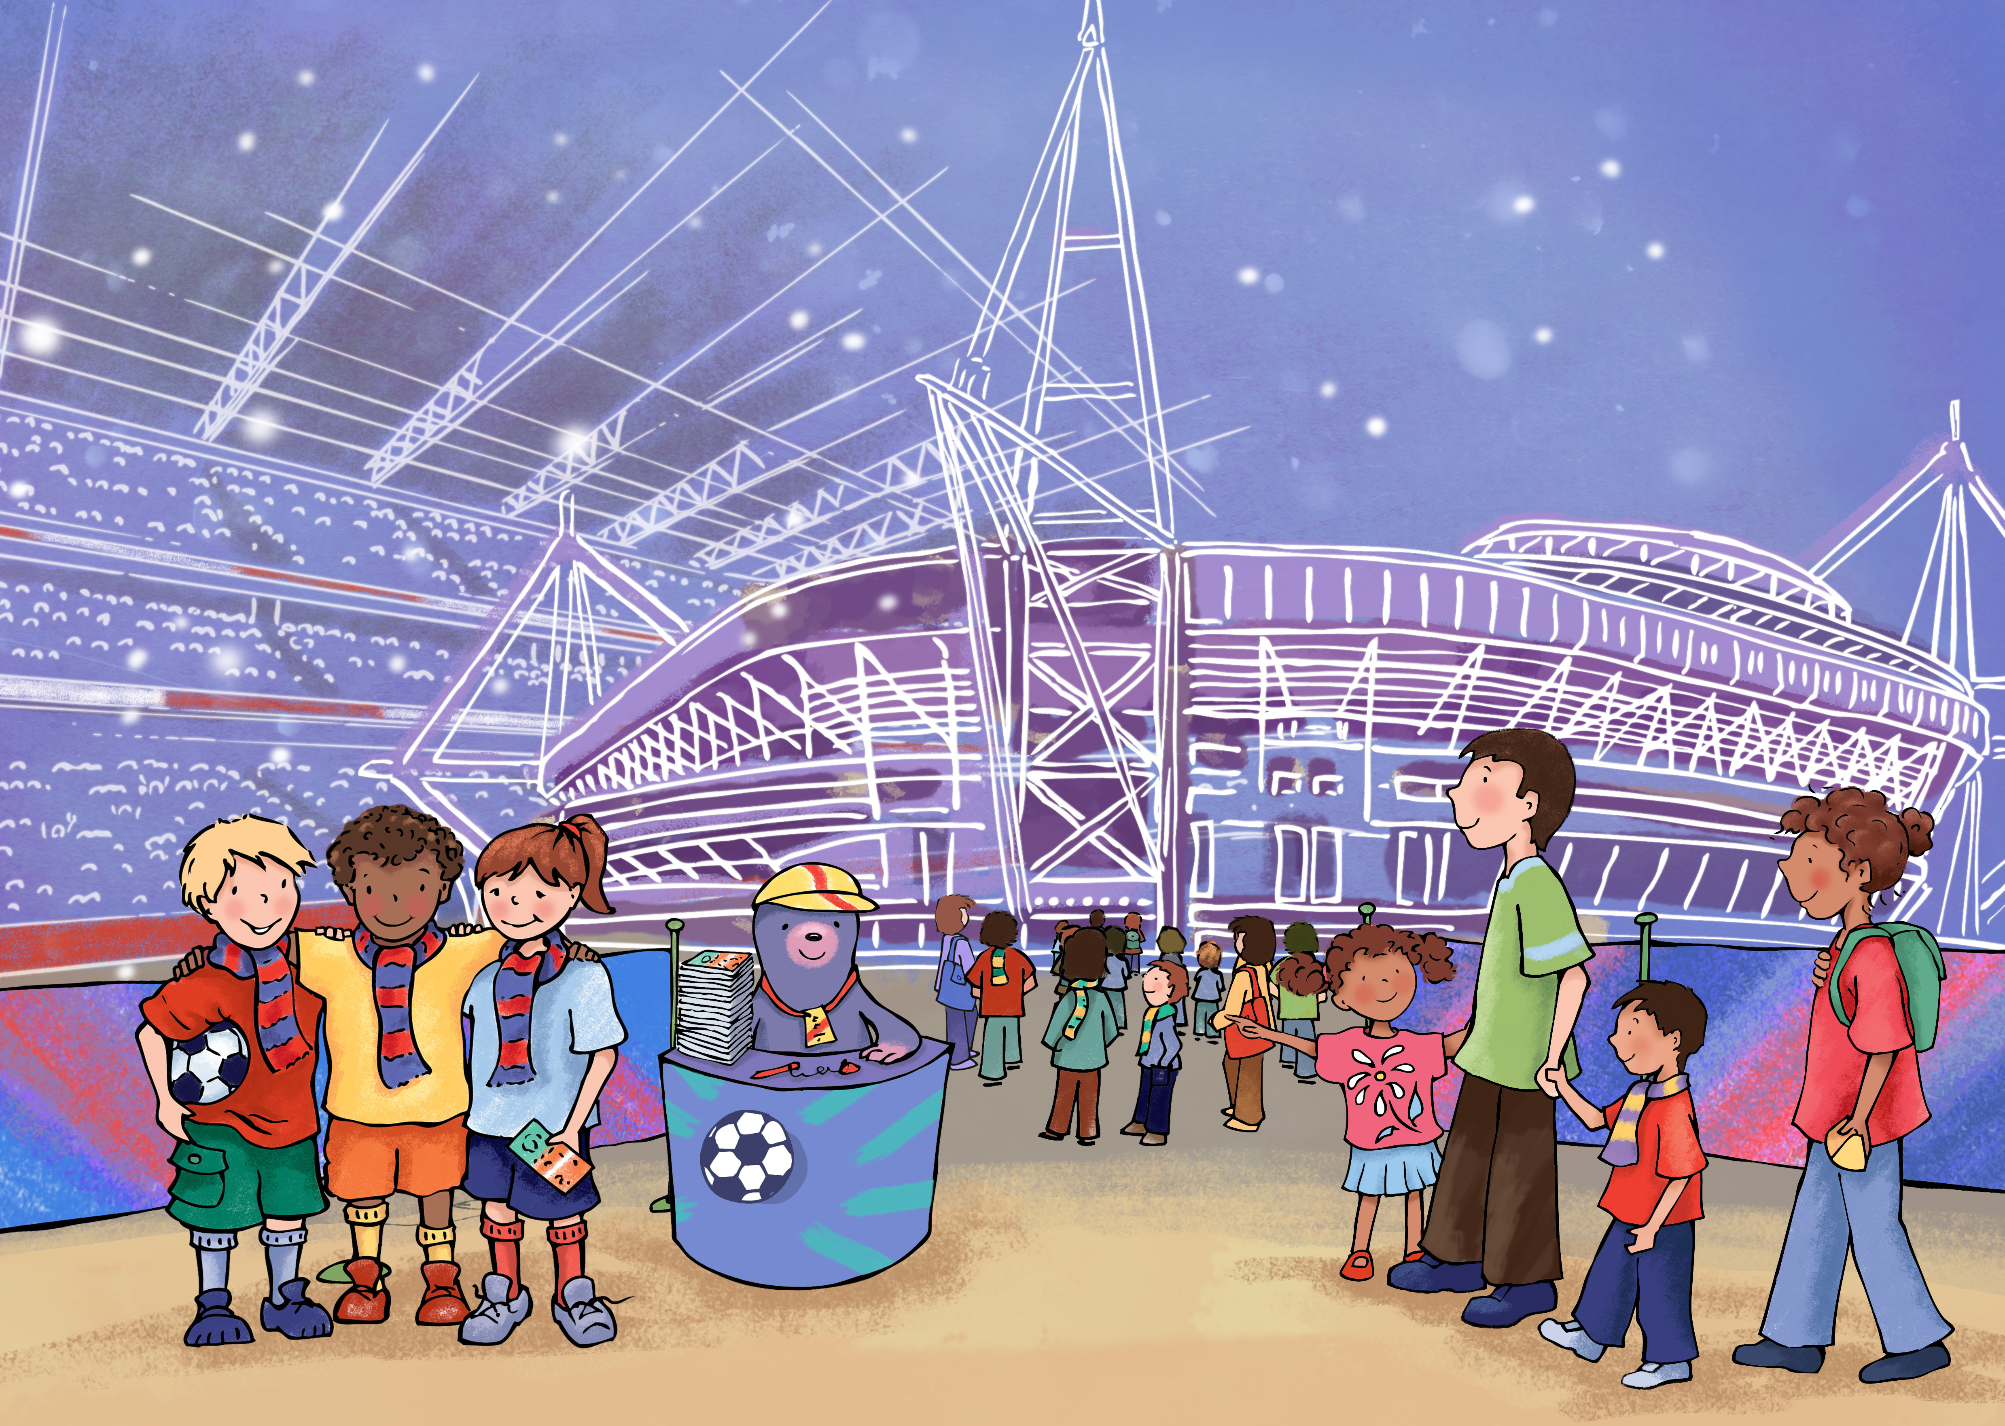
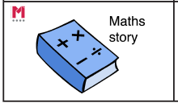
Big pictures
Year 3
Autumn Term
What maths can you see?
?
Notes:
Time: 5 minutes
Purpose: To show parents how we use the big picture to connect maths to a context/the real world.
Facilitation: Explain that the big pictures are used to provide children with opportunities to connect maths with the real world, make connections and supports mathematical talk and reasoning. The Big Pictures in Year 3 relate to places in the UK. Give parents a copy of the Wembley Stadium big picture (in parent pack or display on the board) and explain that this is used in the place value unit, which is our focus today. Allow them to discuss what maths they can see with their children.
Mathematics Mastery encourages pupils to make connections between the maths they are doing and real life contexts. Often pupils are asked to relate the maths they are doing to a real life problem which we call a “maths story”. (click to animate sticker)

Slide 9
Year 3 Autumn Curriculum Map
Year 3
Autumn Term
Number sense and exploring calculation strategies | Place value | Graphs
Read, write and order and compare numbers to 100 Calculate mentally using know facts, round and adjust, near doubles, adding on to find the difference Derive new facts from a know fact | Read, write, represent, partition, order and compare 3-digit numbers Find 10 and 100 more or less Round to the nearest multiple of 10 and 100 | Collect, interpret and present data using charts and tables
Addition and Subtraction | Length and Perimeter
Develop and use a range of mental calculation strategies Illustrate and explain formal written methods – column method | Measure, draw and compare lengths Add and subtract lengths Calculate perimeter
Notes:
Time: 2 minutes
Purpose: To share the Autumn curriculum map with parents.
Facilitation: Allow parents to view the Year 3 curriculum map for Autumn and briefly talk through the focus of each unit (no need to go through the individual objectives)
Explain that the Autumn map is in the parent pack.
You may want to handout entire Year 3 curriculum map for parents to take home. Entire curriculum map: http://toolkit.mathematicsmastery.org/download/5ce3b99b3c6e1

Slide 10
In focus: Place value
Year 3
Autumn Term
Value of each digit in 3-digit numbers
Partition 3 digit numbers in different ways
Order and compare 3-digit numbers
Add and subtract 10 or 100
Round numbers to the nearest 10 or 100
Notes:
Time: 2 minutes
Purpose: To share the progressive learning steps pupils will follow for addition and subtraction.
Facilitation: In this workshop we have chosen to focus on place value as this is a big focus for us this term and learning from these units will be used and applied throughout the year.
In Year 3 pupils begin to explore numbers with up to three digits, they are expected to have a deep understanding of the value of each digit, for example in 258, they understand that the 2 is worth 200 and understand what 200 would look like in comparison to other numbers. They are expected to be able to split numbers into parts (partition) numbers in different ways then order and compare these numbers, find 10 less or more and finally round numbers to the nearest 10 and 100.
The learning in this unit aims to increase children’s number sense and will support pupils when they begin to do calculations later in the term and throughout the year. To fully understand the value of each digit in three digit numbers pupils use various resources and pictures to represent numbers.

Slide 11
Representing 3-digit numbers
Year 3
Autumn Term
245
hundreds
tens
ones
Notes:
Time: 2 minutes
Purpose: To model how to represent the number 245 using Dienes
Facilitation: In school we use Dienes blocks to represent numbers. Point out the value of each block. (Use concrete dienes rather than the PowerPoint if possible.)
Model how we would represent 245.

Slide 12
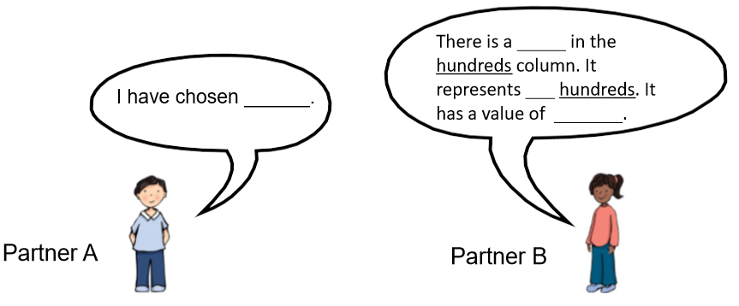
Representing 3-digit numbers
Year 3
Autumn Term
Talk Task
Choose one of the three digit numbers below. Represent each digit of your chosen number with Dienes and say the value of each digit.
367 672 302 862 179 750
Hundreds tens ones digit numeral place value
Notes:
Time: 3-5 minutes
Purpose: To show an example of a Talk Task and to allow parents to explore representing 3-digit numbers with Dienes.
Facilitation: Explain that the board shows a Talk Task. Each lesson pupils carry out a verbal task before completing their independent work to build their mathematical language and reasoning as well as giving teachers an opportunity to assess their understanding.
Point out the star words and explain that pupils are encouraged to include these words in their conversations.
Model the Talk Task which is taken from Y3 U2 L1. Allow parents to have a go.

Slide 13
Partitioning numbers
Year 3
Autumn Term
146
146
146
100
40
6
30
6
90
hundreds tens ones value partition is equal to
Notes:
Time: 3 minutes
Purpose: To explain partitioning and how to partition in different ways
Facilitation: Point out the star words and explain what partition means. Use Dienes to model partitioning 146 into hundreds tens and ones. Explain that it is important that pupils can partition into hundreds tens and ones but also that they can partition in other ways.
Move one of the tens dienes to the next part. 146 = 110 + 30 + 6
We can also change the amount of parts. Model regrouping the hundred into ten tens and then put 90 into the first part. We have 56 remaining. 146 = 90 + 56. Explain that we encourage children to come up with lots of different ways of partitioning the same number and write the accompanying number sentences.

Slide 14
Partitioning numbers
Year 3
Autumn Term
243
hundreds tens ones value partition is equal to
Notes:
Time: 5 minutes
Purpose: To allow parents to partition in different ways using dienes
Facilitation: Allow parents and their children to partition 243 in different ways using the dienes and then writing the accompanying calculations. Share some of the examples created.

Slide 15
Rounding Numbers
Year 3
Autumn Term
$$147$$
Notes:
Time: 3 minutes
Purpose: To show parents the number line model for rounding
Facilitation: Explain that in Year 3 pupils are expected to round numbers with three digits to the nearest ten and hundred. Pupils use a number line whilst doing this (you may wish to show a bead string as well as or in place of a number line in this example), rather than just teaching rules such as 0-4 rounds down, the number line helps them to understand which multiple of ten and hundred the number is nearest to and avoids pupils getting confused or mixed up when trying to remember rules that they might not understand.
Model rounding 147 to the nearest ten using the number line/bead sting.
You may want to model rounding to the nearest hundred afterwards.

Slide 16
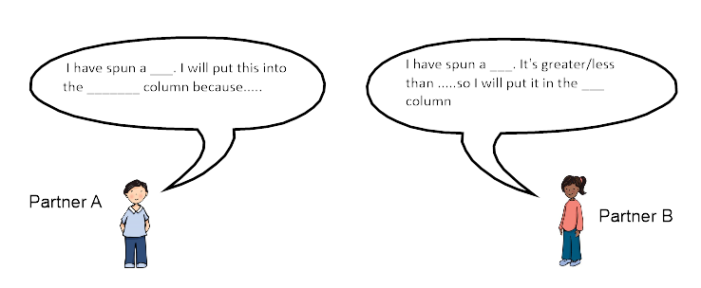
Let’s Explore – Place Vale battle
Year 3
Autumn Term
You will need: 0-9 spinner
Player 1 spins the spinner and chooses which column to place the digit in. (hundreds, tens or ones)
Player 2 then takes a turn.
When all three columns are filled, the highest number wins.
I have spun a ____. I will put this into the ________ column because…
I have spun a ____. It’s greater/less than …so I will put it into the ___column.
hundreds tens ones value column
Notes:
Time: 2 minutes
Purpose: To model how to play game 1
Facilitation: Model how to play place value battle using the sentence stems, taken from unit 2 lesson 3. Use the spinner or a 0-9 dice, select a column to place your digit and create it in Dienes, the largest number wins. Give parents a spinner template to take home.
Explain that pupils are encouraged to be using mathematical language whilst playing.

Slide 17
Let’s Explore – Rounding battle
Year 3
Autumn Term
10
20
30
40
50
60
70
You will need: a pair of dice (or roll one die twice)
A list of multiples of ten ranging from 10 – 70.
Roll the pair of dice, decide which order you would like to place the numbers to make a two digit number. For example if you rolled a two and a five, you could make 25 or 52.
Round the number to the nearest multiple of ten and cross that multiple of ten off your list.
The first to cross out all multiples of ten is the winner.
round multiple digit value nearest multiple of ten
Notes:
Time: up to15 minutes
Purpose: To explain how to play game 2 and give parents and their children time to play both games.
Facilitation: 2+ players, this game might be good to play as a group.
Model how to start playing the game, taking a turn and using a hand drawn number line to round. Explain that this game should be without time pressure and pupils may want to use the number line strategy to round, especially while still getting used to rounding fluently.
Explain that there is less chance of getting the number 70 ( you will need a six and a five or a double six) so you may want to just play numbers 10 -60 when first playing and getting used to rounding fluently. If you do roll a 6 and a five towards the beginning of the game, it’s best to round to 70 rather than 60, as there’s less chance of getting the 70 later on in the game.
Variation: You could also use the spinner or a 0-9 dice to play this game using multiples 0 - 100

Slide 18
Helping at home
Year 3
Autumn Term
Games played today
Exploring the big picture, vocabulary and activities in this term’s Maths Pack
Talking about maths during “everyday” routines e.g. shopping, cooking, daily routine, calendar.
Board games
Singing
Practising times tables (2,3,4, 5, 8 and 10)
Telling the time
Notes:
Time: 1 minute
Purpose: To suggest activities to build upon learning in school.
Facilitation: Go through each bullet point.
Explain that today’s games and some further activities to support addition and subtraction can be found in the maths pack.
Make sure everyone takes their maths pack home.

Slide 19
Year 3
Autumn Term
Thank you
Notes:
Thank parents for attending the workshop and take any questions afterwards.

