Slide 1
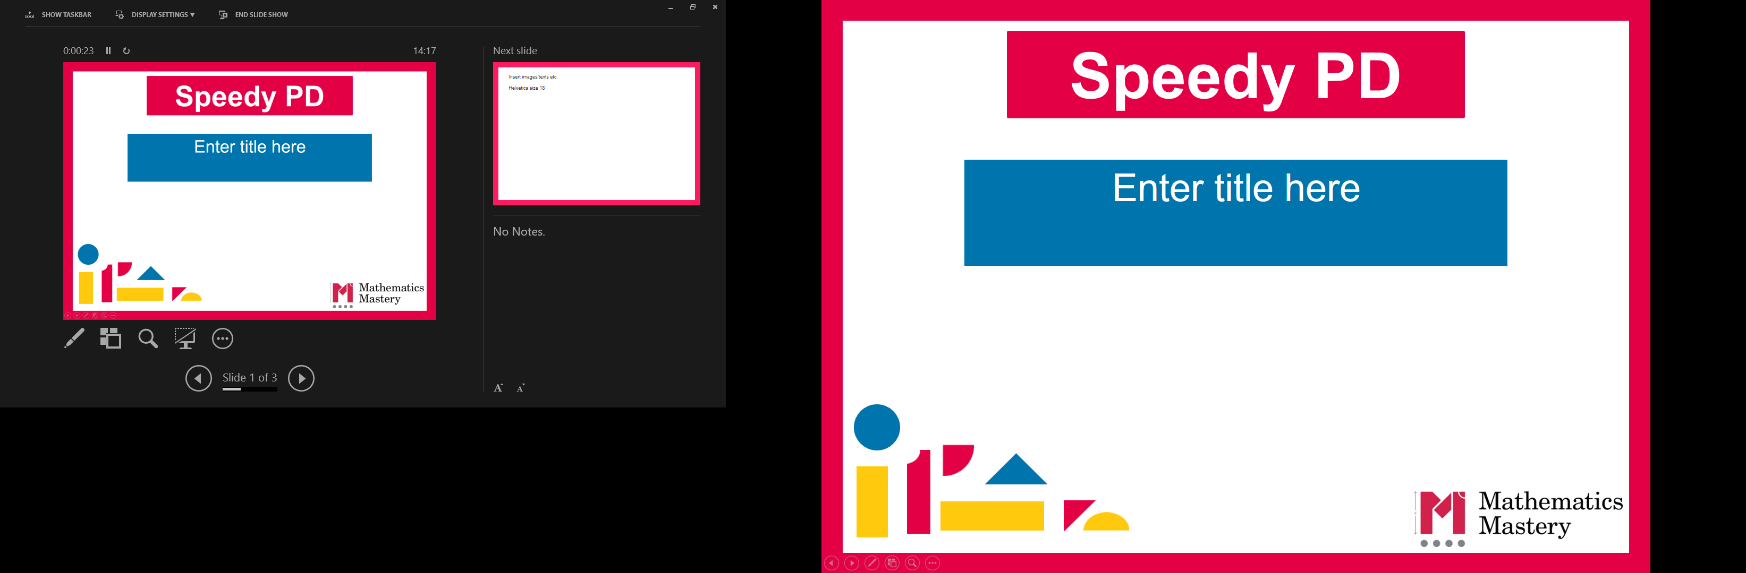

Year 2
Autumn Term
Parent workshop
Notes:
General Guidance about parent workshops
This workshop (if delivering in full) is designed to be completed in 50 minutes – 1 hour.
This workshop can be adapted and shortened to suit the priorities of your school. Select the parts that are purposeful for you.
See our parent workshop guidance for an overview of the structure to support you in adapting.
Additionally you may wish to add in information specific to your school e.g. photos, videos, calculation policy.
Have on the tables the termly parent packs - these are to be taken home after the workshop and contain the Big Picture, vocabulary, key representations and games discussed in the workshop. This can also be sent out to parents who were not able to attend the workshop.
Resources
Printed Parent Maths Packs
Counters
Dienes
Part whole templates
Dice for game one
Counters and plastic cups for game two
Blank paper and pencils or mini whiteboards for games.

Slide 2
What is Mathematics Mastery?
Year 2
Autumn Term
Success for all pupils
Based on research and evidence
Problem solving is at the heart
Focus is on depth, not acceleration
Aligned to National Curriculum
Focus on talk and reasoning about mathematics
Notes:
Time: 10 – 15 minutes for introduction slides 1 – 6. Depending on how familiar parents are from previous workshops, you may just want to quickly recap on the Dimensions of Depth, or go into more detail.
Purpose: To give an overview of Mathematics Mastery.
Facilitation: Explain that the school follows a mastery curriculum. Mastery reflects the needs of the 2014 curriculum (click) with a greater focus on talk and reasoning (click) with problem solving at its heart. (click) The programme is based on research and evidence from across the world (click) and the curriculum is designed so that all pupils can succeed (click) regardless of background and ability, with greater focus on exploring a problem in depth rather than moving onto something new, for example pupils will fully explore numbers within 20 before moving onto larger numbers.

Slide 3
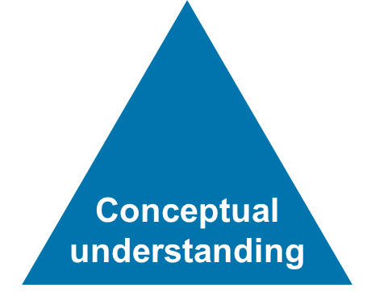
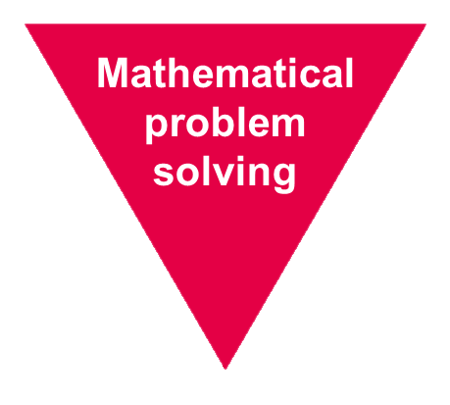
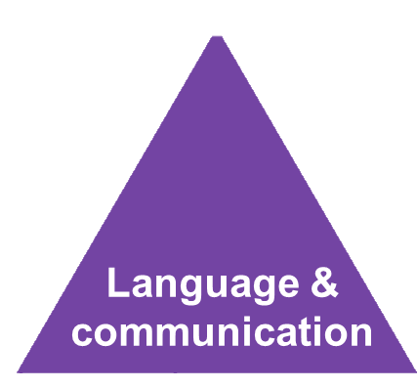
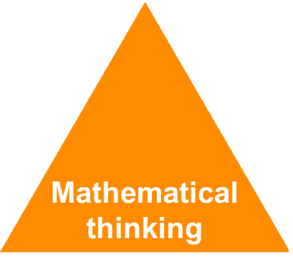
Depth not acceleration
Year 2
Autumn Term
What do we mean by depth?
How do we deepen understanding?
Notes:
Time: 10 – 15 minutes for introduction slides 1 – 6. Depending on how familiar parents are from previous workshops, you may just want to quickly recap on the DofD or go into more detail.
Purpose: To explain what we mean by depth.
Facilitation: Link to the previous slide, where it was noted that mastery is about having a deep understanding rather than moving on to something new, for example fully understanding numbers 1 – 20 before moving on to larger numbers. But what do we mean by depth? (click)
Explain that the Mathematics Mastery programme is based on three key principles (the dimensions of depth): conceptual understanding, language and communication and mathematical thinking.

Slide 4
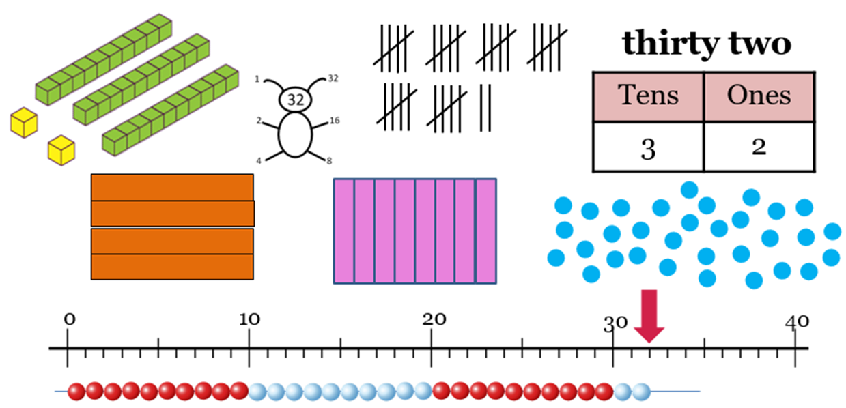
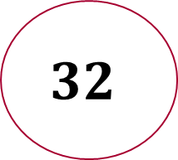
Conceptual understanding
Year 2
Autumn Term
Representing a concept in different ways
Making connections between each way to deepen their understanding.
$$32$$
Notes:
Time: 10 – 15 minutes for introduction slides 1 – 6. Depending on how familiar parents are from previous workshops, you may just want to quickly recap on the DofD or go into more detail
Purpose: To explain how to develop conceptual understanding.
Facilitation: Have manipulatives out to show concrete examples of the number 32.
Explain in the following way: When a child first hears or see the number 32, they have little understanding of what it means: it’s only by seeing other representations that they build connections and develop understanding. (Animate slide)
Each representation build pupils' understanding of a different aspect of that number. For example: some of these representations place emphasis on place value (point out base ten/Dienes). Some of these help pupils to understand the order of numbers (number line). Some of these help pupils to see combinations to make 32 (part whole, Cuisenaire).
It’s important pupils see maths in different ways, make connections between these ways and deepen their understanding. Remember, just because a child knows how to say and count to 32 doesn’t mean that they know where it might lie on a number line, how far away it is from 40 or how to separate it into three tens and two ones etc.
Explain that at home parents can use everyday items such as buttons, coins, money. For place value, straws bundled into tens with an elastic band make a good representation.

Slide 5
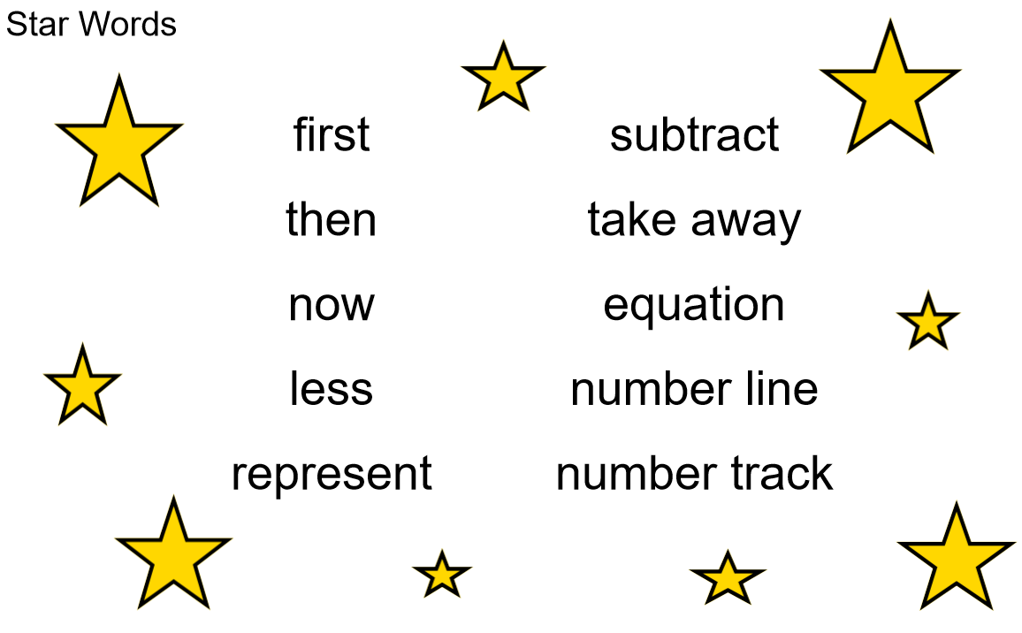

Language and communication
Year 2
Autumn Term
Can you say that in a full sentence, please?
Notes:
Time: 10 – 15 minutes for introduction slides 1 – 6. Depending on how familiar parents are from previous workshops, you may just want to quickly recap on the DofD or go into more detail
Purpose: To explain how to develop language and communication in maths.
Facilitation: Emphasise that the programme and your school place an emphasis on pupils using precise mathematical vocabulary. Each lesson has key words, called star words, and there will be some of this term’s star words included in the parent pack to take home.
Share that we encourage pupils to speak in full sentences. This supports them in applying that vocabulary and with more practise builds their ability to have a mathematical discussion and reason about the maths. Mathematical talk is central to all maths lessons and happens throughout the lesson. It helps to build pupils’ understanding and gives them opportunity to work together and share strategies.
Explain that when working with children at home parents should aim to talk about maths rather than give them a sheet of maths to do alone. They could try asking your child about this week’s star words, “What new maths words did you use today? How do you use them in a sentence?”. Emphasise that the more they discuss maths with their child the more they will get an idea of their understanding.

Slide 6
Mathematical thinking
Year 2
Autumn Term
Do you think … would always happen?
What’s the same? What’s different?
What do you think would happen if…?
How do you know that?
What else could go in this set? What couldn’t?
Can you see a pattern? What would come next?
Notes:
Time: 10 – 15 minutes for introduction slides 1 – 6. Depending on how familiar parents are from previous workshops, you may just want to quickly recap on the DofD or go into more detail.
Purpose: To explain how to develop mathematical thinking.
Facilitation: Share in the following way: Pupils are encouraged to think mathematically which includes imagining, sorting and comparing, making connections to things that you already know, spotting patterns and drawing conclusions.
These are things children do without being taught and you may have noticed your child doing them in their play, e.g. pointing out patterns, or sorting their toys into groups according to certain properties.
The slide shows some question prompts to support your child with mathematical thinking.

Slide 7
Creating a positive attitude to maths
Year 2
Autumn Term
Talk to your children about everyday maths
Play maths games with them
Value mistakes as learning opportunities
Recognise that there is more than one way to work things out
Praise children for effort over outcome
Avoid saying things like “I’m useless at maths”
Notes:
Time: 2 minutes
Purpose: To give advice about opportunities to support with mathematics at home
Facilitation: Share, making the following points:
Everyday Talk: try to talk about maths when doing activities like shopping, cooking, time etc. 5 minutes a day can make a big difference!
Play with your child: puzzles, board games, verbal games help them to apply vocabulary, problem solve and reason. Interaction and dialogue that you cannot get from playing on a computer or iPad!
Mistakes are opportunities for learning.
You may have learned one method at school but at school we actively encourage children to seek out multiple strategies and choose one that works for them and build connections between strategies.
Praise children for trying hard and overcoming challenges. If pupils are only praised for getting everything correct they may not try and challenge themselves as they may be afraid to get things wrong.
6) Try to avoid saying things like “I’m useless at maths”. You may remember maths as being hard, but if your child hears you saying that, or that it's not important to be good at maths, they will believe that too!

Slide 8

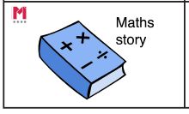
Big Pictures
Year 2
Autumn Term
What maths can you see?
Notes:
Time: 3 minutes
Purpose: To show parents how we use the big picture to connect maths to a context/the real world.
Facilitation: Explain that the Big Pictures are used to provide children with opportunities to connect maths with the real world, make connections and support mathematical talk and reasoning. The Big Pictures in Year 2 relate to occupations - this Big Picture relates to the occupation of a bus driver. Give parents a copy of the Big Picture (in parent pack or display on the board) and explain that this is used in the addition and subtraction unit, which is our focus today. Allow them to discuss what maths they can see with their children.
Mathematics Mastery encourages pupils to make connections between the maths they are doing and real life contexts. Often pupils are asked to relate the maths they are doing to a real life problem which we call a “maths story”. (click to animate sticker)

Slide 9
Year 2 Autumn Curriculum Map
Year 2
Autumn Term
Numbers within 100 | Addition and subtraction of 2-digit numbers | Addition and subtraction word problems
Read, write, represent, partition, compare and order numbers to 100 Explore patterns including odds and evens, tens and ones | Apply number bonds to add and subtract Represent and explain addition and subtraction of two 2-digit numbers. Add three 1-digit numbers | Introduction to bar models as a representation Create, label and sketch bar models
Measures: Length | Graphs | Multiplication and division: 2, 5, and 10
Draw and measure lengths in centimetres Use <, > and = to compare and order lengths in metres and centimetres | Represent and interpret: pictograms, block diagrams, tables and tally charts. | Calculate the times tables of 2, 5, and 10 by skip counting Relate the 2 times table to doubling Explore representations of multiplication and division Commutativity
Notes:
Time: 2 minutes
Purpose: To share the Autumn curriculum map with parents.
Facilitation: Allow parents to view the Year 2 curriculum map for Autumn and briefly talk through the focus of each unit (no need to go through the individual objectives).
Explain that the Autumn map is in the parent pack.
You may wish to provide the entire Year 2 curriculum map for parents to take home. Entire curriculum map: http://toolkit.mathematicsmastery.org/download/5ce3b99ad5406

Slide 10
In focus: addition and subtraction
Year 2
Autumn Term
Addition and subtraction of 2-digit numbers
Using number bonds in addition and subtraction
Adding and subtracting ones with a two-digit number
Adding and subtracting multiples of ten
Adding and subtracting tens with a two digit numbers
Adding and subtracting two 2-digit number
Adding three 1 digit numbers
Representing information in a bar model
Representing addition and subtraction word problems as a bar model.
Notes:
Time: 2 minutes
Purpose: To share the progressive learning steps pupils will follow for addition and subtraction.
Facilitation: In this workshop we have chosen to focus on addition and subtraction as this a big focus for pupils this term and learning from these units will be used and applied throughout the remainder of the year.
Explain that in Year 2, pupils are required to use number bonds explored in Year 1 to calculate with numbers up to 100. Mathematics Mastery is a cumulative curriculum meaning that learning is built over time, with new learning that makes connections to prior learning. The slide shows each small progressive step in addition and subtraction this term.
Pupils begin by re-familiarising their number bonds and using these to make connections to other facts. They move on to calculating with two digit numbers using a range of strategies that link to facts they know. Pupils then look at addition and subtraction problems in context. Bar models are a pictorial representation used to show the mathematical structure of a problem and we will look at these later in the workshop.

Slide 11
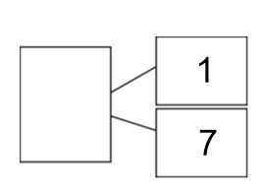
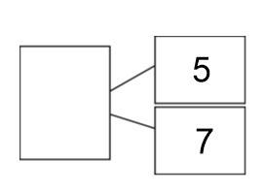
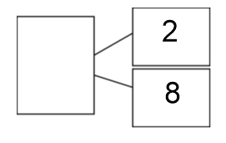
Number bonds
Year 2
Autumn Term
13
part whole is equal to plus subtract
Notes:
Time: 2 minuets
Purpose: To remind parents about the importance of number bonds.
Facilitation: In Year 1, pupils will have explored number bonds within 20 and by Year 2 pupils should now be familiar with these. The part whole model which was used throughout Year 1 helps to support pupils with the structure of calculations. Model completing the first part whole model: “My parts are 1 and 7, my whole is 8. 1 plus 7 is equal to 8”. Pupils can use concrete manipulatives such as counters to support them, but should aim to become familiar with these facts so that they can recall them to support them with other areas of maths. You can practise number bonds at home verbally with your children.
Explain that the star words are displayed and that star words are introduced each lesson. Children are expected to use these works in their full sentences. Allow parents and their children to talk through the other three examples using the star words.

Slide 12
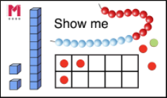
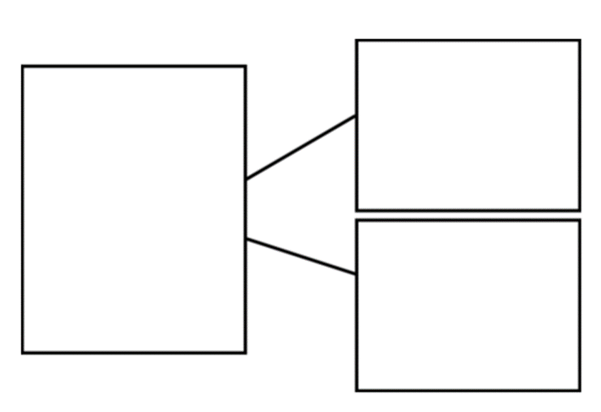


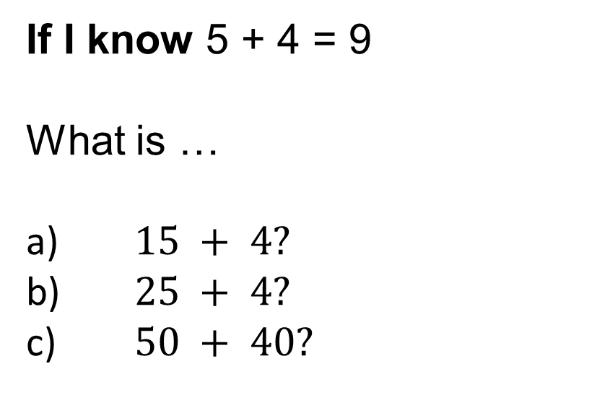
Using number bonds
Year 2
Autumn Term
If I know 5 + 4 = 9
What is …
a) $15 + 4?$
b) $25 + 4?$
c) $50 + 40?$
ones tens add subtract is equal to If I know…then I know…
Notes:
Time: 5 minutes
Purpose: To show how we can use number bond facts to derive new facts
Facilitation: Explain the importance of pupils making connections to facts that they already know – once children are familiar with their number bonds they can use them to work out other facts. Point out the star words and briefly explain the meaning of each if required.
Explain that pupils are often asked to explain their answers and manipulatives are used to support those discussions or to “convince someone” that they are right. The manipulatives are not used to help pupils work out the answer, but to support their understanding of the structure of the numbers and help them to reason and discuss.
Show parents the tens and ones Dienes, explaining what each one represents. Model the first question. “If I know 5 add 4 is equal to 9 then I know 15 add 4 is equal to 19, as 15 is ten more that 5.” (Show using dienes in a part whole diagram.) "We have not added any ones so the ones digit remains the same”.
Let parents explore the other two questions with their children - remind the to us the star words as they are doing each calculation.

Slide 13
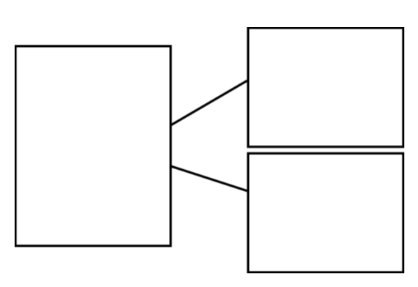
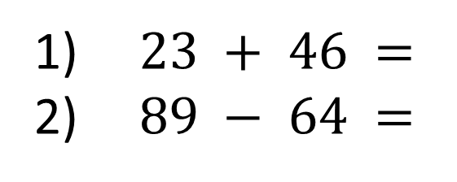
Adding and subtracting 2-digit numbers
Year 2
Autumn Term
How many different mental strategies can you use to solve:
$23 + 46 =$
$89 − 64 =$
Talk Task
Partner A: chooses a calculation and partitions both numbers into tens and ones.
Partner B: thinks of the number bonds required for the tens and ones.
"I am going to count on from 46. I will partition 23 into tens and ones—20 + 3. I know 4 tens + 2 tens = 6 tens, which is 60, so 46 + 20 = 66. I still need to add the 3 ones. I know 6 + 3 = 9, so 66 + 3 = 69."
"I am going to partition both numbers. I know 3 ones plus 6 ones is 9 ones. I know 2 tens and 4 tens is 6 tens which is 60. 60 + 9 is equal to 69."
ones tens add subtract is equal to partition If I know…then I know… part whole
Notes:
Time: 5 minutes
Purpose: To show how pupils use number bond facts to add and subtract two digit numbers.
Facilitation: In Year 2, pupils add and subtract two-digit numbers. Pupils are encouraged to use mental strategies and continue to make connections to their number bonds. Explain that the board shows a Talk Task. Each lesson pupils carry out a verbal task before completing their independent work to build their mathematical language and reasoning as well as giving teachers an opportunity to assess their understanding.
Again point out the start words and explain the meaning of partition.
Demonstrate this Talk task with another adult. This could be a volunteer parent.
Ask parents to try the second one with their child.

Slide 14
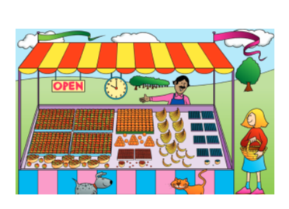
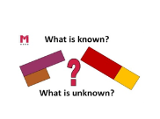
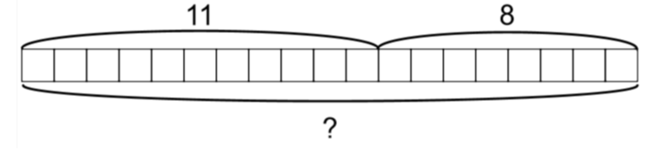
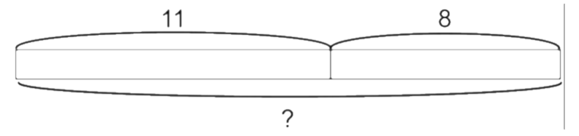
Introducing bar models
Year 2
Autumn Term
Anna bought 11 red apples. Joe bought 8 bananas. How many pieces of fruit did they both buy?
Notes:
Time: 2 minutes
Purpose: To introduce parents to the bar model representation, making connections to the part-whole model.
Facilitation: Explain the importance of problem solving and that bar models are used to support pupils make sense of a problem so that they can identify the correct operation and calculation.
Model reading the problem aloud and identifying what we know: one part is 11 and one part is 8. Then what is unknown: the whole. Place these in the part whole model.
Bar models are another way of representing this and this representation will support pupils to understand the mathematical structure of a problem and the relationship between the given numbers. Introduction to these in this year will be useful to make sense of more complex problems later in the school so it is important they get regular exposure to them.
Bar models may not always look the same, for this bar model we could make it concretely with cubes, or draw it with individual squares (top diagram) or a continuous bar (bottom diagram) (as numbers get larger we move more towards the continuous model).
Allow parents time to draw their own version of the bar model and use part whole language to describe it.
Advance the slide for another word problem for parents to try.

Slide 15
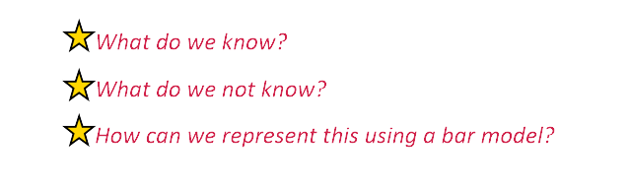

Introducing bar models
Year 2
Autumn Term
There fruit seller has 67 carrots but he sells 35 of them. How many does he have still to sell?
Remove to reveal example bar model
67
35 | ?
Notes:
Time: 3 minutes
Purpose: To allow parents an opportunity to try to represent a problem as a bar model.
Facilitation: Point out that this problem is a subtraction. Go through the questions displayed as a group and draw a part whole diagram. What do we know: We know that the whole is 67. We know one part is 35 but we don’t know the value of the other part.
Allow parents to have a go drawing this as a bar model. You may want to do this as a group.

Slide 16


Let’s Explore – Make 100
Year 2
Autumn Term
For this game, you need a die, a pencil and paper.
Each player draws an addition grid like this:
$$+$$
$$=$$
Take it in turns to roll the die. After you have rolled the die, you decide which box to place that number in. Once all four numbers have been placed, add your two 2-digit numbers to get your total. Closest to 100 wins.
Adapting: You can change the target total, or try using subtraction.
ones tens add subtract is equal to If I know…then I know…
Notes:
Time: 2 minutes
Purpose: Introduce game one.
Facilitation: Model how to play the game with a partner. If parents don’t have dice at a home, explain that a link to online dice is included in their parent pack. Explain that they will have time to have a go after we have introduced the second game.

Slide 17
Zero the Hero
Year 2
Autumn Term
4 | 0 | 3 | 1
6 | 3 | 2 | 2
7 | 1 | 7 | 5
6 | 4 | 5 | 8
For this game you need the number grid, (or make your own filled with numbers under 10) two cubes/counters, a plastic cup and pencil and paper.
Write 50 down as your starting score.
Put two cubes into the plastic cup and roll them onto the grid. Add the two numbers they land on together, then subtract from 50.
Take it in turns to do this. The first to reach zero is the winner.
ones tens add subtract is equal to If I know…then I know…
Notes:
Time: 15-17 minutes
Purpose: Introduce game 2 and give parents time to play both games
Facilitation: Explain that this game is great for practising number bonds as well as subtracting two-digit numbers.
When playing the game in the workshop, Dienes ones cubes work well or you may want to use an everyday item such as paperclips. Explain that materials from home could easily be used: if you don’t have counters/cubes you could use something from the house e.g. smarties, blue tack, pennies, paper clips, frozen peas etc.. A grid like the one shown can be drawn by parents, but a copy is available in their pack. Explain that when playing the game you can use concrete manipulatives, part whole models and bar models to represent each calculation, each turn should not be under a time pressure and children will naturally get faster the more they play and get familiar with calculations.
(Adapted from N-Rich, “pass the peas please” https://nrich.maths.org/1247),
Spend around 15 minutes giving parents time to play both games with their child.

Slide 18

Helping at home
Year 2
Autumn Term
Games played today
Exploring the Big Picture, vocabulary and activities in this term’s Maths Pack
Talking about maths during “everyday” routines e.g. shopping, cooking, daily routine, calendar.
Board games
Singing
Experience of handling/discussing money
Practising number bonds and times tables (2s, 5s, 10s)
Notes:
Time: 1 minute
Purpose: To suggest activities to build upon learning in school.
Facilitation: Go through each bullet point.
Explain that today’s games and some further activities to support addition and subtraction can be found in the maths pack.
Ensure everyone takes their maths pack home.

Slide 19
Year 2
Autumn Term
Thank you
Notes:
Thank parents for attending the workshop and take any questions afterwards.

