Slide 1
Year 1
Autumn Term
Parent workshop
Notes:
General Guidance about parent workshops
This workshop (if delivering in full) is designed to be completed in 50 minutes – 1 hour.
This workshop can be adapted and shortened to suit the priorities of your school. Select the parts that are purposeful for you.
See our parent workshop guidance for an overview of the structure to support you in adapting.
Additionally you may wish to add in information specific to your school e.g. photos, videos, calculation policy.
Have on the tables the termly parent packs - these are to be taken home after the workshop and contain the Big Picture, vocabulary, key representations and games discussed in the workshop. This can also be sent out to parents who were not able to attend the workshop.

Slide 2
What is Mathematics Mastery?
Year 1
Autumn Term
Success for all pupils
Based on research and evidence
Problem solving is at the heart
Focus is on depth, not acceleration
Aligned to National Curriculum
Focus on talk and reasoning about mathematics
Notes:
Time: 10 – 15 minutes for introduction slides 1 – 6. Depending on how familiar parents are from previous workshops in Reception, you may just want to quickly recap on the Dimensions of Depth or go into more detail
Purpose: To give an overview of Mathematics Mastery.
Facilitation: Explain that the school follows a mastery curriculum. Mastery reflects the needs of the 2014 curriculum (click) with a greater focus on talk and reasoning (click) with problem solving at its heart. (click) The programme is based on research and evidence from across the world (click) and the curriculum is designed so that all pupils can succeed (click) regardless of background and ability, with greater focus on exploring a problem in depth rather than moving onto something new, for example pupils will fully explore numbers within 20 before moving onto larger numbers.

Slide 3
Depth not acceleration
Year 1
Autumn Term
What do we mean by depth?
How do we deepen understanding?
Notes:
Time: 10 – 15 minutes for introduction slides 1 – 6. Depending on how familiar parents are from previous workshops, you may just want to quickly recap on the DofD or go into more detail.
Purpose: To explain what we mean by depth.
Facilitation: Link to the previous slide, where it was noted that mastery is about having a deep understanding rather than moving on to something new, for example fully understanding numbers 1 – 20 before moving on to larger numbers. But what do we mean by depth? (click)
Explain that the Mathematics Mastery programme is based on three key principles (the dimensions of depth): conceptual understanding, language and communication and mathematical thinking.

Slide 4
Conceptual understanding
Year 1
Autumn Term
Representing a concept in different ways
Making connections between each way to deepen their understanding.
32
Notes:
Time: 10 – 15 minutes for introduction slides 1 – 6. Depending on how familiar parents are from previous workshops in Reception, you may just want to quickly recap on the DofD or go into more detail
Purpose: To explain how to develop conceptual understanding.
Facilitation: Have manipulatives out to show concrete examples of the number 32.
Explain in the following way: When a child first hears or see the number 32, they have little understanding of what it means: it’s only by seeing other representations that they build connections and develop understanding. (Animate slide)
Each representation build pupils' understanding of a different aspect of that number. For example: some of these representations place emphasis on place value (point out base ten/Dienes). Some of these help pupils to understand the order of numbers (number line). Some of these help pupils to see combinations to make 32 (part whole).
It’s important pupils see maths in different ways, make connections between these ways and deepen their understanding. Remember, just because a child knows how to say and count to 32 doesn’t mean that they know where it might lie on a number line, how far away it is from 40 or how to separate it into three tens and two ones etc.
Explain that at home parents can use everyday items such as buttons, coins, money. For place value, straws bundled into tens with an elastic band make a good representation.

Slide 5
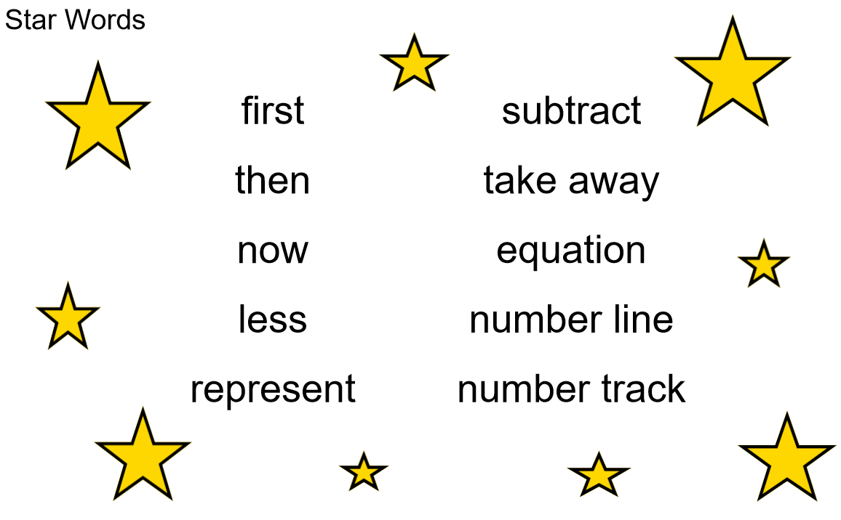
Language and communication
Year 1
Autumn Term
Can you say that in a full sentence, please?
Notes:
Time: 10 – 15 minutes for introduction slides 1 – 6. Depending on how familiar parents are from previous workshops in Reception, you may just want to quickly recap on the DofD or go into more detail
Purpose: To explain how to develop language and communication in maths.
Facilitation: Emphasise that the programme and your school place an emphasis on pupils using precise mathematical vocabulary. Each lesson has key words, called star words, and there will be some of this term’s star words included in the parent pack to take home.
Share that we encourage pupils to speak in full sentences. This supports them in applying that vocabulary and with more practise builds their ability to have a mathematical discussion and reason about the maths. Mathematical talk is central to all maths lessons and happens throughout the lesson. It helps to build pupils’ understanding and gives them opportunity to work together and share strategies.
Explain that when working with children at home parents should aim to talk about maths rather than give them a sheet of maths to do alone. They could try asking your child about this week’s star words, “What new maths words did you use today? How do you use them in a sentence?”. Emphasise that the more they discuss maths with their child the more they will get an idea of their understanding.

Slide 6
Mathematical thinking
Year 1
Autumn Term
Do you think … would always happen?
What’s the same? What’s different?
What do you think would happen if…?
How do you know that?
What else could go in this set? What couldn’t?
Can you see a pattern? What would come next?
Notes:
Time: 10 – 15 minutes for introduction slides 1 – 6. Depending on how familiar parents are from previous workshops, you may just want to quickly recap on the DofD or go into more detail.
Purpose: To explain how to develop mathematical thinking.
Facilitation: Share in the following way: Pupils are encouraged to think mathematically which includes imagining, sorting and comparing, making connections to things that you already know, spotting patterns and drawing conclusions.
These are things children do without being taught and you may have noticed your child doing them in their play, e.g. pointing out patterns, or sorting their toys into groups according to certain properties.
The slide shows some question prompts to support your child with mathematical thinking.

Slide 7
Creating a positive attitude to maths
Year 1
Autumn Term
Talk to your children about everyday maths
Play maths games with them
Value mistakes as learning opportunities
Recognise that there is more than one way to work things out
Praise children for effort over outcome
Avoid saying things like “I’m useless at maths”
Notes:
Time: 2 minutes (possibly change wording, from dos and don’ts)
Purpose: To give advice about opportunities to support with mathematics at home
Facilitation:
Share, making the following points:
Everyday Talk: try to talk about maths when doing activities like shopping, cooking, time etc. 5 minutes a day can make a big difference!
Play with your child: puzzles, board games, verbal games help them to apply vocabulary, problem solve and reason. Interaction and dialogue that you cannot get from playing on a computer or iPad!
Mistakes are opportunities for learning.
You may have learned one method at school but at school we actively encourage children to seek out multiple strategies and choose one that works for them and build connections between strategies.
Praise children for trying hard and overcoming challenges. If pupils are only praised for getting everything correct they may not try and challenge themselves as they may be afraid to get things wrong.
6) Try to avoid saying things like “I’m useless at maths”. You may remember maths as being hard, but if your child hears you saying that, or that it's not important to be good at maths, they will believe that too!

Slide 8
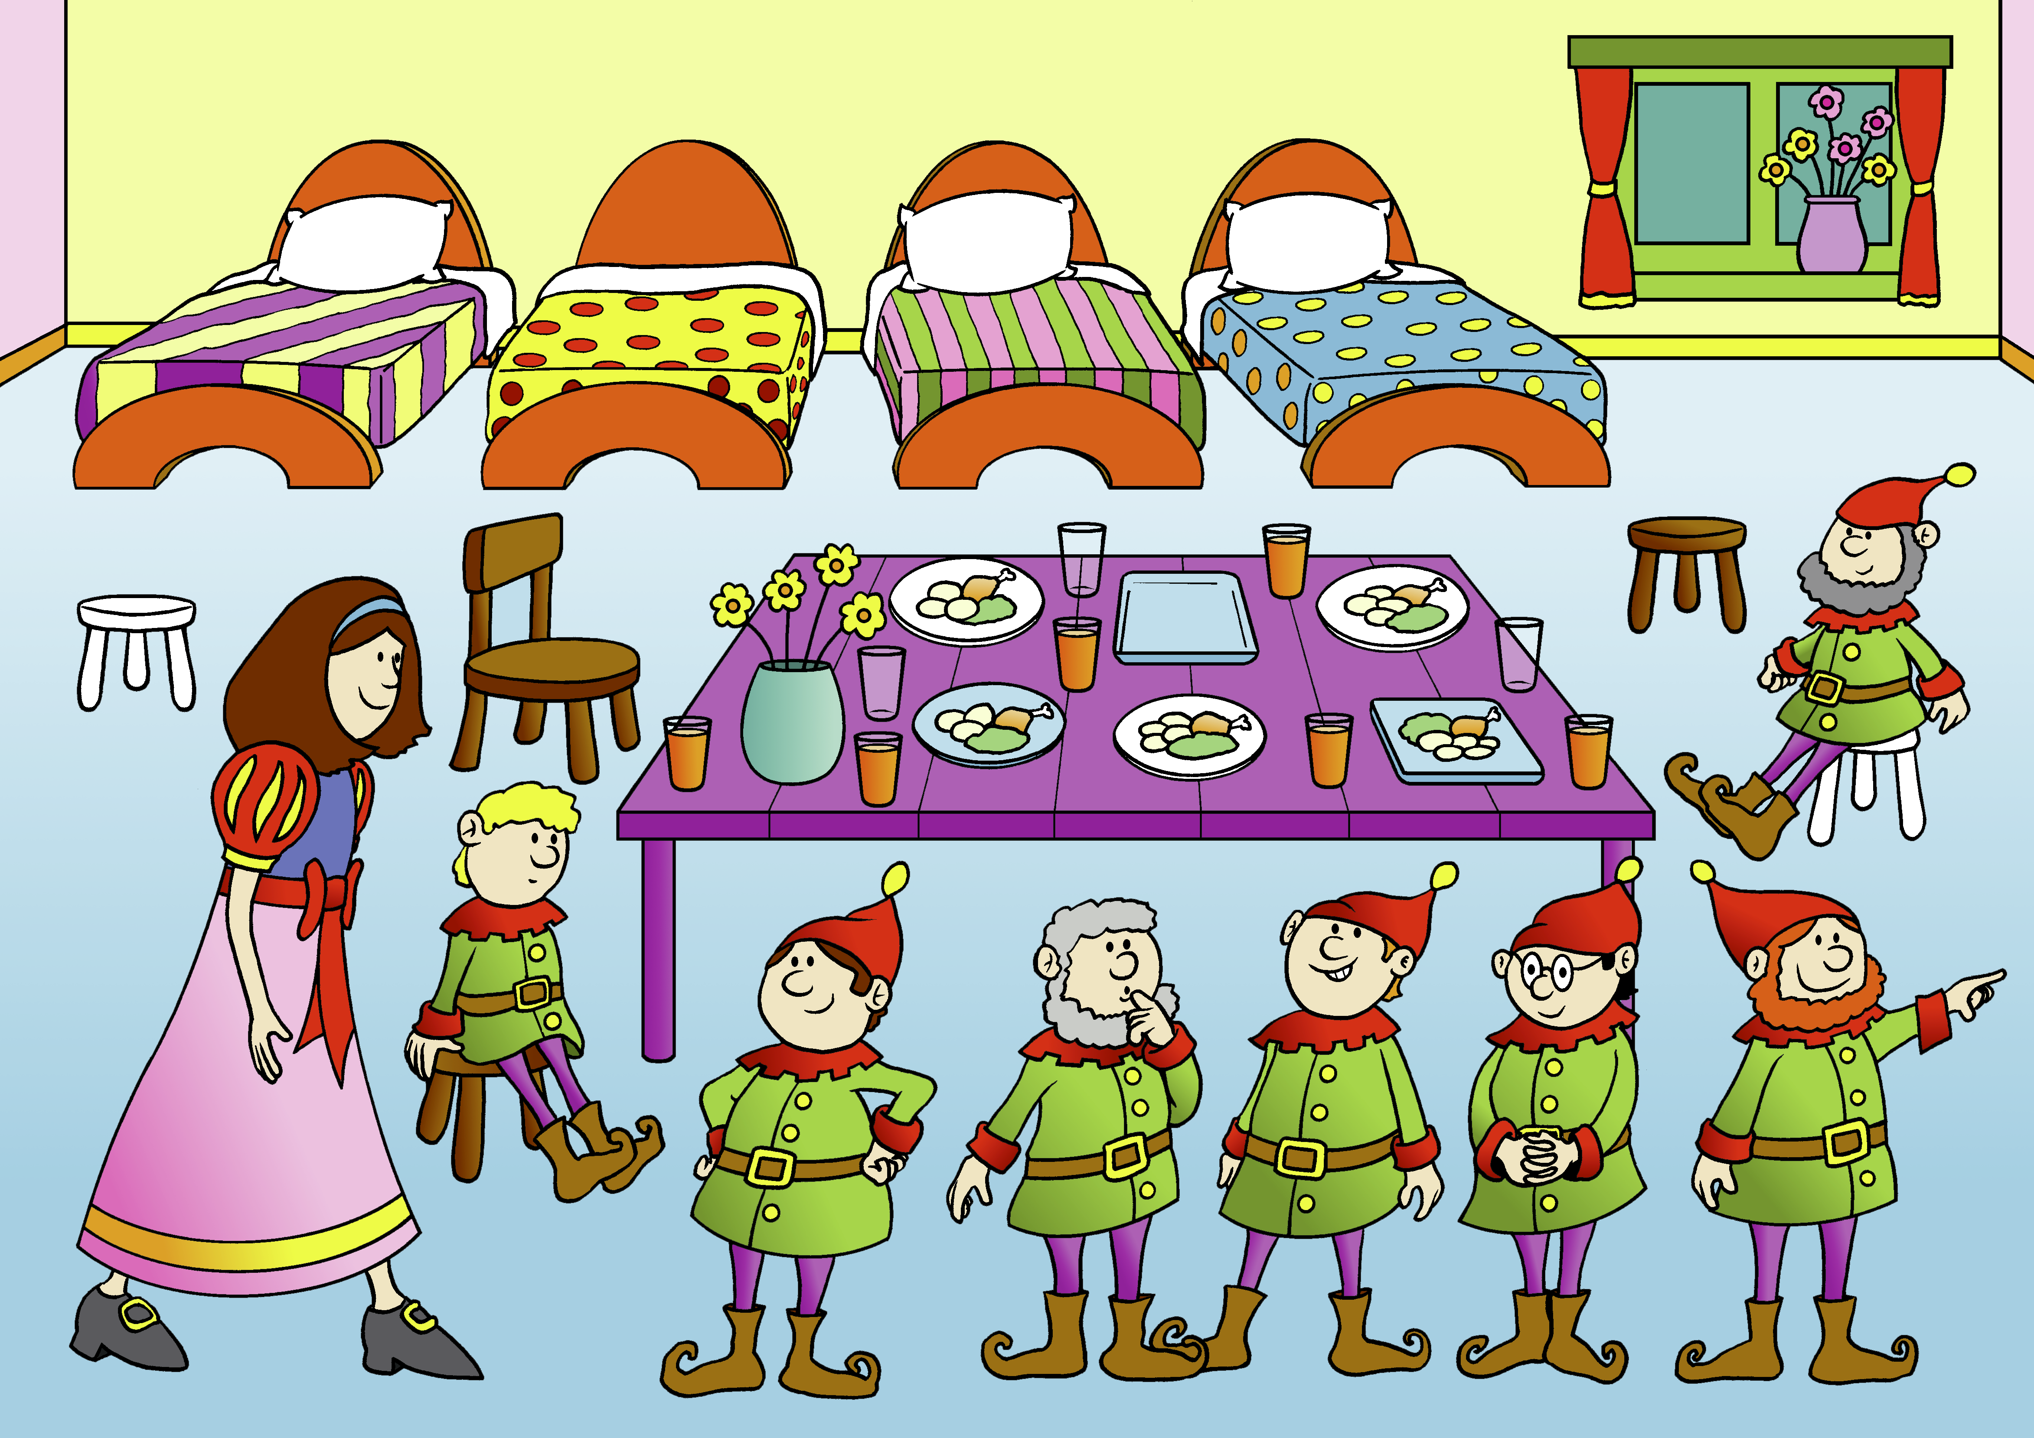
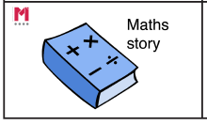
Big Pictures
Year 1
Autumn Term
What maths can you see?
?
equation add addition plus is equal to part whole
Notes:
Time: 5 minutes
Purpose: To show parents how we use the big picture to connect maths to a context/the real world.
Facilitation: Explain that the big pictures are used to provide children with opportunities to connect maths with the real world, make connections and supports mathematical talk and reasoning. The Big Pictures in Year 1 relate to fairy tales. Give parents a copy of the Snow White Big Picture (in parent pack or display on the board) and explain this is used in the addition and subtraction unit, which is our focus today. Allow them to discuss what maths they can see with their children.
Mathematics Mastery encourages pupils to make connections between the maths they are doing and real life contexts. Often pupils are asked to relate the maths they are doing to a real life problem which we call a “maths story”. (click to animate sticker)

Slide 9
Year 1 Autumn Curriculum Map
Year 1
Autumn Term
Numbers to 10 | Addition and subtraction within 10 | Shape and patterns
Represent, compare and explore numbers within 10 One more and one less Doubling and halving | Represent and explain addition and subtraction Commutativity Addition and subtraction facts | Identify, describe, sort and classify 2-D and 3-D shapes Investigate repeating patterns Use and follow instructional and positional language
Numbers to 20 | Addition and subtraction within 20
Identify, represent, compare and order numbers to 20 Doubling and halving One more and one less | Represent and explain addition and subtraction strategies including ‘Make Ten’ Use known facts to add and subtract
Notes:
Time: 2 minutes
Purpose: To share the Autumn curriculum map with parents.
Facilitation: Allow parents to view the Year 1 curriculum map for Autumn and briefly talk through the focus of each unit (no need to go through the individual objectives)
Explain that the Autumn map is in the parent pack.
You may want to handout entire Year 1 curriculum map for parents to take home. Entire curriculum map: http://toolkit.mathematicsmastery.org/download/5ce3b987ecdd7

Slide 10
In focus: addition and subtraction
Year 1
Autumn Term
Addition facts to 10 by combining amounts
Subtraction facts to 10 by partitioning
Explore related facts in addition and subtraction
Using number bonds to add within 20
Using the ‘make ten’ strategy to add within 20
Notes:
Time: 2 minutes
Purpose: To share the progressive learning steps pupils will follow for addition and subtraction.
Facilitation: In this workshop we have chosen to focus on addition and subtraction as this a big focus for us this term and learning from these units will be used and applied throughout the remainder of the year.
Explain that in Year 1, pupils are required to represent and use number bonds within 20. Mathematics Mastery is a cumulative curriculum meaning that learning is built over time, with new learning that makes connections to prior learning.
Pupils begin by using strategies to calculate number facts to ten. They use a combining strategy for an addition and a partitioning strategy for subtractions. Share that both of these will be explained in the workshop. Later in the term they use this learning to derive facts to 20.
By the end of the year pupils should be able to recall the number bonds to 10 but it is also important thy have a deep understanding of why those facts are correct and how they relate to the real world. This is why clear visual representations are used when we introduce the facts.

Slide 11
Finding totals by counting all and counting on
Year 1
Autumn Term
$$+$$
$$=$$
$$=$$
$$+$$
equation add addition plus is equal to part whole
Notes:
Time: 5 minutes
Purpose: To introduce the part-whole model for addition
Facilitation: Pupils will be familiar with the part whole model shown and the language of parts and whole. (Indicate where the parts and whole are and point out the star words below). Explain that a list of key vocabulary is included in the Maths Pack. The part whole model supports pupils’ understanding of the structure of addition and subtraction. When we first begin using the part whole model we use concrete objects such as cubes to show pupils the process of addition and subtraction so that they can see how the amount changes. In year 1 pupils will use these alongside equations and make connections between the two, understanding the position of the parts and whole.
Using a part whole model and cubes (preferably using concrete manipulatives, rather than the PowerPoint), model an addition within ten e.g. 4 + 5. “The parts are four and five." Move the first part to the whole box “My first part is four.” Move the second part to the whole. “My second part is 5”. Model counting all (count the cubes one –nine) "My whole is 9.”
Explain that pupils will move on from counting all to counting on(counting on from 4 to 9) and model this. Emphasise the importance of pupils using the language when calculating to support their understanding. Finally complete the equation, emphasising that it’s important that the is equal to sign is not always at the end of the equation.
You may wish to give parents an opportunity to try another problem with their children.

Slide 12
Subtracting
Year 1
Autumn Term
$$−$$
$$=$$
$$=$$
$$−$$
equation subtract minus partition count back number line
Notes:
Time: 5 minutes
Purpose: To explain how to use the part-whole model for subtraction
Facilitation: Explain that in subtraction we start with the whole and we partition the whole into two parts. Point out partition in the star words and briefly explain its meaning.
Model a subtraction e.g. 9 – 5 = 4. “First count out nine cubes. The whole is nine. Now move five of those to one of the parts. One part is five. Now count out what’s left. One, two, three, four. There are four left over. The other part is four. Nine subtract five is equal to four.” Finally complete the written equation.
You may wish to give parents an opportunity to try another problem with their children.
Explain to parents that the part whole model can be used flexibly, the parts do not always need to be in the same position and sometimes we use more than 2 parts. These can be drawn at home too rather than needing a template.

Slide 13
Number bonds are key!
Year 1
Autumn Term
By the end of Year 1 all pupils should:
“represent and use number bonds and related subtraction facts within 20”
7
7
?
9
?
9
?
2
7
Notes:
Time: 2 minutes
Purpose: To share the expectations for learning number bonds in Year 1
Facilitation:
Cover the following points:
By the end of Year 1 pupils should be able to memorise their number bonds to ten and ideally within 10 and use these facts to begin exploring all facts within twenty. (Emphasise that this is a process built upon over time and by the end of Year 2 they should be able to recall all facts within 20 fluently.)
When practising at home ensure pupils begin with number bonds within ten and are really secure in these before moving on to number bonds within 20.
Encourage pupils to make connections between number facts. E.g. 9 - 7 = 2 and 9 = 2 + 7, making fact families.
The part whole model can be used to support their understanding, rather than just “memorising facts”.
Reassure parents that practise at home should be verbal and fun and we are not expecting them to be practising in a test-style.

Slide 14
Make 10 strategy
Year 1
Autumn Term
Key question: How many more would you need to make ten?
$$8 + 6 =$$
$$6$$
Make ten strategy add is equal to partition number bond
Notes:
Time: 5 minutes
Purpose: To demonstrate the make 10 strategy.
Facilitation: Share that when adding numbers that will result in a whole greater than ten, pupils use the make ten strategy. This is explored in Year 1 and developed in Year 2. Recognise that this is something that most of us do “in our head” but it is important that it is taught step by step, initially with manipulatives, so that pupils are all able to understand this strategy and can apply it to problems later in Key Stage one.
Model 8 + 6 using concrete manipulatives. “Our first part is 8. I know that 8 and 2 make ten. We need to partition the 6. My first part is two. My second part is four. We now have ten and four which is equal to 14. “
Pupils will practise this using concrete manipulatives. This will help them visualise when doing similar strategies mentally later in key stage one.
This strategy can also be used for subtraction, for example 14 – 5. We would first take away four then one.

Slide 15
Let’s Explore – Adding Circles
Year 1
Autumn Term
For this game, you need dice, a pencil and paper.
• Each of you should draw four circles on your piece of paper.
• Write a different number between 2 and 12 in each circle.
• Roll two dice (or roll twice, if you only have one die). Add the two numbers.
• If the total is one of the numbers in your circles then you may cross it out.
• The first person to cross out all four circles wins.
part whole add Is equal to
Notes:
Time: 2 minutes
Purpose: To explain how to play game 1
Facilitation: Explain that parents are now going to have a chance to try out some of the strategies talked about using an addition and a subtraction game that they can play at home. Model both games then give parents the remaining time to play with their children.
Model the game with a pupil using a part whole model and cubes, explain that pupils may wish to use pictorial or concrete objects to support them and that there should not be a time limit. However, the more they play this game, the faster they will become and eventually they may wish to use their number bonds mentally.
Ensure that on tables there are whiteboards, laminated part whole models, counters/cubes.
Explain that if you don’t have dice at home, it is possible to play the game with online dice and there’s a link in parent pack. You may also wish to consider sending such equipment home with pupils.

Slide 16
Let’s Explore – Grab bag subtraction
Year 1
Autumn Term
Choose a number of things to work with and put that many objects into a bag.
• You can use crayons, coins, beans, buttons, etc.
• Grab a handful of the items and count them. Ask your partner how many items are now left.
“I started with ___ items. I’ve taken out ___. How many are left?”
• Write down the equation.
• Encourage counting on or back, use manipulatives e.g. counters if you need to.
• You get a point for getting each equation correct.
• Let your partner have a turn.
?
part whole subtract Is equal to
Notes:
Time: 15 minutes
Purpose: To explain how to play game 2
Facilitation: Ensure each parent has a plastic/paper bag to use with their child.
Model the activity with another child. Again, use part whole model and cubes/counters to work out the subtractions.
Remind parents to use the Star Words.
Give parents 10-15 minutes to have a go at the games with their children.

Slide 17
Helping at home
Year 1
Autumn Term
Games played today
Exploring the Big Picture, vocabulary and activities in this term’s Maths Pack
Talking about maths during “everyday” routines e.g. shopping, cooking, daily routine, calendar.
Board games
Singing
Practising number bonds
Notes:
Time: 1 minute
Purpose: To suggest activities to build upon learning in school.
Facilitation: Go through each bullet point.
Explain that today’s games and some further activities to support addition and subtraction can be found in the maths pack.
Make sure everyone takes their maths pack home.

Slide 18
Year 1
Autumn Term
Thank you
Notes:
Thank parents for attending the workshop and take any questions afterwards.

