Slide 1

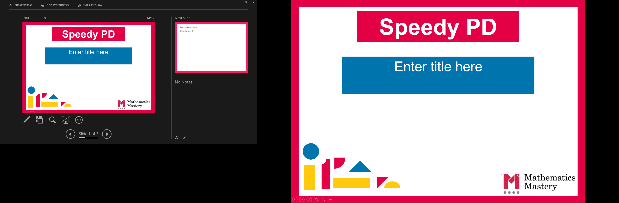

Reception
Autumn Term
Parent workshop
Notes:
General Guidance about parent workshops
This workshop (if delivering in full) is designed to be completed in 50 minutes – 1 hour.
This workshop can be adapted and shortened to suit the priorities of your school, select the parts that are purposeful for you.
See our parent workshop guidance for an overview of the structure to support you in adapting.
Additionally you may wish to add in information specific to your school e.g. photos, videos, website links, calculation policy.
Have the termly parent packs already on the tables - these are to be taken home after the workshop and contain the big picture, vocabulary, key representations and games discussed in the workshop. This can also be sent out to parents who were not able to attend the workshop.
Resources
Counters
Countable objects e.g. small play, everyday items
Bead strings
Ten frames
Five frames
Dot cards (see folder)

Slide 2
What is Mathematics Mastery?
Reception
Autumn Term
Success for all pupils
Based on research and evidence
Problem solving is at the heart
Focus is on depth, not acceleration
Reflects the 2014 National curriculum
Focus on talk and reasoning about mathematics
Notes:
Time: 10 – 15 minutes for introduction slides 1 – 6.
Purpose: To give an overview of Mathematics Mastery.
Facilitation: Explain that the school follows a mastery curriculum. Mastery reflects the needs of the 2014 curriculum (click) with a greater focus on talk and reasoning (click) with problem solving at its heart. (click) The programme is based on research and evidence from across the world (click) and the curriculum is designed so that all pupils can succeed (click) regardless of background and ability, with greater focus on exploring a problem in depth rather than moving onto something new, for example pupils will fully explore numbers within 20 before moving onto larger numbers.

Slide 3
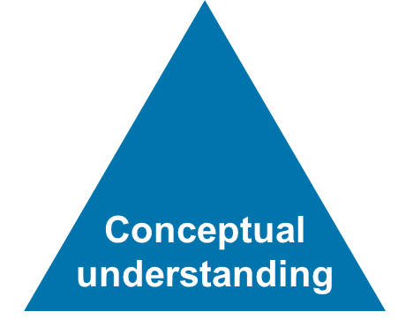
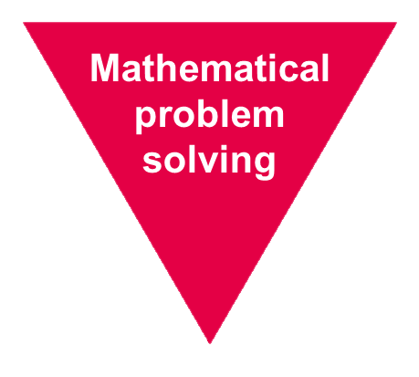
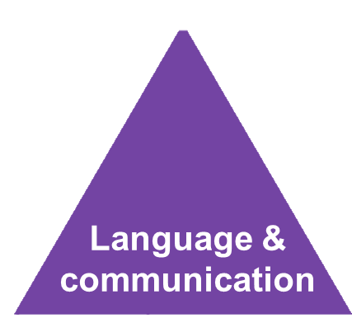
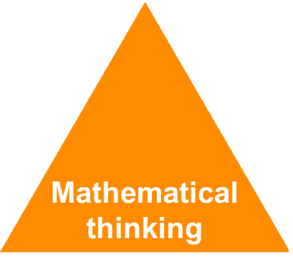
Depth not acceleration
Reception
Autumn Term
What do we mean by depth?
How do we deepen understanding?
Notes:
Time: 10 – 15 minutes for introduction slides 1 – 6.
Purpose: To explain what we mean by depth.
Facilitation: Link to previous slide that mastery is about having a deeper understanding of a concept rather than moving on to something new, for example fully understanding numbers 1 – 5 before moving on to numbers 1-10. But what do we mean by depth? (click)
Mathematics Mastery is based on three key principles (the dimensions of depth): Language and communication (click) mathematical thinking (click) and conceptual understanding (click). Research shows that these three aspects lead to a depth of understanding and ultimately success in mathematics, allowing children to become better mathematicians and thus better problem solvers. (click)

Slide 4
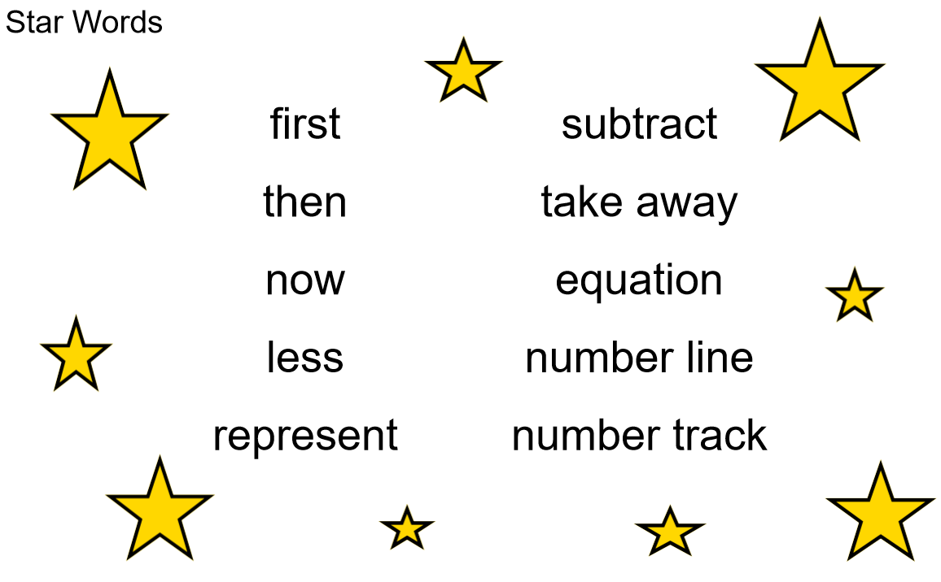

Language and communication
Reception
Autumn Term
Can you say that in a full sentence, please?
Notes:
Time: 10 – 15 minutes for introduction slides 1 – 6.
Purpose: To explain how to develop Language and Communication in maths.
Facilitation: Emphasise that the programme and your school place an emphasis on pupils using precise mathematical vocabulary. Each lesson has key words, called star words, and there will be some of this term’s star words included in the parent pack to take home.
Share that we encourage pupils to speak in full sentences. This supports them in applying that vocabulary and with more practise builds their ability to have a mathematical discussion and reason about the maths. Mathematical talk is central to all maths lessons and happens throughout the lesson. It helps to build pupils’ understanding and gives them opportunity to work together and share strategies.
Explain that when working with children at home parents should aim to talk about maths rather than give them a sheet of maths to do alone. They could try asking your child about this week’s star words, “What new maths words did you use today? How do you use them in a sentence?”. Emphasise that the more they discuss maths with their child the more they will get an idea of their understanding.

Slide 5
Mathematical thinking
Reception
Autumn Term
Do you think … would always happen?
What’s the same? What’s different?
What do you think would happen if…?
How do you know?
What else could go in this set? What couldn’t?
What pattern can you see? How would it continue?
Notes:
Time: 10 – 15 minutes for introduction slides 1 – 6
Purpose: To explain how to develop Mathematical Thinking.
FacilitationShare in the following way: Pupils are encouraged to think mathematically which includes imagining, sorting and comparing, making connections to things that you already know, spotting patterns and drawing conclusions.
These are things children do without being taught and you may have noticed your child doing them in their play, e.g. pointing out patterns, or sorting their toys into groups according to certain properties.
The slide shows some question prompts to support your child with mathematical thinking.

Slide 6

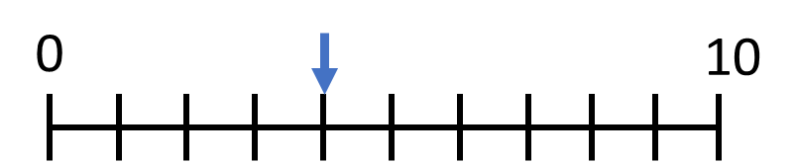
Conceptual understanding
Reception
Autumn Term
Representing a concept in different ways
Making connections between each way to deepen their understanding.
four
4
Notes:
Time: 10 – 15 minutes for introduction slides 1 – 6.
Purpose: To explain how to develop Conceptual Understanding.
Facilitation: Have manipulatives out to show concrete examples of the number 4.
When a child first hears or see the number 32, they have little understanding of what it means, it is just an abstract symbol Children need to see it represented in lots of different ways and make connections - understand that they all represent the same thing. (Animate slide) Representations can be concrete e.g. anything that your child can move around, pictorial – anything your child can draw or abstract which holds no meaning by itself such as the spoken word, numerals or word.
Each representation helps your children understand a different aspect of that number.
For example: some of these representations place emphasis on the value of the number (five frame model). Some of these help pupils to understand the order of numbers (number line). It’s important pupils see maths in different ways, make connections between these ways and deepen their understanding. Remember just because a child knows how to say and count to 4 doesn’t mean that they know where it might lie on a number line or how far away it is from 5 or 10 or how to separate it into three and one, to groups of two etc.

Slide 7

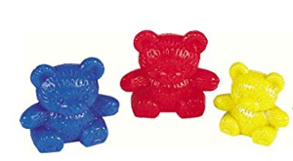
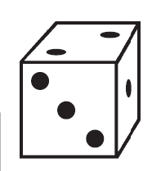
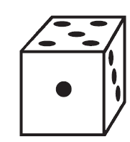
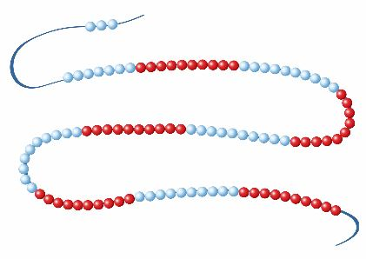

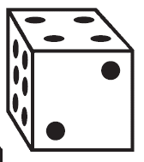

Representing numbers 1 – 6
Reception
Autumn Term
three
How many ways can you represent the number 3?
$$3$$
What does each representation tell us about the number three?
Notes:
Time: 6-7 minutes
Purpose: To allow parents to explore different ways of representing the same number.
Facilitation: Have a range manipulatives and pictorial representations out of the table: e.g. bead string, part-whole model, five frame, counters, cubes, small world items e.g. teddy bears as well as whiteboards and whiteboard pens.
Explain that in order to develop understanding, pupils need to make connections between different representations and they will have opportunities during the lessons to see each number to six in different ways to develop a deeper understanding. That is why pupils in this term solely focus on these numbers, we want them to have a secure understanding as it’s important for calculation skills later on in their schooling.
Invite parents to make the number three in various ways. Ask them what each representation might tell us about the number 3.
E.g. compliments to three, size of three, on to ne correspondence, conservation of number, cardinality etc.

Slide 8
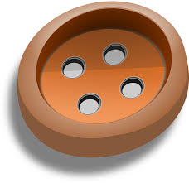
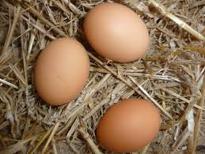

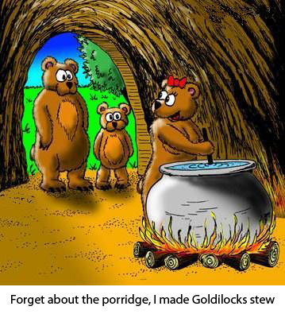



Using every day objects and the environment
Reception
Autumn Term
Notes:
Time: 1 minute
Purpose: To share some ideas of ways to use concrete representations at home.
Facilitation: Explain that we don’t expect you to have the same resources we use at school - there plenty of every day items you can use. For example: buttons, coins, straws, dried pasta, tins, toys, teddy bears.
Also look out for numbers in the environment. Who can spot the number three on the walk to school? This can include the numeral as well as sets of three objects.

Slide 9
Creating a positive attitude to maths
Reception
Autumn Term
Talk to your children about everyday maths
Play games with them
Value mistakes as learning opportunities
Recognise that there is more than one way to work things out.
Praise children for effort over outcome.
Avoid saying things like “I’m useless at maths”.
Notes:
Time: 2 minutes (possibly change wording, from dos and don’ts)
Purpose: To give advice about opportunities to support with mathematics at home
Facilitation: Share, making the following points:
Everyday Talk: try to talk about maths when doing activities like shopping, cooking, time etc. 5 minutes a day can make a big difference!
Play with your child: puzzles, board games, verbal games help them to apply vocabulary, problem solve and reason. Interaction and dialogue that you cannot get from playing on a computer or iPad!
Mistakes are opportunities for learning.
You may have learned one method at school but at school we actively encourage children to seek out multiple strategies and choose one that works for them and build connections between strategies.
Praise children for trying hard and overcoming challenges. If pupils are only praised for getting everything correct they may not try and challenge themselves as they may be afraid to get things wrong.
6) Try to avoid saying things like “I’m useless at maths”. You may remember maths as being hard, but if your child hears you saying that, or that it's not important to be good at maths, they will believe that too!

Slide 10

Big pictures
Reception
Autumn Term
What maths can you see?
?
equation add addition plus is equal to part whole
Notes:
Time: 5 minutes
Purpose: To show parents how we use the Big Picture to connect maths to a context/the real world.
Facilitation: Explain that Big Pictures are used to provide children with opportunities to connect maths with the real world, make connections and supports mathematical talk and reasoning.
Give parents a copy of the 5 speckled frogs Big Picture (in parent pack, or display on the board) and explain this is used in the addition and subtraction unit, which is our focus today.
Allow them to discuss what maths they can see with their children and take some feedback.
Mathematics Mastery encourages pupils to make connections between the maths they are doing and real life contexts. Often pupils are asked to relate the maths they are doing to a real life problem which we call a “maths story”.

Slide 11
Reception Autumn Curriculum Map
Reception
Autumn Term
Early Mathematical Experiences | Pattern and early number | Numbers within 6
Classifying objects based on one attribute Comparing objects and sets Ordering objects and sets | Recognise, describe, copy and extend colour and size patterns Count and represent the numbers 1 to 3 Estimate and check by counting | Count up to six objects One more or one fewer Order numbers 1 – 6 Conservation of numbers within 6
Addition and subtraction within 6 | Measures | Shape and sorting | Calendar and time
Explore zero Explore addition and subtraction | Estimate, order, compare, discuss and explore capacity, weight and lengths | Describe and sort 3-D shapes Describe position accurately | Days of the week and seasons Sequence daily events
Notes:
Time: 3 minutes
Purpose: To share the Autumn curriculum map with parents.
Facilitation: Allow parents to view the Reception curriculum map and talk through the focus of each unit (no need to go through the individual objectives).
Emphasise the importance of looking deeply at the structures of numbers and the importance of pupils being able to represent numbers in more than one way to emphasise different properties. MM supports a deep understanding of number and although children may be able to count to ten and beyond, it doesn’t mean they understand the structure and the value of each number. This is why we begin with just numbers 1-3, building up to numbers 1 – 6 this Autumn.
Optional Handout – Curriculum map

Slide 12
In focus: numbers 1 to 6
Reception
Autumn Term
Count 1, 2 and 3 reliably (using objects, images, sounds)
Create representations for numbers 1,2 and 3.
Count numbers 1- 6 reliably
Create representations for numbers 1-6
Place numbers 1-6 in order
Recognise numerals 1- 6
Explore one more and one less
Addition and subtraction of numbers 1 – 6
Understand the concept of 0
Notes:
Time: 2 minutes
Purpose: To share the progressive learning steps pupils will follow for numbers 1-6.
Facilitation: In this workshop we have decided to focus on exploring numbers 1-6 as this is a key focus for the Autumn term. The slide shows some of the key learning objectives that pupils will be working on throughout Autumn. Your children will fully explore numbers up to 3 before moving on to numbers up to 6. They then will move on to explore numbers to 10 in spring. This ensures pupils have a deep understanding that they can later connect to new learning throughout the remainder of the year. Mathematics Mastery is a cumulative curriculum meaning that learning is built upon over time, therefore pupils will consolidate their understanding of numbers 1- 3 when looking at numbers 1 -6 and again their understanding of numbers 1-6 will be developed when looking at the numbers 1- 10 in spring. It is important pupils fully understand numbers 1 to 6 before moving on to numbers of greater value.

Slide 13
Key early number skills
Reception
Autumn Term
Counting Principles
Associating one object with one number - One to one principle.
The order of number names remains consistent e.g. 1,2,3 not 2,3,1 -Stable order principle
The final word tells us the number of objects - Cardinal principle .
You can count any collection of things whether real, imaginary or sounds - Abstraction principle.
It doesn’t matter what order we count objects in - Order irrelevance principle
Notes:
Time: 6-7 minutes
Purpose: To share and explain key early number skills.
Facilitation: So what do we mean by fully understanding numbers? When counting, just knowing the number names isn’t the only thing your child needs to understand. Lets have a look at the principles of counting. (MMSL note: first identified by Gelman and Gallistel, 1978, but know integral to EY practice)
Have a range of everyday objects out to demonstrate each principle. If you are not confident in demonstrating a video has been included on slide 15, which you may prefer to show.
One to one correspondence – matching a number with an object.
Stable order – Numbers should be named in order, 1,2 3, some children may begin counting in order but may count another set of numbers in a different order, or miss numbers out e.g 1,2,4,5,3,
Cardinal principle - refers to the number of objects as a whole; developing an understanding of the ‘three-ness of three’ rather than a number in a sequence of numbers: 1, 2, 3. The final number in the count represents the cardinal value of the number.
Abstraction principle - counting objects that are not visible such as hand claps, dropping coins into a tin.
Order irrelevance - to understand that objects can be counted in any order. For example, counting does not have to take place from left to right – they can be counted in any order and the total number will be the same.

Slide 14
Key early number skills
Reception
Autumn Term
Other early number key skills
Understanding that the amount of objects remains the same, even if we rearrange them
- Conservation of number.
The ability to instantly recognise how many objects are in a group - Subitising
Notes:
Time: 6-7 minutes
Purpose: To share and explain key early number skills.
Facilitation:
Have a range of everyday objects out to demonstrate each skill.
Conservation of number – the ability to know that a set of counted objects, such as cubes, when rearranged differently, is the same number – we don’t need to recount each time. Young children will often need to keep checking the number of fingers on each hand for example as they have not yet established conservation of number. This is a developmental stage and through frequent exposure to number will be grasped by pupils.
Subitising – the ability to know how many objects in a set without counting. Generally five is seen as the maximum number that can be subitised, for numbers larger than this you see smaller numbers, for example, for six, someone may see three dots and three dots and know that is six without counting them all. Using dotted dice is a good way of knowing if a pupil can subitise or not.
Explain that we will refer to these skills throughout the rest of the workshop and not to worry too much about the technical terms but the skills being demonstrated.

Slide 15
Key early number skills: video
Notes:
Time: 6-7 minutes
Purpose: To share and explain key early number skills.
Facilitation:
Play video from folder for further demonstration of Early number skills if required.
Whilst watching the video think about how you might develop these types of skills at home. What objects could you use? What questions could you ask?

Slide 16
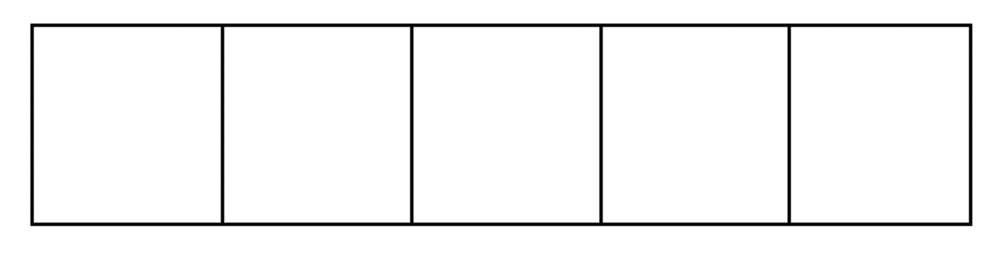

Key representations – The five frame
Reception
Autumn Term
What is a five frame?
How can we use the five frame to support key early number skills?
one two three four five more less
Notes:
Time: 2 minutes
Purpose: To show how the five frame model develops early number skills.
Facilitation: Although seeing various representations builds understanding, we talked about how particular representations can draw out different aspects of mathematics. For this reason we ensure the models and representations we use are purposeful so that learning can remain cumulative – be built upon and strengthened over time. One representation we use in school is the five frame. Demonstrate some key early maths skills using the five frame on screen or using a visualiser and printed five frame alongside counters.
The five frame builds pupils understanding of one to one correspondence – each counter has one space.
It creates opportunities to explore conservation of number – we can make the number three, if we move the counters into a different position we still have three.
It allows pupils to subitise numbers up to five, E.g. ”I can see that I have three counters without having to count”, or “I can see that I have two counters on the left and one on the right”
We can also use this model as a number tracker using vocabulary of 1st, 2nd, 3rd etc. to develop pupils vocabulary of ordinal numbers,

Slide 17

Key representations – The five frame
Reception
Autumn Term
What numbers are represented?
What does the arrangement tell you about the numbers?
What can you say about each number’s relationship to five?
Notes:
Time: 2 minutes
Purpose: to demonstrate how different representations show different aspects of a number
Facilitation: Let’s look at different ways of representing the number three using the five frame.
What does each arrangement tell you about the number 3?
What can we say about each arrangement and the relationship three has to five?

Slide 18
Key representations – The ten frame
Reception
Autumn Term
Notes:
Time:1 minute
Purpose: To introduce the ten frame as the next step after the five frame.
Facilitation: Highlight that the ten frame will be introduced to pupils after they have had the opportunity to explore the five frame. Similarly to the five frame it can support pupils’ understanding about the early number skills and allows them to being thinking about number facts within and up to ten.

Slide 19
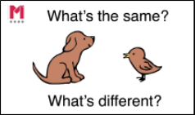
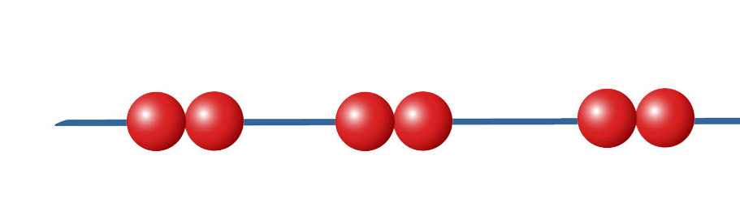
Same and different
Reception
Autumn Term
same different one two three four five
Notes:
Time: 2 minutes
Purpose: To show that one number can be shown in different arrangements using the bead string.
Facilitation: To support conservation of number and mathematical thinking pupils compare representations that show the same number in different ways. Demonstrate this with a bead string by showing 6 then showing another representation of six (e.g. with gaps “we still have six beads but now we have grouped the beads into...”
Show another number on the bead string e.g. 5 and ask parents to show you the number 5 in a different way.

Slide 20
Let’s explore – flip and create
Reception
Autumn Term
Flip and Create
2-4 players
What you need: 12 dot cards with a variety of dot patterns representing numbers 1 to 6 and counters/buttons/stones/cubes etc. (6 per person required).
How to play: Have the cards in a pile face down. The first player flips over one card. The rest of the players then use counters to replicate the arrangement of dots on his/her card and says the number out loud. The dealer checks the results. The next player then flips over the next card and places it on top of the previous card. The players rearrange their counters. This continues until all the cards are used.
Variations
More or fewer: Each child can predict aloud whether the new card has more, fewer or the same number of dots as the previous card. The prediction is checked by the dealer, by observing whether counters need to be taken away or added.
Create your own dot cards: Change the arrangements or increase/decrease the number of dots on the cards.
one two three four five six more fewer less
Notes:
Time: 2 minutes
Purpose: To explain how to play game 1
Facilitation: Have 1-6 card printed out and cut up. Model the first game.
The parent will turn over a card and the child will have to represent that number using counters. Explain that buttons, pennies, sweets, grapes etc could be used instead. Explain the game can be adapted to include “higher or lower” style questioning. “if the most we can have is six, do you think the next card will be greater or less than this one?”. Although state that it is still important for children to make the number first and challenge them to arrange their representations differently to that on the card.

Slide 21
Let’s explore – pairs
Reception
Autumn Term
Pairs
2 players
What you need: 12 dot cards with a variety of dot patterns representing numbers 1 to 6.
How to play: Spread all the cards out face down. The first player turns over any two cards. If they are a pair (i.e. have the same number of dots), the player removes the cards and scores a point. If they are not a pair, both cards are turned back down in their places. The second player then turns over two cards and so on. When all the cards have been matched, the player with more pairs wins.
Variations
1. Increase the number of pairs of cards used.
2. Use a greater number of dots on the cards.
3. Pair a dot card with a numeral card.
one two three four five six
Notes:
Time: 10 – 15 minutes
Purpose: To explain how to play game 2
Facilitation: Have 1-6 card printed out and cut up. Explain that 1-5 cards are also available.
Model this game. Place 12 cards face down. The first player picks up two cards, if they match the player removes the cards. Then it’s the next player’s turn.
Explain that to play these games at home you can photocopy the cards from the template in their pack, make your own or use every day playing cards (using numbers to six initially)
Once both games have been modelled let parents have 10 minutes to play the games with their children.

Slide 22
Helping at home
Reception
Autumn Term
Games played today
Exploring the Big Picture and vocabulary in this term’s Maths Pack
Talking about maths during “Everyday” routines e.g. shopping, cooking, daily routine, calendar.
Play board games e.g. snakes and ladders
Singing e.g. five little speckled frogs
Picture books
Notes:
Time: 1 minute
Purpose: To suggest activities to build upon learning in school.
Facilitation: Go through each bullet point.
Make sure everyone takes their maths pack home.

Slide 23
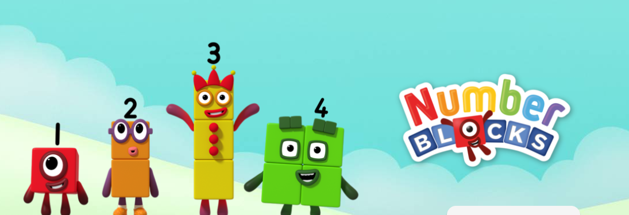
Website links
Reception
Autumn Term
https://www.bbc.co.uk/cbeebies/shows/numberblocks
Notes:
Time: 1 minute
Purpose: To share useful websites
Facilitation: Show parents the number blocks website and adapt this slide to add any other online materials your school uses and/or the school website/maths section of website.

Slide 24

Reception
Autumn Term
Thank you

