Slide 1
Year 3
Autumn Term
Parent Maths Pack
Focus: Place Value
This pack includes:
An overview of Mathematics Mastery
Key vocabulary
Key representations for place value
Big pictures
Place Value games to play at home

Slide 2
Mathematics Mastery
What is ‘Mastery’?
The ‘mastery approach’ to teaching mathematics is the underlying principle of Mathematics Mastery. Instead of learning mathematical procedures by rote, we want your child to build a deep understanding of concepts which will enable them to apply their learning in different situations. To achieve this we aim to develop pupils’ Conceptual Understanding, Mathematical Thinking and Language and Communication.
(See diagram below).
Representing concepts using objects, pictures, words and symbols; making connections
Making conjectures, trying out specific examples, organising, comparing, looking for patterns and generalizing
Conceptual understanding
Explaining, justifying and discussing using accurate mathematical language
Mathematical problem solving
Mathematical thinking
Language & communication
Central to learning mathematics
Success for all
At school we believe all pupils can achieve success in maths. We encourage pupils to have a ‘growth mindset’ – a belief that effort leads to success and that challenges are opportunities to learn.
Here are a few tips to encourage your children at home with maths:
Talk to your children about everyday maths
Play games with them
Value mistakes as learning opportunities
Recognise that there is more than one way to work things out.
Praise children for effort over outcome.
Avoid saying things like “I’m useless at maths”.

Slide 3
Autumn focus: Place Value (three digit numbers)
Year 3 - Autumn Curriculum Map
Number sense and exploring calculation strategies | Place value | Graphs
Read, write, order and compare numbers to 100 Calculate mentally using known facts, round and adjust, near doubles, adding on to find the difference Derive new facts from a known fact | Read, write, represent, partition, order and compare 3-digit numbers Find 10 and 100 more or less Round to the nearest multiple of 10 and 100 | Collect, interpret and present data using charts and tables
Addition and subtraction | Length and perimeter
Develop and use a range of mental calculation strategies Illustrate and explain formal written methods – column method | Measure, draw and compare lengths Add and subtract lengths Calculate perimeter
This term one of our key focuses in Year 3 is place value as pupils begin to explore numbers with three digits. Below are some of the key small steps pupils will be learning about:
Recognising the value of each digit in a 3-digit number
Partitioning numbers in different ways
Ordering and comparing numbers
Identifying 10 more and 10 less
Rounding numbers to the nearest multiple of 10
Rounding numbers to the nearest multiple of 100.
Solving place value problems
Key vocabulary for Year 3 – Place Value
Ones: Tens: Hundreds:
is equal to (=) digit numeral position value rounding greater than less than more fewer increase decrease multiple of ten multiple of one hundred nearest multiple of ten/one hundred
Partition - to split a number into two or more parts. E.g. we can partition 16 into 10 and 6.
Regroup – to exchange one ten for ten ones or unitise ten ones for one ten. “ I have regrouped my ten ones for one ten”.
Representing 3-digit numbers
In Year 3, pupils use Dienes blocks to represent numbers with up to three digits. This supports pupils with their understanding of the value of each digit and the relative difference in size between hundreds in comparison to tens and ones. These can then be manipulated to investigate and reason about different ways to partition a number. E.g. “How many ways can you make 245?” Once pupils are familiar with using the concrete materials, they can move on to drawing diagrams to represent the blocks. Try using diagrams at home to represent different 3-digit numbers.
245
Hundreds
Tens
Ones

Slide 4
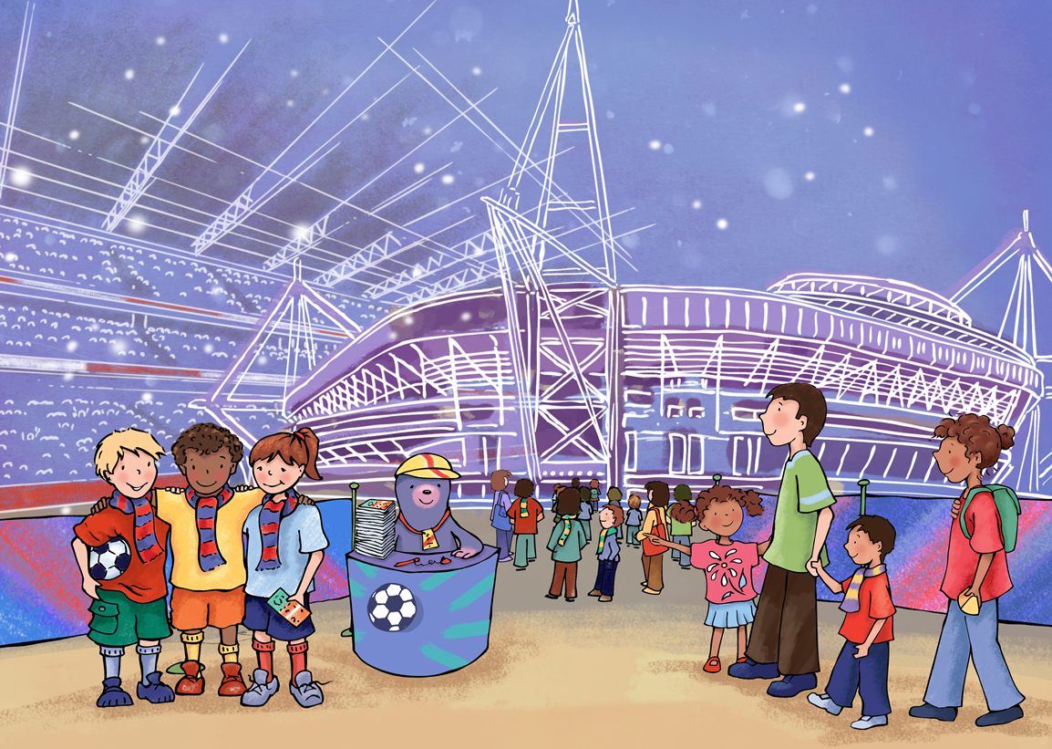
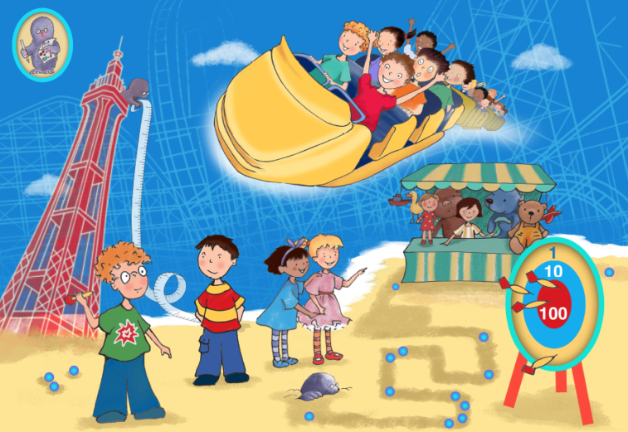
Big Pictures
What maths can you see? Discuss with your children at home using the key vocabulary from the previous page.

Slide 5
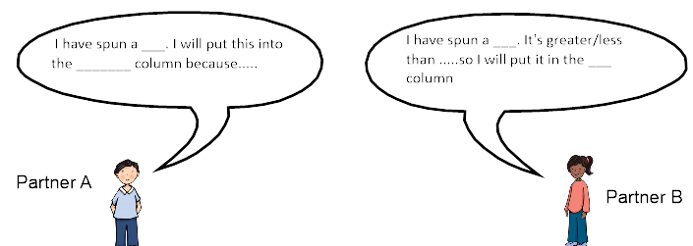
Try this at home – workshop games
Place Value battle
You will need: 0-9 spinner
Player 1 spins the spinner and chooses which column to place the digit. (hundreds, tens or ones)
Player 2 then takes a turn.
When all three columns are filled, the highest number wins.
hundreds tens ones value column
10
20
30
40
50
60
70
Rounding battle
You will need: a pair of dice (or roll one die twice)
A list of multiples of ten ranging from 10 – 70.
Roll the pair of dice, decide which order you would like to place the digits to make a two digit number. For example if you rolled a two and a five, you could make 25 or 52.
Round the number to the nearest multiple of ten and cross that multiple of ten off your list.
The first to cross out all multiples of ten is the winner.
Round multiple digit value nearest multiple of ten

Slide 6
Try this at home – more ideas
Daily practice
Talking about number with your children every day will support them with their understanding of place value. Use questions such as “Which number has the greatest value, how do you know?”, “How can we round that number?”, “What is the approximate answer?”, “How many tens make…?”
Outside of number daily practice of telling the time and times tables is also valuable practice for the Year 3 curriculum.
Number of the day
Select a three digit number as your number of the day. Each day ask questions such as:
What would that number look like? Can you think of something that long, that price, that amount etc?
What is the value of each digit?
What is the nearest multiple of ten or 100?
What is 10 more or 10 less? What is 100 more/less?
Money, money, money
Money is a great way of practising place value. You can start with using just 1p and 10p coins. Grouping pennies into piles of ten and regrouping for a ten pence piece. Asking questions such as “can you change these pennies into 10ps for me?” This can be extended to larger amounts and eventually using pounds, pence and notes.
To practice ordering numbers, compare two amounts of money.
“Who has more? How do you know? Convince me!”
Questions to support thinking
What do you think would happen if….
What’s the same? What’s different?
How do you know that?
Can you see a pattern? What would come next?
What else could go in this set? What couldn’t?
Websites
The Oxford Owl website has some extra helpful tips and videos for helping your child at home with place value.
https://www.oxfordowl.co.uk/for-home/advice-for-parents/learning-at-home-videos/parent-how-to-videos/how-to-help-with-place-value-videos/
Online dice:
To play the dice game included in the pack you might want to use online dice.
https://www.random.org/dice/?num=2

