Slide 1


Year 2
Autumn Term
Parent Maths Pack
Focus: Addition and Subtraction
This pack includes:
An overview of Mathematics Mastery
Key vocabulary
Key representations for addition and subtraction
Big Pictures
Addition and subtraction games to play at home

Slide 2
Mathematics Mastery
What is ‘Mastery’?
The ‘mastery approach’ to teaching mathematics is the underlying principle of Mathematics Mastery. Instead of learning mathematical procedures by rote, we want your child to build a deep understanding of concepts which will enable them to apply their learning in different situations. To achieve this we aim to develop pupils’ Conceptual Understanding, Mathematical Thinking and Language and Communication. (See diagram below)
Representing concepts using objects, pictures, words and symbols; making connections
Making conjectures, trying out specific examples, organising, comparing, looking for patterns and generalising
Conceptual understanding
Explaining, justifying and discussing using accurate mathematical language
Mathematical problem solving
Mathematical thinking
Language & communication
Central to learning mathematics
Success for all
At school we believe all pupils can achieve success in maths. We encourage pupils to have a ‘growth mindset’ – a belief that effort leads to success and that challenges are opportunities to learn.
Here are a few tips to encourage your children at home with maths:
Talk to your children about everyday maths
Play games with them
Value mistakes as learning opportunities
Recognise that there is more than one way to work things out.
Praise children for effort over outcome.
Avoid saying things like “I’m useless at maths”.

Slide 3


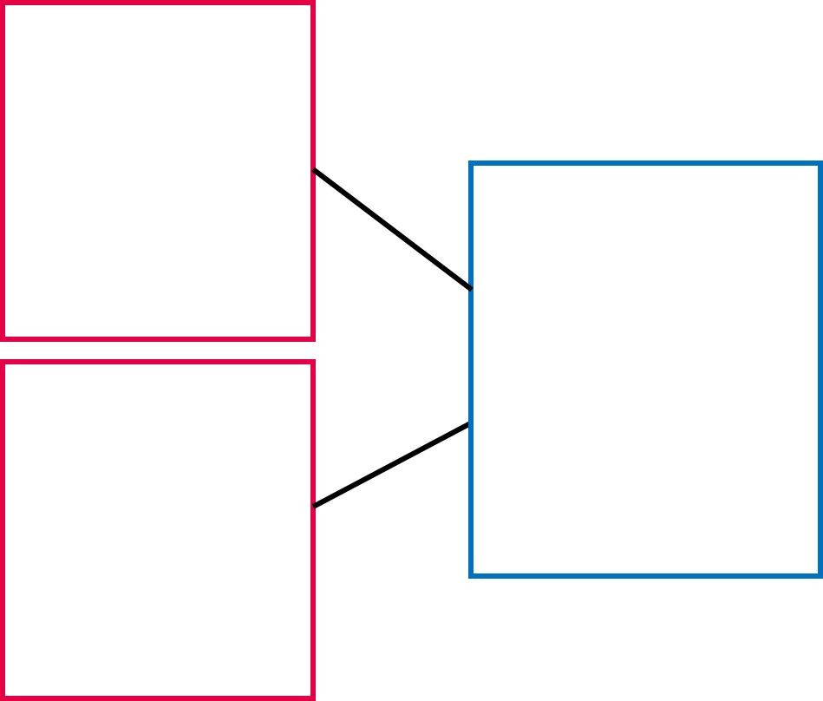



Autumn focus: Addition and Subtraction
Year 2 - Autumn Curriculum Map
Numbers within 100 | Addition and subtraction of 2-digit numbers | Addition/ Subtraction problems
Read, write, represent, partition, compare and order numbers to 100 Explore patterns including, odds and evens, tens and ones | Apply number bonds to ass and subtract Represent and explain addition and subtraction of two 2-digit numbers Add three 1-digit numbers | Introduction to bar models as a representation Crate, label and sketch bar models.
Measures: Length | Graphs | Multiplication and division: 2,5,10
Draw and measure lengths in centimetres Use <,> and = to compare and order lengths in m and cm | Represent and interpret: pictograms, block diagrams, tables and tally charts. | Calculate the times tables of 2,5, and 10 by skip counting Relate the 2 times table to doubling Explore representations Commutativity
This term one of our key focuses in Year 2 is addition and subtraction within 100. Below are some of the key small steps pupils will be learning about:
Using number bonds in addition and subtraction
Adding and subtracting ones with a two-digit number
Adding and subtracting multiples of ten
Adding and subtracting tens with a two digit numbers
Adding and subtracting two 2-digit number
Adding three 1 digit numbers
Representing information in a bar model
Representing addition and subtraction word problems as a bar model.
Key vocabulary for Year 2 - addition and subtraction
Part Whole Ones: Tens:
Add/Addition Subtract/Subtraction Is equal to (=)
If I know…then I know What is known? What is unknown?
Equation: a mathematical statement where two values are equal indicated by the = sign. E.g. 12 + 4 = 16 is an equation.
Number bonds: pairs of numbers that add together to make a different number. E.g. one number bond to 8 is 3 and 5.
Partition: to split a number into two or more parts e.g. we can partition 16 into 10 and 6.
Introducing the bar model
In Year 2 pupils continue to use the part-whole model and begin to use the bar model to interpret problems. This supports pupils in understanding the mathematical structure of the problems they are solving. The language of parts and whole continue to be used.
“The parts are 16 and 11, the whole is 24.”
16
27
16 | 11
27
11
$$16$$
11
$$24$$

Slide 4
Big Pictures
What maths can you see? Discuss with your children at home using the key vocabulary from the previous page.

Slide 5


Try this at home – workshop games
Make 100
For this game, you need dice, a pencil and paper.
Each player draws an addition grid like this:
$$+$$
$$=$$
Take it in turns to roll the dice. After you have rolled the dice, you decide which box to place that number in. Once all four numbers have been placed, add your two 2-digit numbers to get your total. Closest to 100 wins.
Adapting: You can change the target total, or try using subtraction.
ones tens add subtract is equal to If I know…then I know…
Zero the hero
4 | 0 | 3 | 1
6 | 3 | 2 | 2
7 | 1 | 7 | 5
6 | 4 | 5 | 8
For this game you need the number grid, (or make your own filled with numbers under 10) two cubes/counters, a plastic cup and pencil and paper.
Write 50 down as your starting score. Put two cubes into the plastic cup and roll them onto the grid. Add the two numbers together then subtract from 50.
Take it in turns to do this. The first to reach zero is the winner.
ones tens add subtract is equal to If I know…then I know…

Slide 6
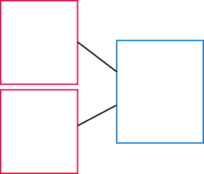
Try this at home – more ideas
Daily practice: number bonds
Challenge your children with missing number problems verbally.
Example
“The whole is 9. One part is 3. What is the missing part?”
Or “I think of a number, I subtract 3 and I am left with 6, what was my number?”
3
3
19
?
?
16
Dice games
Playing with dice can be a great way to support your children with number bonds. If you don’t have a pair of dice, try these online dice:
https://www.random.org/dice/?num=2
Fact of the day/week
Have a ‘fact of the day’, e.g. 15 = 7 + 8. Pin this fact up around the house. Practise reading it in a quiet, loud, or squeaky voice. Ask your child over the day if they can recall the fact.
Board games, sports and leisure
Board games and sports provide lots of opportunities to develop mathematical skills such as problem solving and strategy. Additionally lots of board games and sports also allow opportunities for addition and subtraction when totalling scores or finding the difference. When playing, ask questions such as:
“How may points do Amy and Mina have altogether?”
“What’s the difference between my score and yours?“
“How much more does Charlie have compared to Ahmed?”
“How many more do I need to win?”
Money, money, money
Allow children to have experience handling money. Some experiences could include:
Counting amounts
Regrouping – e.g. exchange ten 10 ps for 1 pound
Finding a change
Discussing prices in the supermarket and involving your children when paying
Saving up pocket money for something. “How much more do you need?”
Questions to support thinking
What do you think would happen if….
What’s the same? What’s different?
How do you know that?
Can you see a pattern? What would come next?
What else could go in this set? What couldn’t?

