Slide 1
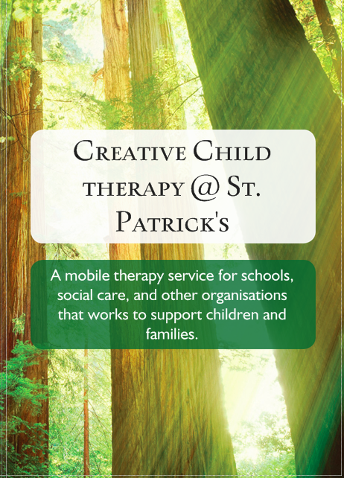
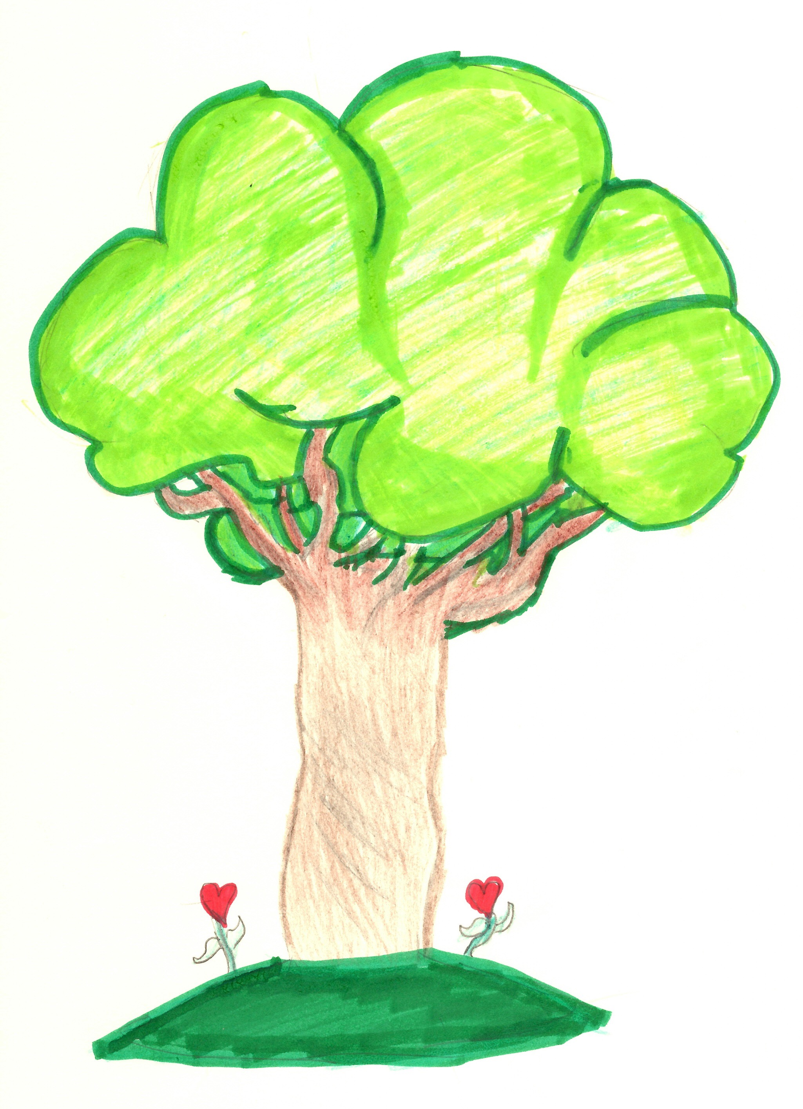

Slide 2
Creative Child Therapy
Creative Child Therapy is the therapy service at
St. Patrick’s Primary School.
It is available to the children and families at the school,
and as an outreach service to other schools and organisations.
We provide:
Direct therapeutic work
Training
Professional supervision
Individual support and guidance to other adults living or working with children and young people in distress
Therapeutic support provides children with the help to explore, express and make sense of difficult or painful experiences or feelings.
It enables children to deal with feelings and to find ways to achieve emotional well-being so they can manage and enjoy everyday life.

Slide 3
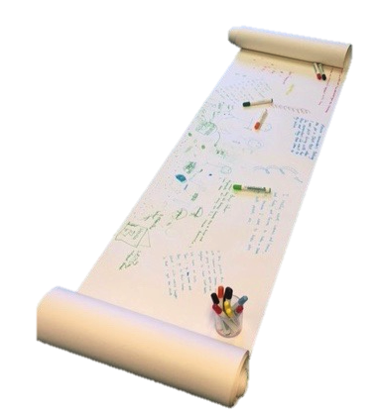
Life Story Therapy /
Therapeutic Life Story Work
Life Story Therapy is a creative, dynamic therapy in which the child explores their history and experiences in order to help them make sense of their story, manage their feelings and relationships, and develop a sense of self.
It covers themes including family changes, loss, separation, relationships, trauma, emotional difficulties, and identity.
Life Story Therapy is a more in-depth approach than traditional life story work that gives the child their history whilst life story therapy engages them in a therapeutic process to;
make sense of their history,
understand how it impacts on them and how
they deal with things in the present,
support them to achieve emotional
well-being and make positive choices
in the future,
build relationships
By helping the child to make links between their experiences and their thoughts, feelings and actions, they can be supported to gain some control over challenging emotions and resulting behaviours.
Life story therapy involves 3 stages: research about the child’s history, direct therapy sessions with the child and key adults, and the life story book comprising the work undertaken in the therapy sessions.

Slide 4
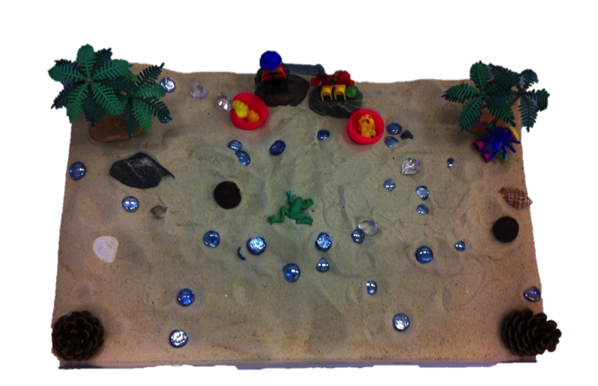
Play Therapy
Play Therapy is a therapeutic process which uses play to enable children to process their feelings and make more sense of them. This in turn can help them to manage their emotions and actions.
Children naturally use play as a communication therefore it provides a non-threatening environment in which to express themselves. As it can be non-verbal, play therapy can be a useful approach for children who are unable to express themselves with words.
Play therapy is not ordinary play, the relationship between the child and the therapist enables the therapist to help the child make links between the internal world or thoughts and feelings and the external worlds of actions and experiences.
The aim of play therapy is to help the child to deal with difficult feelings and achieve emotional well-being.
Play therapy usually takes place one to one with the child and review meetings are held with the family.
Therapeutic play techniques can
also sometimes be used when
working with families together.

Slide 5
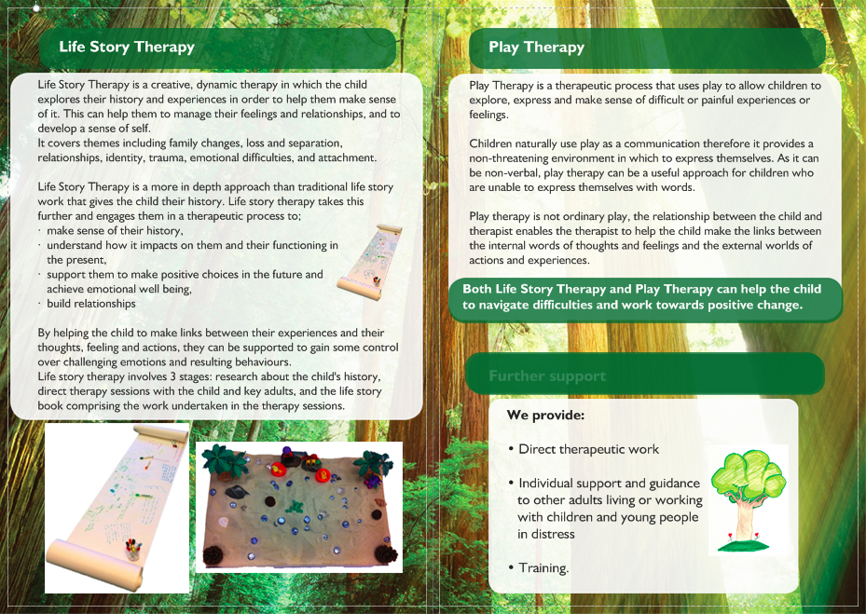
Contact us:
Referrals:
Referrals are welcome from schools, social care, other organisations and self referrals from families.
This service is free for children attending St. Patrick’s Primary School.
For all other children this service does involve a fee.
To make a referral, or for any further information, please contact us at St. Patrick’s, details below:
Contact:
Creative Child Therapy @ St. Patrick’s
St. Patrick’s Catholic Primary School
Upper Hill Street
Liverpool
L8 5UX
Tel. 0151 709 1062
Email: pprice@stpatricksliverpool.co.uk

